Slide 1



IODA: A Host/Device Co-Design for Strong Predictability Contract on Modern Flash Storage
Huaicheng Li☆✶, Martin L. Putra☆, Ronald Shi☆,
Xing Lin✽, Gregory R. Ganger✶, Haryadi S. Gunawi ☆
The 28th ACM Symposium on Operating Systems Principles (SOSP’21)
☆University of Chicago, ✶Carnegie Mellon University, ✽NetApp

Slide 2

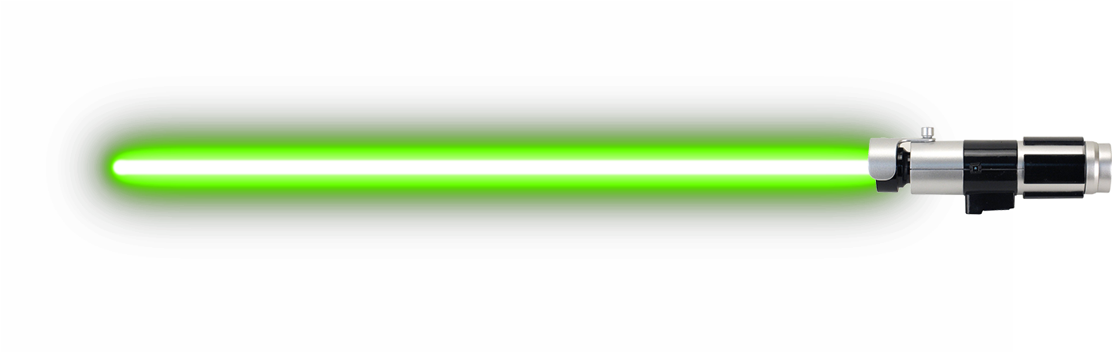
IODA: A Host/Device Co-Design for Strong Predictability Contract on Modern Flash Storage
“Small but powerful”
IODA close to ideal!

Slide 3

“Attack of GC” ⎼ Unpredictability in SSDs
Host
SSD
Controller
NAND Flash
☺
100us
Flash Firmware
Garbage
Collection (GC)
10ms
100x slower
due to GC
GC is Invisible to the Host

Slide 4
“The Tail Menace” in Flash Arrays
Host
Better
R
Percentage
100us
RAID
☺
R₁
R₃
R₀
SSD0
SSD1
SSD2
SSD3

Slide 5

“The Tail Menace” in Flash Arrays
Better
Worse
R
Percentage
Long Tails
100us
10ms
RAID
☺
R₁
R₃
R₀
A slow SSD makes the entire flash array slow!
SSD0
SSD1
SSD2
SSD3
GC
GC

Slide 6


“A New Hope” ⎼ NVMe Predictable Latency Mode
NVMe Predictable Latency Mode (PLM)
TW
Are you busy?
Go busy!
A major leap
…
Predictable/Busy Time Window (TW)
Predictable
Busy
Predictable
Busy
Device status query & toggling
Time
How to leverage NVMe PLM
and enhance it
for predictable latencies?
But insufficient
Coarse-grained device-level predictability
“Soft-contract” breaking predictability
Requiring complex status tracking
…

Slide 7
The IODA Story
Goal: Tail-free flash array system on top of slightly-extended PLM interface
Design Principles:
NVMe PLM
Simple policies for efficiency
Minimal changes for easy deployment
Coarse-grained
IODA Approach/Techniques:
“Soft-contract”
+ Per-I/O latency predictability
Complex
+ Busy Remaining Time (BRT) Exposure
+ Time Window (TW) Formulation
+ An end-to-end design exploiting above extensions

Slide 8
Background & Motivation
IODA Overview
IODA Design
  Predictable latency flagged I/Os
  Busy remaining time
  Time window formulation
  Relaxed TW for better write amplification
Evaluation
Summary

Slide 9
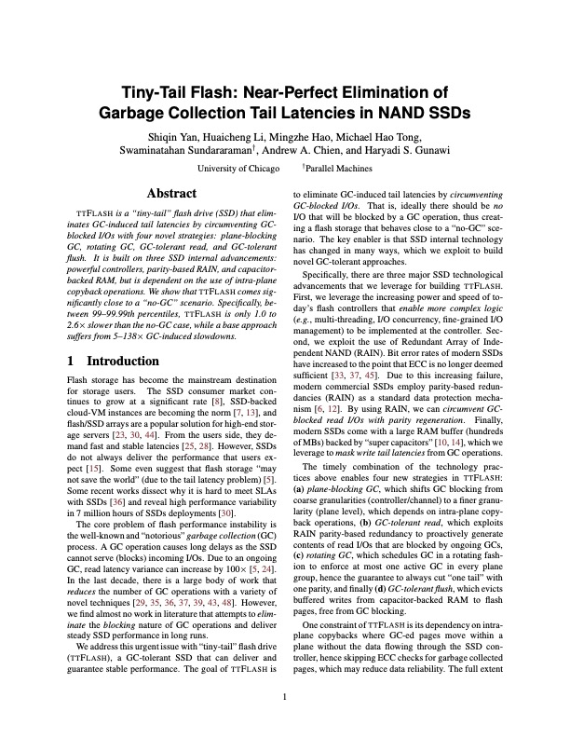
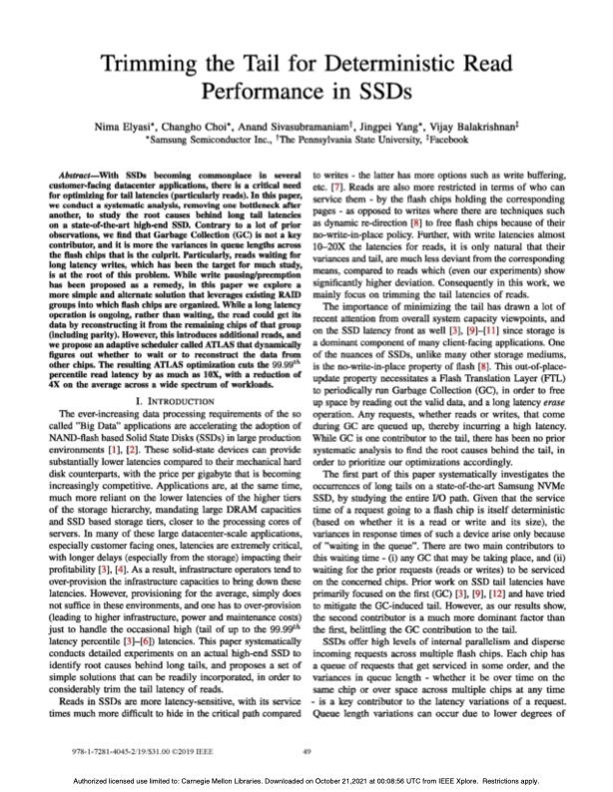
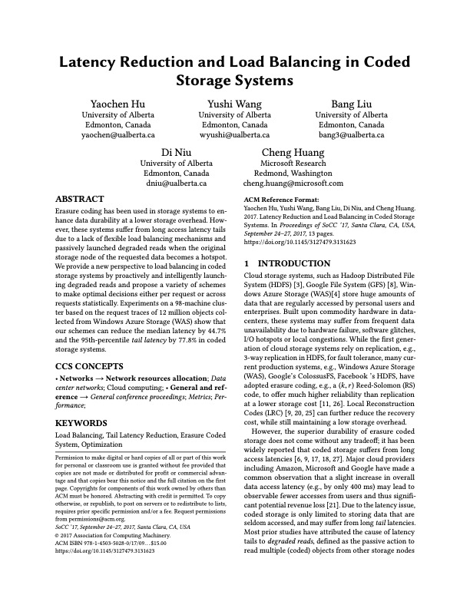
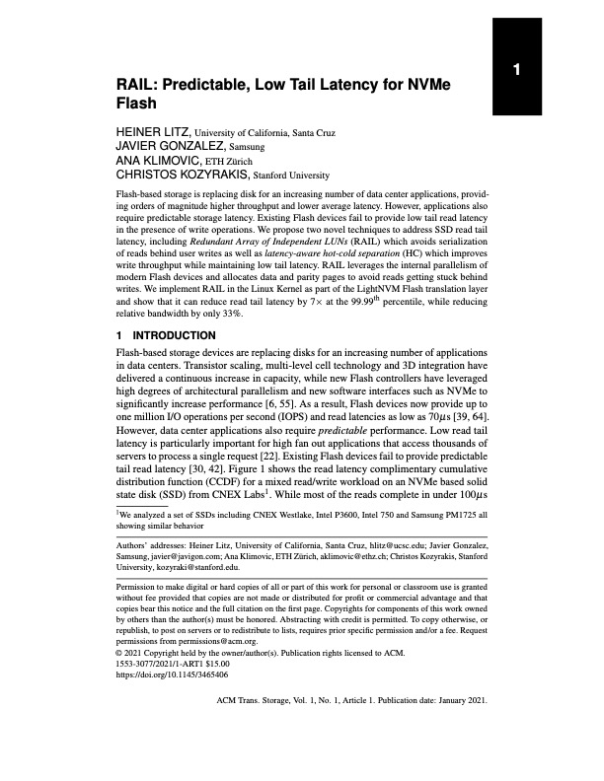
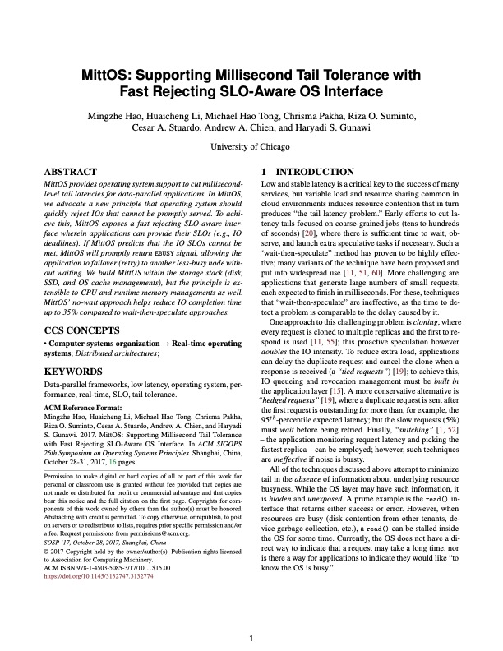
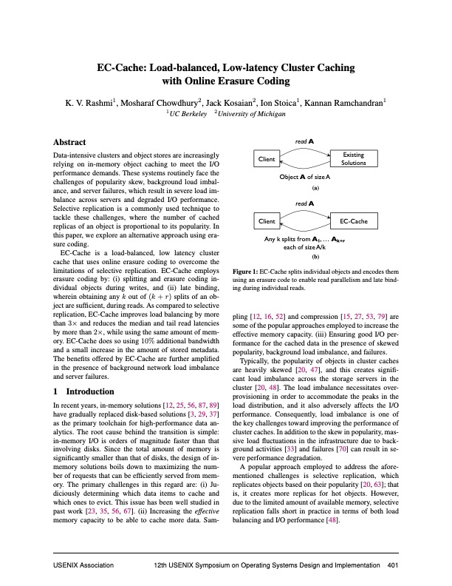
Leverage Redundancy for Performance
An old, effective idea;
Yet, challenging for PLM
When to issue the parity reads?
(1) Wait for timeout
Best threshold? Tricky
(2) Always Proactive (always send full-stripe)
Increased load Inefficient
Semantic gap between the Host and SSD to communicate the “busyness”

Slide 10
IOD₁: Predictable Latency Flagged I/Os
“Fail-if-Slow”: the SSD should fast-fail an I/O if it contends with GC
Host
Lightweight
flag=true
Fast-Fail
Deterministic
SSD
SSD #2
“Seems your submission
targets a crowded area,
early-rejection!”
early-rejection !

Slide 11



Host
~100us
R
RAID5
xor()
R₀
R₁
R₂
R₂
R₁
R
R
R₃
R₀
fast-fail
100us
SSD0
SSD1
SSD2
SSD3
GC
~10ms

Slide 12
The Effectiveness of “Fail-if-Slow” Interface
NoGC
@p99 ~5x
(n, k):
IOD₁ couldn’t handle
>k busy sub-IOs
@p95 ~7x
Cut tails up to ~99th percentile

Slide 13
A Case Against Proactive Reconstruction
Host
Semantic Gap: the host doesn’t know how long SSD “busyness” will last
R
RAID5
✘
xor()
R₀
R₁
R₂
R₁
R
R₃
R₀
fast-fail
End up waiting for the busiest SSD
SSD0
SSD1
SSD2
SSD3
GC
GC

Slide 14
Busy Remaining Time (BRT) Exposure
“Fail-if-Slow”: the SSD should fast-fail an I/O if it contends with GC
Piggybacking BRT to reconstruct data from less busy SSDs
Host
flag=true
Fast-Fail
“BRT: 60ms”
SSD

Slide 15

The Effectiveness of “BRT” Interface
BRT helps a little
Can we do better?

Slide 16
IODA Busy Latency Windows
“Fail-if-Slow”: the SSD should fast-fail an I/O if it contends with GC
TW Coordination: SSDs take turns to perform GCs
☺
IODA: Always Predictable Latencies!
How long should TW be?

Slide 17
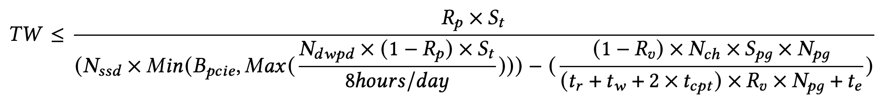
IODA Time Window (TW) Formulation
B_{burst} : User load
SSD free space >= User load
Busy
SSD
t0
t1
t2
t3
B_{gc} : GC reclamation speed
S_{p}
: Over-provisioning space
TW Upper Bound

Slide 18
No Tails!
IODA closes the gap between Base and NoGC

Slide 19
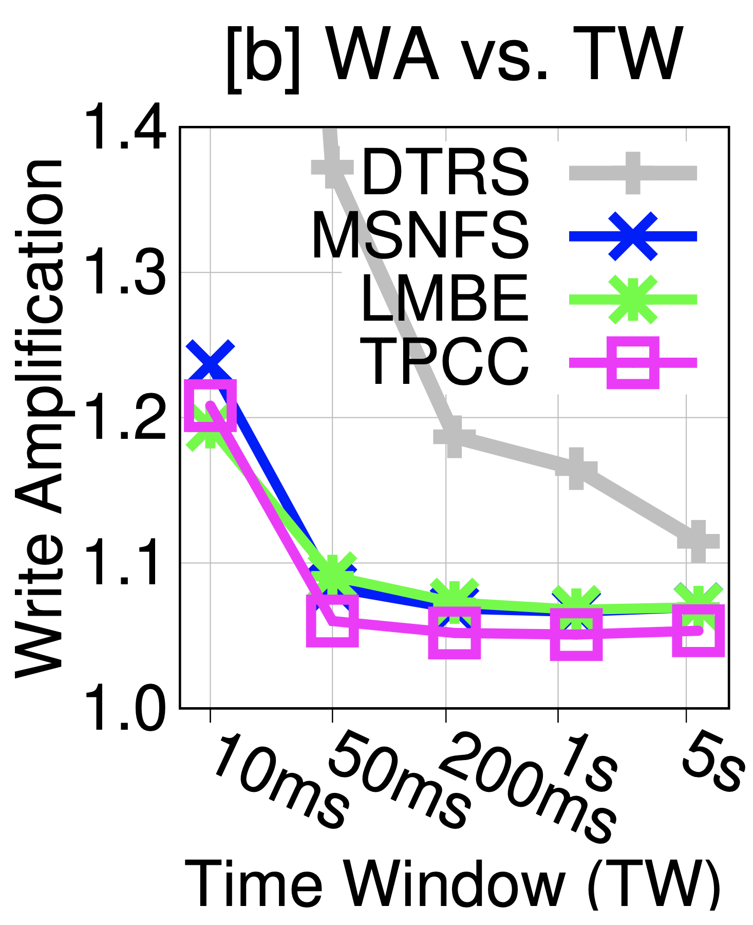
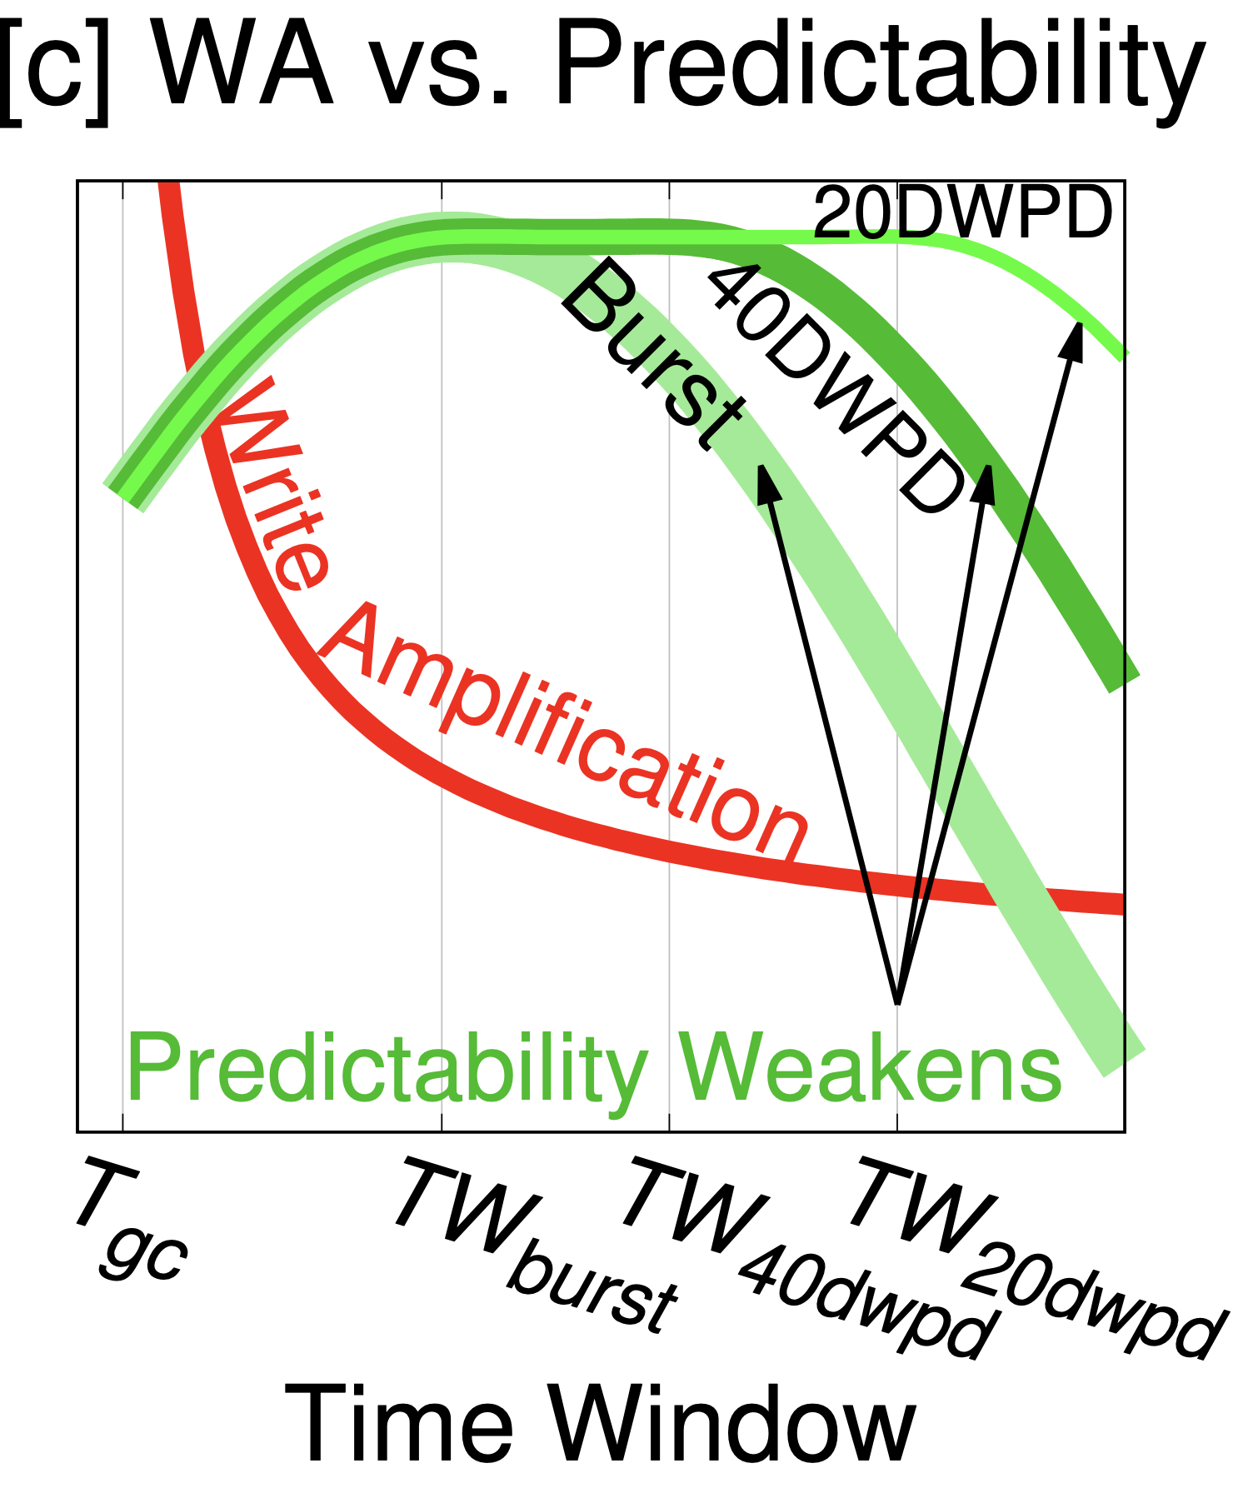
TW vs. Write Amplification (WA)
Relaxed TW for better WA, but at weaker predictability guarantee

Slide 20
Time Window vs. Write Amplification Tradeoffs
Relaxed TW for better WA, but at weaker predictability guarantee

Slide 21
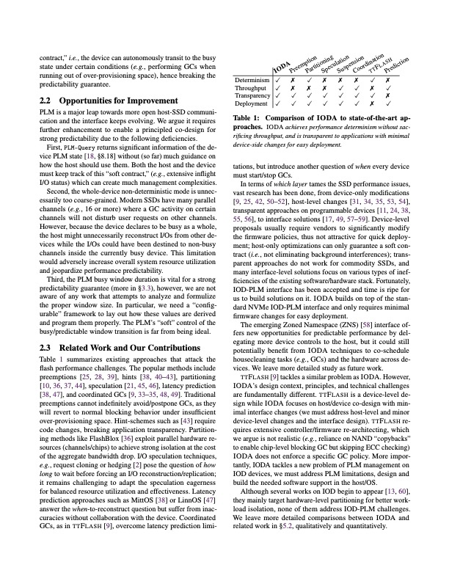
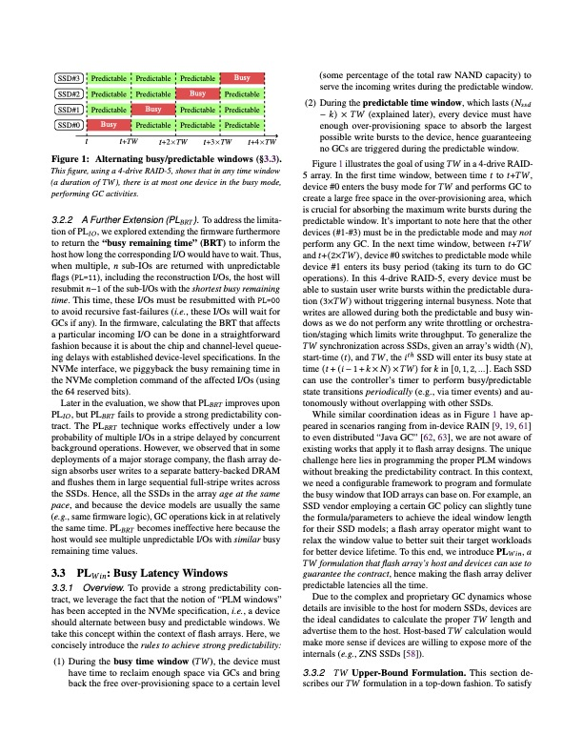
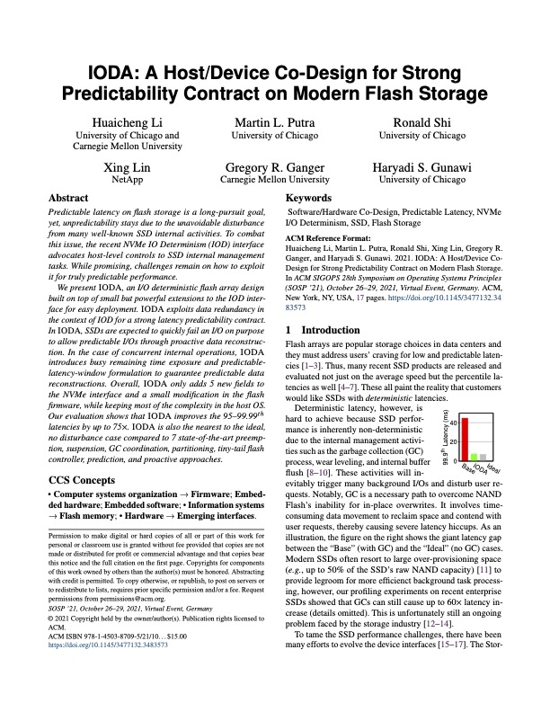
More in the paper!
IODA TW analysis
  6 SSD models
  Relaxed TW
  TW vs. WAF tradeoffs
Implementation
  Platforms: FEMU + OpenChannel-SSD
  Kernel: Linux Software-RAID + NVMe
More evaluation results
  9 datacenter block traces + 21 real applications
  IODA vs. 7 State-of-the-art approaches
  IODA on OpenChannel-SSD
  IODA throughput and write latency
  …

Slide 22
IODA Stack and Evaluation Setup
9 datacenter
I/O traces
6 FileBench
Workloads
15 Data Intensive Applications
User
Storage Workloads
Metric: Read tail latencies
Software-RAID
Kernel
vs. State-of-the-art
NVMe Driver
Preemption
Coordination
SQ
CQ
Speculation
Suspension
Partitioning
SLO-aware
Tiny-Tail
SSDs
OpenChannel-SSD
FEMU

Slide 23
IODA Evaluation
Predictable Latency Flag + Reconstruction
Predictable Latency Flag
+ Busy Remaining Time
Base
Predictable Latency Flag
+ Time Window
IODA is close to Ideal!

Slide 24
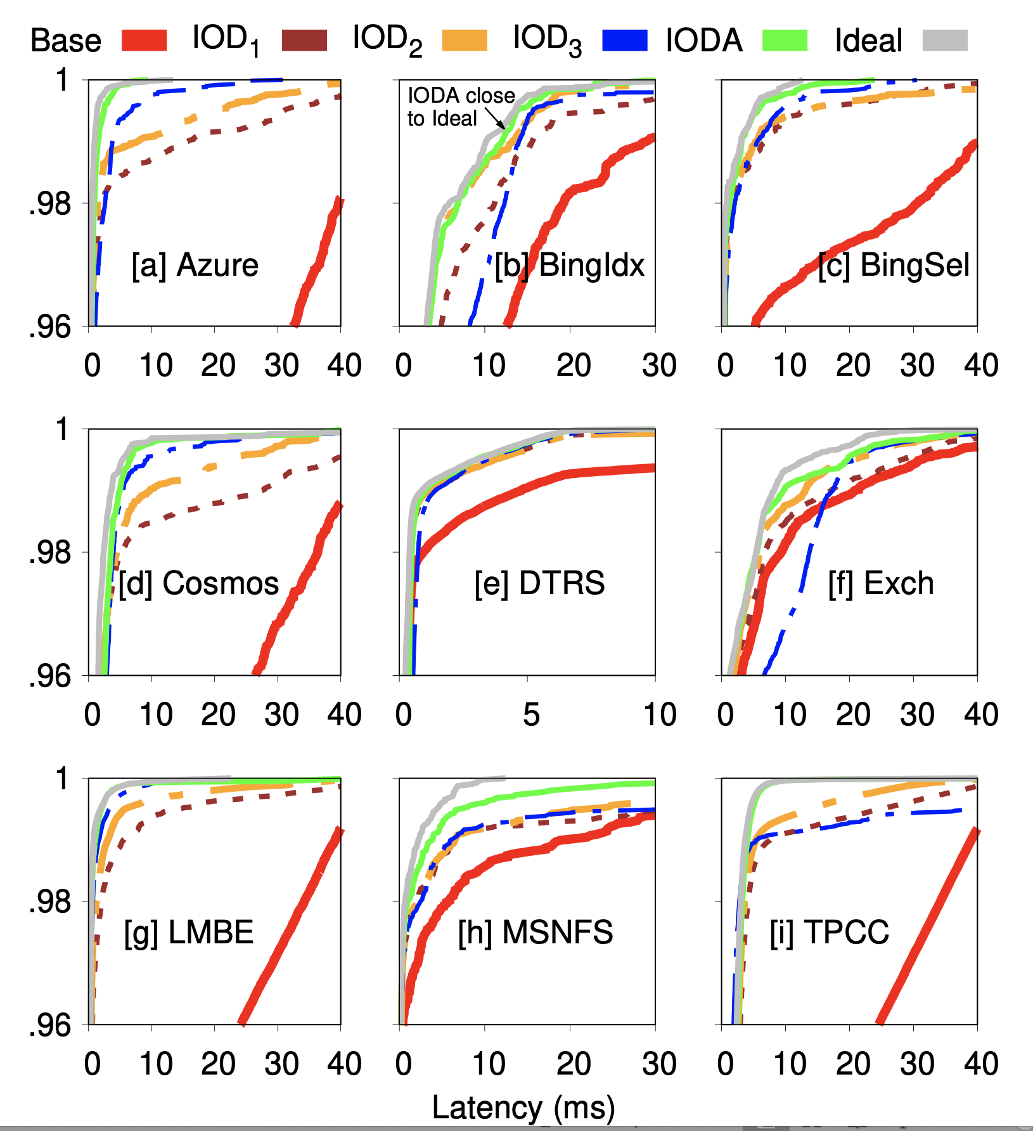
IODA Results: (95th – 99.99th)
Up to 75x improvement over Base
vs.
IODA is more deterministic and efficient in cutting tail latencies!
Preemption
Coordination
Speculation
Suspension
Partitioning
SLO-aware
Tiny-Tail

Slide 25
IODA Throughput
(K IOPS)
Read
Write
Read Only
RW 80/20
Write Only
IODA doesn’t sacrifice the array’s aggregate bandwidth

Slide 26

IODA Takeaways
A Co-Design Approach for Performance Predictability
  Proactive reconstruction via fast-fail interface
  BRT for improved latencies
  TW formulation to program the window length
  Cross-device synchronization
Thank you!
IODA: https://github.com/huaicheng/IODA
Host
SSD
SSD
SSD

