Slide 1
Towards Continually Learning
Application Performance Models
Ray A. O. Sinurat, Anurag Daram, Haryadi S. Gunawi, Robert B. Ross and Sandeep Madireddy
Notes:
(25 seconds)
Hi everyone, I am Ray Sinurat,
In this talk I will give proof of concept that distribution drift in performance data is real.
Thus will lead to bad performance modeling.
And how do we mitigate this problem.
This is a joint work with my advisor Sandeep Madireddy from Argonne, Haryadi S. Gunawi from the University of Chicago,
Anurag Daram from UT San Antonio and Robert B. Ross from Argonne

Slide 2

System performance changes overtime!
What do you mean?
Give me examples!
Hardware degradation
(Black-Box problem diagnosis in parallel file systems, FAST’20)
Hardware replacement and anomalies
(Fail-Slow at scale: Evidence of hardware performance faults in large productions systems, FAST’18)
Software upgrades
(A year in the life of a parallel file system, SC’18)

Slide 3
System performance changes overtime!
What do you mean?
Give me examples!
Hardware degradation
(Black-Box problem diagnosis in parallel file systems, FAST’20)
Hardware replacement and anomalies
(Fail-Slow at scale: Evidence of hardware performance faults in large productions systems, FAST’18)
Software upgrades
(A year in the life of a parallel file system, SC’18)
Examples of Concept Drifts!

Slide 4
Then? why?
Good questions!
Why does it even matter?
This leads to awful performance modeling because of forgetting of prior knowledge!
This modeling is crucial for:
Notes:
Catastrophic forgetting: forgetting of prior knowledge

Slide 5
Then? why?
Good questions!
Why does it even matter?
This leads to awful performance modeling because of forgetting of prior knowledge!
This modeling is crucial for:
Making decisions about
job scheduling
Application optimization
Capacity planning of facilities
Machine Learning and Understanding for Intelligent Extreme Scale Scientific Computing and Discovery (DOE ASCR Workshop Report ‘15)

Slide 6
Oh no!
Continual learning to the rescue!
Then, how do we tackle this?

Slide 7
Oh no!
Continual learning to the rescue!
Then, how do we tackle this?
Improving model overtime while alleviating catastrophic forgetting
of prior knowledge or experiences caused by concept drifts.
Notes:
Improve model overtime -> combined with Online Learning
Main point: Alleviate catastrophic forgetting

Slide 8
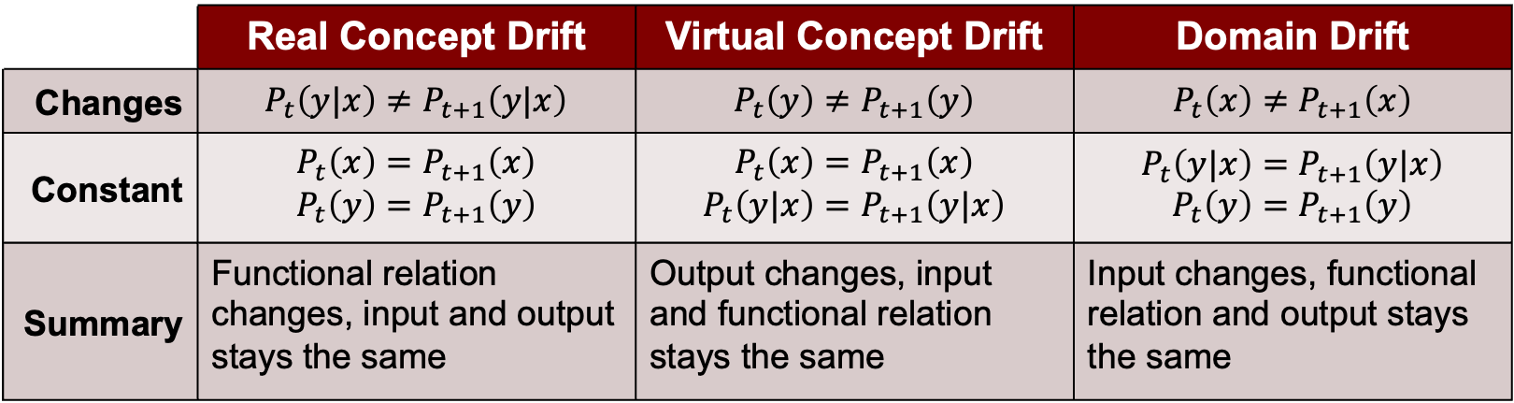
CONCEPT DRIFTS
 | Real Concept Drift | Virtual Concept Drift | Domain Drift
Changes | $$P_{t}\left(y|x\right)≠P_{t+1}\left(y|x\right)$$ | $$P_{t}\left(y\right)≠P_{t+1}\left(y\right)$$ | $$P_{t}\left(x\right)≠P_{t+1}\left(x\right)$$
Constant | $$P_{t}\left(x\right)=P_{t+1}\left(x\right)$$ $$P_{t}\left(y\right)=P_{t+1}\left(y\right)$$ | $$P_{t}\left(x\right)=P_{t+1}\left(x\right)$$ $$P_{t}\left(y|x\right)=P_{t+1}\left(y|x\right)$$ | $$P_{t}\left(y|x\right)=P_{t+1}\left(y|x\right)$$ $$P_{t}\left(y\right)=P_{t+1}\left(y\right)$$
Summary | Functional relation changes, input and output stays the same | Output changes, input and functional relation stays the same | Input changes, functional relation and output stays the same
Understanding Continual Learning Settings with Data Distribution Drift Analysis

Slide 9
CONCEPT DRIFTS
 | Real Concept Drift | Virtual Concept Drift | Domain Drift
Changes | $$P_{t}\left(y|x\right)≠P_{t+1}\left(y|x\right)$$ | $$P_{t}\left(y\right)≠P_{t+1}\left(y\right)$$ | $$P_{t}\left(x\right)≠P_{t+1}\left(x\right)$$
Constant | $$P_{t}\left(x\right)=P_{t+1}\left(x\right)$$ $$P_{t}\left(y\right)=P_{t+1}\left(y\right)$$ | $$P_{t}\left(x\right)=P_{t+1}\left(x\right)$$ $$P_{t}\left(y|x\right)=P_{t+1}\left(y|x\right)$$ | $$P_{t}\left(y|x\right)=P_{t+1}\left(y|x\right)$$ $$P_{t}\left(y\right)=P_{t+1}\left(y\right)$$
Summary | Functional relation changes, input and output stays the same | Output changes, input and functional relation stays the same | Input changes, functional relation and output stays the same
Hi, I am the problem in this paper!
Understanding Continual Learning Settings with Data Distribution Drift Analysis

Slide 10
PROBLEMS

Slide 11
PROBLEMS
SOFTWARE UPGRADES

Slide 12
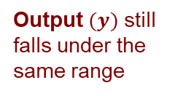
PROBLEMS
SOFTWARE UPGRADES
Output $(y)$ still falls under the same range

Slide 13
PROBLEMS
I/O features $(x)$ (not showed) also does not change in terms of distribution
SOFTWARE UPGRADES
Output $(y)$ still falls under the same range

Slide 14
PROBLEMS
I/O features $(x)$ (not showed) also does not change in terms of distribution
SOFTWARE UPGRADES
REAL CONCEPT DRIFT!
Output $(y)$ still falls under the same range

Slide 15
PROBLEMS
I/O features $(x)$ (not showed) also does not change in terms of distribution
SOFTWARE UPGRADES
REAL CONCEPT DRIFT!
Output $(y)$ still falls under the same range
“For every software upgrade,
there will be changes to the application performance”
Notes:
We can state that:
For every software upgrade there will be changes to the app performance

Slide 16
PROBLEMS
Real concept drift is much harder and less studied
in context of Continual Learning!
Notes:
There are not many works that study real concept drift at least for now.

Slide 17

PROBLEMS
Real concept drift is much harder and less studied
in context of Continual Learning!
RECALL
Virtual concept drift
$$P_{t}\left(y\right)≠P_{t+1}\left(y\right)$$
Notes:
There are not many works that study real concept drift at least for now.

Slide 18
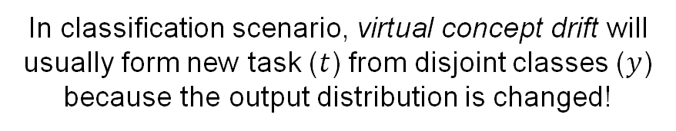
PROBLEMS
Real concept drift is much harder and less studied
in context of Continual Learning!
RECALL
Virtual concept drift
$$P_{t}\left(y\right)≠P_{t+1}\left(y\right)$$
In classification scenario, virtual concept drift will usually form new task ($t$) from disjoint classes ($y$)
because the output distribution is changed!
Notes:
There are not many works that study real concept drift at least for now.

Slide 19
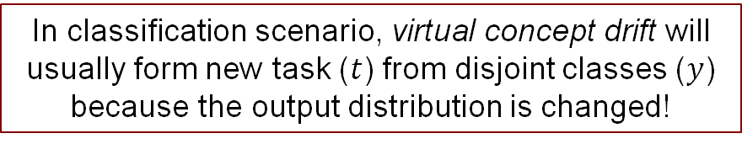
PROBLEMS
Real concept drift is much harder and less studied
in context of Continual Learning!
RECALL
Virtual concept drift
$$P_{t}\left(y\right)≠P_{t+1}\left(y\right)$$
CLASS INCREMENTAL SETTINGS
In classification scenario, virtual concept drift will usually form new task ($t$) from disjoint classes ($y$)
because the output distribution is changed!
Notes:
There are not many works that study real concept drift at least for now.
That's why in our paper, we will try to approach the solution to our problems in class incremental settings

Slide 20
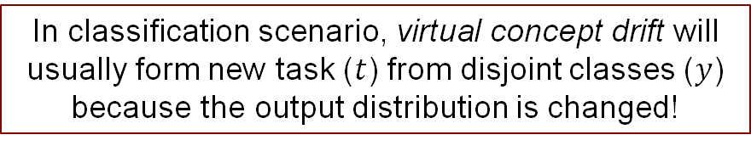
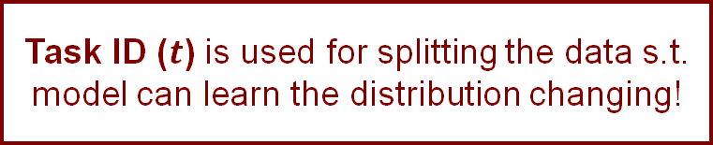
PROBLEMS
Real concept drift is much harder and less studied
in context of Continual Learning!
RECALL
Virtual concept drift
$$P_{t}\left(y\right)≠P_{t+1}\left(y\right)$$
CLASS INCREMENTAL (CI) SETTINGS
Task ID ($t$) is used for splitting the data s.t.
model can learn the distribution changing!
In classification scenario, virtual concept drift will usually form new task ($t$) from disjoint classes ($y$)
because the output distribution is changed!
Notes:
Task ID ($t$) gives you new additional information regarding the concept drifts.

Slide 21
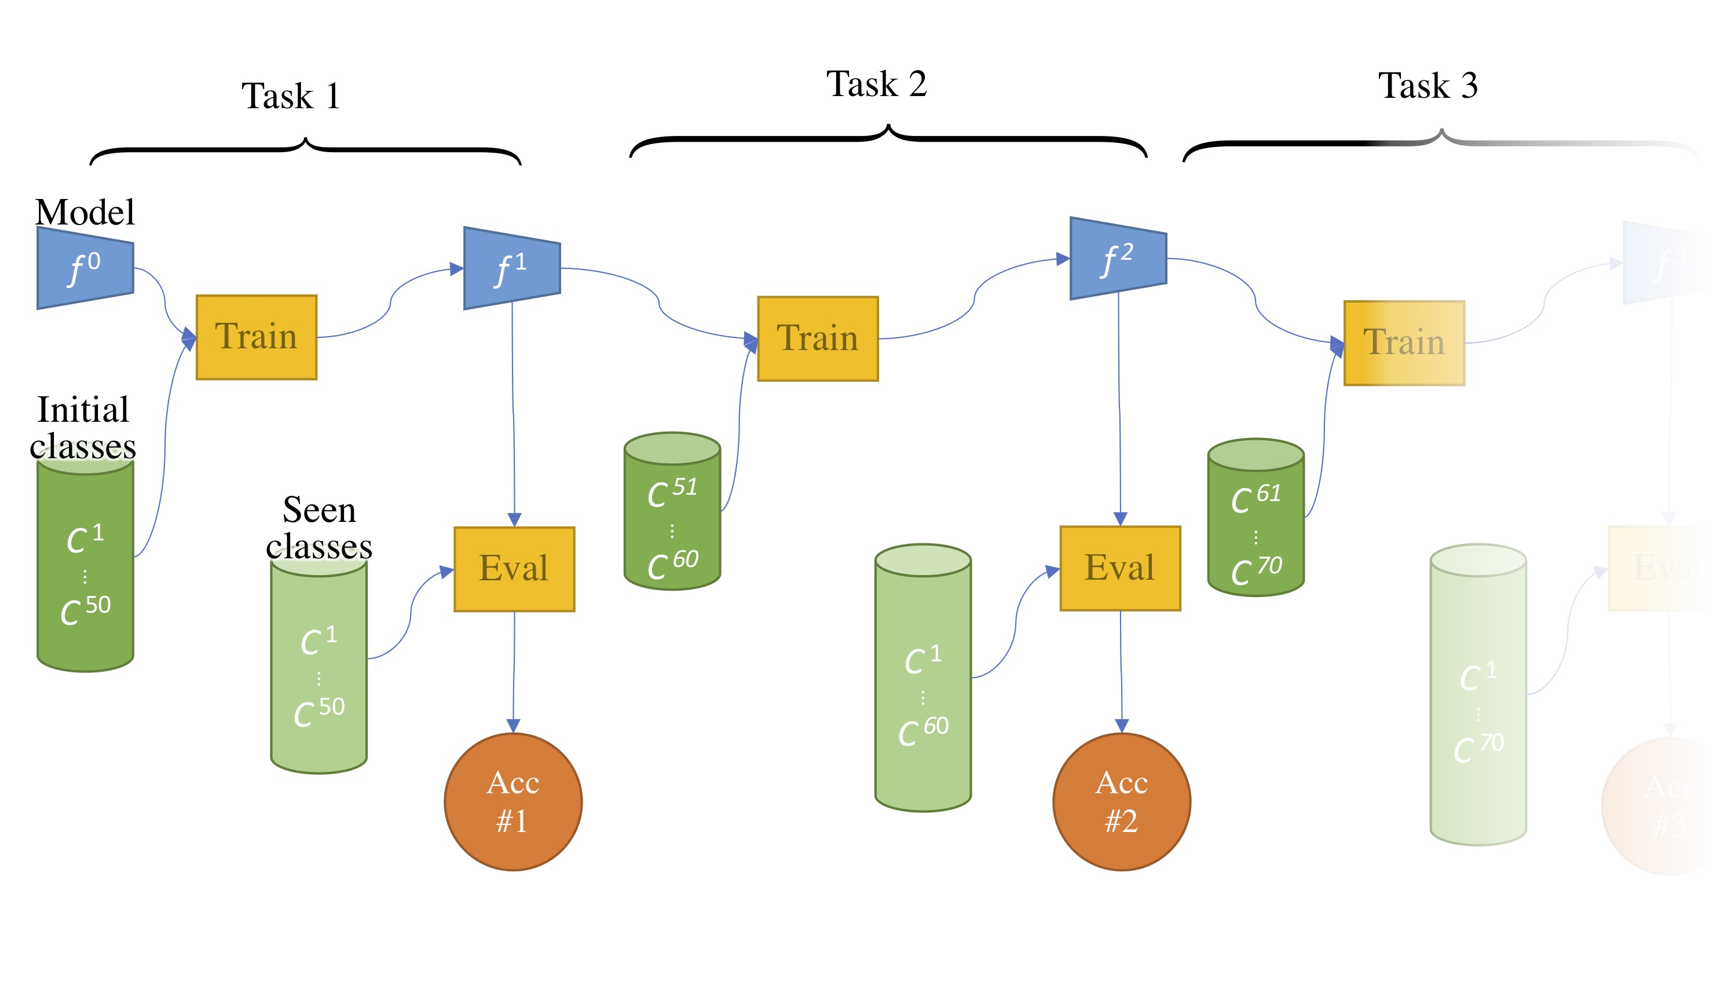

PROBLEMS
CI SETTING
Virtual concept drift where $P_{t}\left(y\right)≠P_{t+1}\left(y\right)$
Creating new tasks based on class such that
every task has a disjoint set of classes.
https://arthurdouillard.com/post/incremental-learning/
Notes:
In this setting, we can see that new tasks are created from the label/class itself.
Each set of class in task are disjoint with each other.

Slide 22
PROBLEMS
CI SETTING
Virtual concept drift where $P_{t}\left(y\right)≠P_{t+1}\left(y\right)$
Creating new tasks based on class such that
every task has a disjoint set of classes.
https://arthurdouillard.com/post/incremental-learning/

Slide 23
PROBLEMS
CI SETTING
Virtual concept drift where $P_{t}\left(y\right)≠P_{t+1}\left(y\right)$
Creating new tasks based on class such that
every task has a disjoint set of classes.
NEW CLASSES
DISJOINT
https://arthurdouillard.com/post/incremental-learning/

Slide 24
PROBLEMS
CI SETTING
Virtual concept drift where $P_{t}\left(y\right)≠P_{t+1}\left(y\right)$
Creating new tasks based on class such that
every task has a disjoint set of classes.
NEW CLASSES
NEW CLASSES
DISJOINT
DISJOINT
https://arthurdouillard.com/post/incremental-learning/

Slide 25
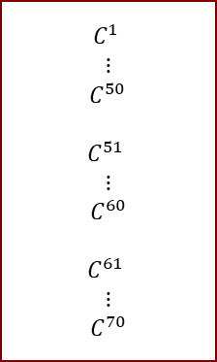
PROBLEMS
CI SETTING
Virtual concept drift where $P_{t}\left(y\right)≠P_{t+1}\left(y\right)$
Creating new tasks based on class such that
every task has a disjoint set of classes.
Set of classes
$$C^{1}$$
$$⋮$$
$C^{50}$
$$C^{51}$$
$$⋮$$
$$C^{60}$$
$$C^{61}$$
$$⋮$$
$$C^{70}$$
NEW CLASSES
NEW CLASSES
DISJOINT
DISJOINT
https://arthurdouillard.com/post/incremental-learning/
Notes:
In this setting, we can see that new tasks are created from the label/class itself.
Each set of class in task are disjoint with each other.
However, we cannot use that in our work because we have fixed set of class.
We won’t encounter new unseen classes in the future.

Slide 26

PROBLEMS
OUR SETTING
Real concept drift where $P_{t}\left(y|x\right)≠P_{t+1}\left(y|x\right)$
Instead of creating new task from disjoint classes,
we will create new task based on its software upgrade timestamps.
SOFTWARE UPGRADES

Slide 27
PROBLEMS
OUR SETTING
Real concept drift where $P_{t}\left(y|x\right)≠P_{t+1}\left(y|x\right)$
Instead of creating new task from disjoint classes,
we will create new task based on its software upgrade timestamps.
SOFTWARE UPGRADES
Task #1
Task #2
Task #3

Slide 28
Wait… Why do we talk about classes/labels here?
Ummm..
You are right….
Don’t you have regression problem?
Notes:
Yes, indeed, we have output (y) from 0.0 to 1.0

Slide 29


PROBLEMS
Regression
Classification
$y$ spans infinitely in range [0.0, 1.0]
$y$ are discrete labels from 1 to 10
Performance
Regime
10
.
.
.
.
.
1
Notes:
Based on our knowledge, there are not many works on regression problems in CL
To simplify the computation we will change regression into classification problem
Y is floating number that defines performance aggregation score
Splitting y spans infinitely from [0.0, 1.0] into 10 regimes equally
Good support from CL library and framework

Slide 30
DATASET

Slide 31


DATASET
CORI (CRAY XC40)
Collected from Cori (Cray XC40) at NERSC
Consists of 8 production applications
Two major software upgrades were performed during this study
TOKIO [1]
Darshan [2]
LMT [3]
Slurm statistics [4]
Profiling outputs
DATASET
[1] TOKIO on ClusterStor: Connecting standard tools to enable holistic I/O performance analysis (Cray User Group ‘18)
[2] Understanding and improving computational science storage access through continuous characterization (ACM Trans. Storage ‘11)
[3] Lustre monitoring tools (https://github.com/LLNL/lmt)
[4] SLURM: Simple linux utility for resource management (Job Scheduling Strategies for Parallel Processing ‘03)
Notes:
Cori (Cray XC40) at NERSC: 12,000 computer nodes and Lustre file systems, 30 PB capacity, peak performance of 700 GB/sec.
NERSC: National Energy Research Scientific Computing Center
Profiled using TOKIO
Darshan
LMT: I/O profiling of Lustre file systems
Slurm scheduling information

Slide 32
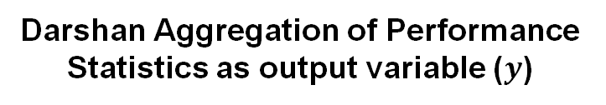

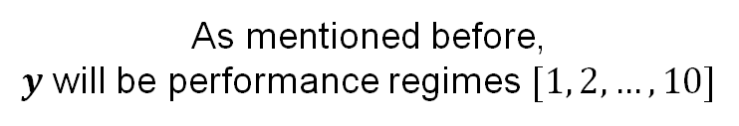

DATASET VARIABLES
I/O Profiling Data as Features ($𝓧$)
Darshan Aggregation of Performance Statistics as output variable ($y$)
Metric​ | Description​ | Tool​
Perc_OST_Full​ | Average % OST fullness​ | LMT
Ave_OSS_CPU​ | Average OSS CPU load​ | LMT
Ave_MDS_CPU​ | Average MDS CPU load​ | LMT
Num_Conc_Jobs​ | Number of concurrent jobs​ | Slurm
FS_Read_Vol​ | Total read volume across FS​ | LMT
FS_Write_Vol​ | Total write volume across FS​ | LMT
Num_Mkdir_Op​ | Number of mkdir operations​ | LMT
Num_Rename_Op​ | Number of rename operations​ | LMT
Num_Rmdir_Op​ | Number of rmdir operations​ | LMT
Num_Unlink_Op | Number of unlink operations | LMT
As mentioned before,
$y$ will be performance regimes $[1, 2, …, 10]$
Task label ($t$)
First data distribution will be labeled as 1
Second data distribution labeled as 2
.
.
n^{th} data distribution will be labeled as n

Slide 33
DATASET VARIABLES
I/O Profiling Data as Features ($𝓧$)
Darshan Aggregation of Performance Statistics as output variable ($y$)
Metric​ | Description​ | Tool​
Perc_OST_Full​ | Average % OST fullness​ | LMT
Ave_OSS_CPU​ | Average OSS CPU load​ | LMT
Ave_MDS_CPU​ | Average MDS CPU load​ | LMT
Num_Conc_Jobs​ | Number of concurrent jobs​ | Slurm
FS_Read_Vol​ | Total read volume across FS​ | LMT
FS_Write_Vol​ | Total write volume across FS​ | LMT
Num_Mkdir_Op​ | Number of mkdir operations​ | LMT
Num_Rename_Op​ | Number of rename operations​ | LMT
Num_Rmdir_Op​ | Number of rmdir operations​ | LMT
Num_Unlink_Op | Number of unlink operations | LMT
As mentioned before,
$y$ will be performance regimes $[1, 2, …, 10]$
Task label ($t$)
First data distribution will be labeled as 1
Second data distribution labeled as 2
.
.
n^{th} data distribution will be labeled as n
This will give information regarding software upgrades!

Slide 34
IMPLEMENTATION

Slide 35
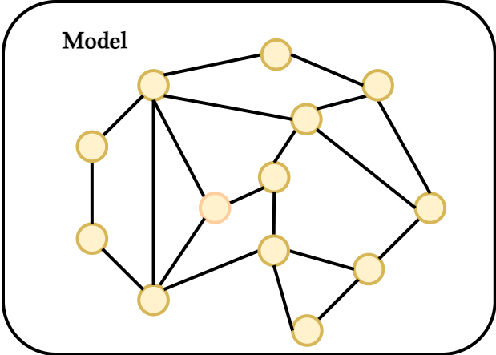



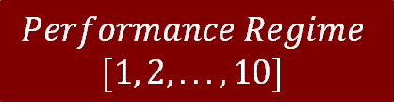


IMPLEMENTATION
While we train the model, task ID $\left(t\right)$ is used for
splitting the data based on its distribution
$$𝒳_{(t=1)}$$
Before 1st Software Upgrade
After 1st Software Upgrade /
Before 2nd Software Upgrade
$$𝒳_{(t=2)}$$
$$Performance Regime$$
$$[1, 2, ... ,10]$$
$$𝒳_{(t=3)}$$
After 2nd Software Upgrade
.
.
.
$$𝒳_{(t=n+1)}$$
After n^{th} Software Upgrade

Slide 36
IMPLEMENTATION
While we train the model, task ID $\left(t\right)$ is used for
splitting the data based on its distribution
$$𝒳_{(t=1)}$$
Before 1st Software Upgrade
After 1st Software Upgrade /
Before 2nd Software Upgrade
$$𝒳_{(t=2)}$$
$$Performance Regime$$
$$[1, 2, ... ,10]$$
$$𝒳_{(t=3)}$$
After 2nd Software Upgrade
.
.
.
$$𝒳_{(t=n+1)}$$
After n^{th} Software Upgrade
We train the model similar to
class incremental settings!

Slide 37

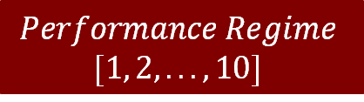
IMPLEMENTATION
OUR SETTING
We can safely omit task ID $\left(t\right)$ while running inferences!
$$𝒳_{test}$$
$$Performance Regime$$
$$[1, 2, ... ,10]$$
Notes:
Why omitting the task id:
It is hard to provide task ID at inference because of the everchanging nature of the production system
Imagine if we have model with task incremental settings, every time there exists new software upgrades, several previous heads will be irrelevant

Slide 38
IMPLEMENTATION
We build our model using Avalanche,
a PyTorch Framework for Continual Learning.
Avalanche: an End-to-End Library for Continual Learning, 2nd CLVISION CVPR ‘21
Notes:
Why omitting the task id:
It is hard to provide task ID at inference because of the everchanging nature of the production system
Imagine if we have model with task incremental settings, every time there exists new software upgrades, several previous heads will be irrelevant

Slide 39
IMPLEMENTATION
We build our model using Avalanche,
a PyTorch Framework for Continual Learning.
Regularization-based
Elastic Weight Consolidation (EWC)
Synaptic Intelligence (SI)
Learning without Forgetting (LwF)
Avalanche: an End-to-End Library for Continual Learning, 2nd CLVISION CVPR ‘21
Notes:
Why omitting the task id:
It is hard to provide task ID at inference because of the everchanging nature of the production system
Imagine if we have model with task incremental settings, every time there exists new software upgrades, several previous heads will be irrelevant

Slide 40
IMPLEMENTATION
We build our model using Avalanche,
a PyTorch Framework for Continual Learning.
Regularization-based
Memory-based
Elastic Weight Consolidation (EWC)
Synaptic Intelligence (SI)
Learning without Forgetting (LwF)
Averaged Gradient Episodic Memory (A-GEM)
Gradient-based Sample Selection (GSS) Greedy
Greedy Sampler and Dumb learner (GDumb)
Avalanche: an End-to-End Library for Continual Learning, 2nd CLVISION CVPR ‘21
Notes:
Why omitting the task id:
It is hard to provide task ID at inference because of the everchanging nature of the production system
Imagine if we have model with task incremental settings, every time there exists new software upgrades, several previous heads will be irrelevant

Slide 41
IMPLEMENTATION
We build our model using Avalanche,
a PyTorch Framework for Continual Learning.
Regularization-based
Memory-based
Elastic Weight Consolidation (EWC)
Synaptic Intelligence (SI)
Learning without Forgetting (LwF)
Averaged Gradient Episodic Memory (A-GEM)
Gradient-based Sample Selection (GSS) Greedy
Greedy Sampler and Dumb learner (GDumb)
Naïve Baseline
This approach basically does nothing to prevent catastrophic forgetting and mimics typical incrementally fine-tuned supervised learning
Avalanche: an End-to-End Library for Continual Learning, 2nd CLVISION CVPR ‘21
Notes:
Why omitting the task id:
It is hard to provide task ID at inference because of the everchanging nature of the production system
Imagine if we have model with task incremental settings, every time there exists new software upgrades, several previous heads will be irrelevant

Slide 42
EVALUATION METRICS

Slide 43
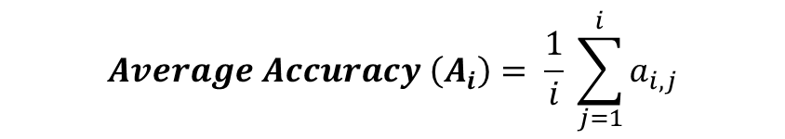
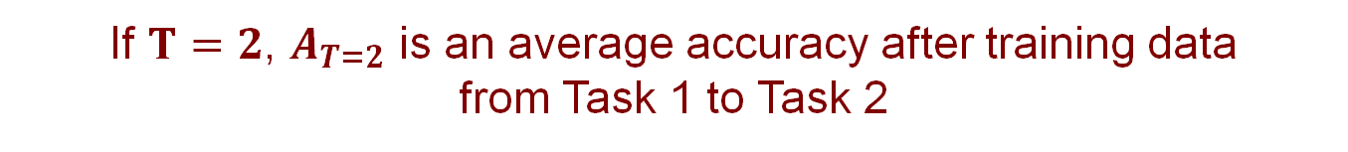
METRICS
AVERAGE ACCURACY
$$Average Accuracy \left(A_{i}\right)= \frac{1}{i} \sum_{j=1}^{i}{a_{i,j}}$$
$A_{T}$ average accuracy after training $T$ whole data sequence
If $T=2$, $A_{T=2}$ is an average accuracy after training data
from Task 1 to Task 2
Online continual learning in image classification: An empirical survey, Neurocomputing ‘22

Slide 44
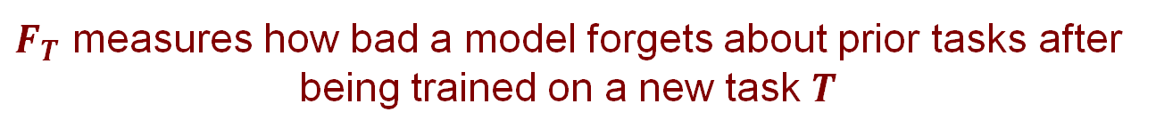
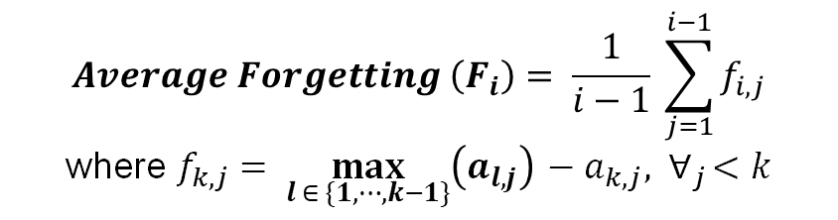
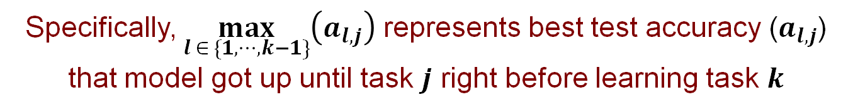
METRICS
AVERAGE FORGETTING
$$Average Forgetting \left(F_{i}\right)= \frac{1}{i−1} \sum_{j=1}^{i−1}{f_{i,j}}$$
where $f_{k,j}= \max_{l ∈ \{1, ⋯,k−1\}}\left(a_{l,j}\right){ − a_{k,j}, ∀}_{j}<k$
$F_{T}$ measures how bad a model forgets about prior tasks after being trained on a new task $T$
Specifically, $\max_{l ∈ \{1, ⋯,k−1\}}\left(a_{l,j}\right)$ represents best test accuracy ($a_{l,j}$) that model got up until task $j$ right before learning task $k$
Online continual learning in image classification: An empirical survey, Neurocomputing ‘22

Slide 45
RESULTS

Slide 46
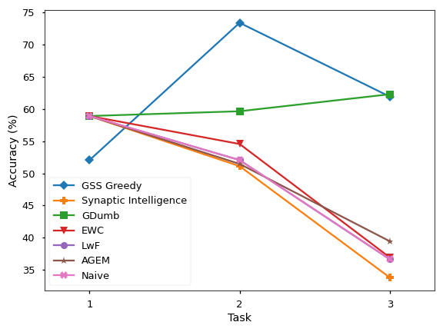
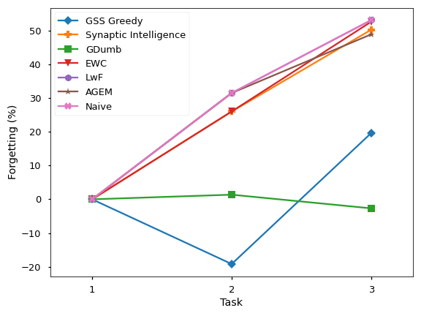
RESULTS
Notes:
Naïve baseline has a subpar accuracy and suffers catastrophic forgetting

Slide 47
RESULTS

Slide 48
RESULTS
Turns out, some CL strategies still suffered catastrophic forgetting
Notes:
The I/O performance modeling using some CL strategies (EWC, LwF, A-GEM, SI) still suffer greatly from the distribution shift

Slide 49
RESULTS
GDumb and GSS Greedy are better than the others!

Slide 50
RESULTS
GSS Greedy suffers
forgetting after learning task 3
GDumb and GSS Greedy are better than the others!
Notes:
GSS suffers after learning task 3 because of its memory size limitation and poor greedy selection of prior task knowledge.
However, we can see that GSS Greedy is still one of the best strategy that we got in this experiment especially for learning two tasks from task 1 to task 2.

Slide 51
CONCLUSION

Slide 52
CONCLUSION
Concept drift in performance modeling for production system is real
Memory-based CL strategies are better than regularization-based strategies
Our work is the first study to apply Continual Learning on performance modeling
Notes:
FIRST:
Catastrophic forgetting happened if we used only transfer learning (Naïve strategy)
Forgetting rate increased ~20% each time a new task is learned
SECOND:
Memory-based CL strategies are better than regularization-based strategies in our dataset
THIRD:
To the best of our knowledge, our work is the first study to apply Continual Learning on performance modeling
We prove that CL are applicable to tackle performance degradation of I/O performance modeling

Slide 53
FUTURE WORKS
Collect more data!
Apply automatic drift detection on production systems
Apply our model inside production systems (e.g. job scheduling or monitoring tools)
Notes:
FIRST:
Automatic drift detection on production systems
Currently we still need operator to label the software upgrade timestamp
Software upgrade is not the only one causing performance drift
Better to make it adaptive
SECOND:
Need more data!
THIRD:
Applied our model inside production systems such as job scheduling or monitoring tools

Slide 54



https://cs.uchicago.edu
https://www.utsa.edu
https://www.anl.gov

