Slide 1


Tiny-Tail Flash
Near-Perfect Elimination of Garbage Collection Tail Latencies in NAND SSDs
Shiqin Yan, Huaicheng Li, Mingzhe Hao,
Michael Hao Tong, Swaminathan Sundararaman*,
Andrew Chien, and Haryadi S. Gunawi
*
ceres.cs.uchicago.edu

Slide 2
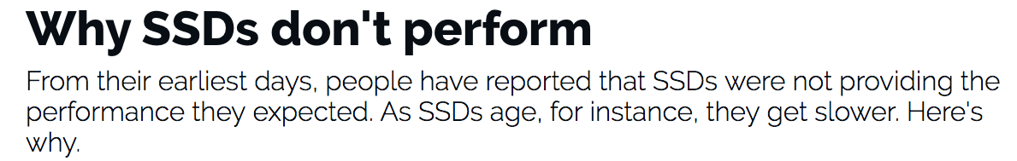

“if your read is stuck behind an erase you may have wait 10s of milliseconds. That’s a 100x increase in latency variance”
http://www.zdnet.com/article/why-ssds-dont-perform/
The Tail at Scale [CACM’13]
https://storagemojo.com/2015/06/03/why-its-hard-to-meet-slas-with-ssds/

Slide 3
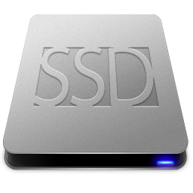
NoGC
100%
Convert to CDF
Reads + Writes
Read Latency
Percentile
Clean/Empty SSD
0.3ms
80%
Time
0.3ms
Read Latency

Slide 4
80 ms!
NoGC
Objective: cut tail
100%
3%
Reads + Writes
≥5 ms
with GC
Long tail !
Percentile
Read Latency
Aged/Full
SSD
0.3ms
80%
Time
0.3ms
Read Latency
80ms

Slide 5


How GC delays read I/Os?
Read
A
B
fast
delayed!
A GC moves tens of valid pages!
which makes channel/chips busy for tens of ms !
A
B
Channel
Chip

Slide 6
How to cut tail latencies?
Tail-tolerant techniques in distributed/storage systems:
Leverage redundancy to cut tail!
Full Stripe Read
C = XOR
(A, B, P)
A
B
C
fast
tail!
RAID:
A
B
C
P
Slow / busy

Slide 7
How to cut tails in SSD?
Error rate increases → RAIN (Redundant Array of Independent NAND)
Similarly, we leverage RAIN to cut “tails”!
Full Stripe Read
A
B
C
C = XOR
(B, C, P)
fast
slow!
SSD:
A
B
C
P
GC

Slide 8
Contribution
Plane-Blocking GC
GC-Tolerant Read
Rotating GC
GC-Tolerant Flush
New
techniques:
Current SSD
technology:
RAIN
(Parity-based Redundancy)

Slide 9
Results
NoGC
+Rotating GC
100%
+GC-Tolerant Read
+Plane-Blocking
CDF (Percentile)
Base
95%
0.3ms
Latency
80ms

Slide 10


100%
Tiny tail!
CDF (Percentile)
Overall results achieved:
Between 99 - 99.99th percentiles:
ttFlash 1-3x slower than NoGC
Base 5-138x slower than NoGC
95%
0.3ms
Latency
80ms

Slide 11
Outline
  Introduction
  Background
  Tiny-Tail Flash Design
  Evaluation, limitations, conclusion

Slide 12
SSD Internals
C₀
C₁
C_{N}
Chip
Die [0]
Die [1]
Plane[0]
…
…
…
…
…
Plane[N]
Chip

Slide 13
SSD Internals
C₀
C₁
C_{N}
Plane
Block[0]
Block[N]
Valid Page
…
…
…
…
…
…
Chip
Plane

Slide 14
14
SSD Controller
for (1 … # of valid pages):
1. read to controller
(check with ECC)
2. write to another block
blocked!
1
2
Old block
Empty block
GCed pages block the channel
…

Slide 15
15
SSD Controller
3. Erase the old block
Old block
Empty block
Erase!
Erase operation block the plane
…

Slide 16
16
blocked!
Channel blocking GC
“Base” approach
A
B
C
…
GCing plane

Slide 17
NoGC
100%
CDF (Percentile)
Base (Channel-Blocking)
95%
0.3ms
Latency
80ms

Slide 18
Outline
  Introduction
  Background
  Tiny-Tail Flash Design
    Plane-Blocking GC
    GC-Tolerant Read
    Rotating GC
    GC-Tolerant Flush
  Evaluation, limitations, conclusion

Slide 19
19
Base:
Channel
Blocking
Plane
Blocking
blocked!
Unblock
the channel
Leverage
intra-plane copyback support
A
A
B
B
C
C
…
…
GCing plane
GCing plane

Slide 20
20
Plane Blocking
Base GC Logic:
for (every valid page)
1. flash read+write
(over channel)
2. wait
SSD Controller
Plane Blocking
GC Logic:
for (every valid page)
flash read+write
(inside plane)
serve other
user I/Os
2
A
Read
Page
B
C
1
“Intra-plane
copyback”
1
Old block
Empty block
2
Overlap
intra-plane copyback with
channel usage for other non-GCing planes
…
1
2

Slide 21
NoGC
100%
Only
1.5%
3% of I/Os
are blocked
by GC
+Plane-Blocking
Base (Channel-Blocking)
95%
0.3ms
Latency
80ms

Slide 22
  Issue 1: No ECC check for garbage-collected pages
    (will discuss later)
  Issue 2:
X
Read
X
Read
Y
Y
Read
Z
GC-ing plane
still blocks
delayed!
Z

Slide 23
Outline
  Introduction
  Background
  Tiny-Tail Flash Design
    Plane-Blocking GC
    RAIN + GC-Tolerant Read
    Rotating GC
    GC-Tolerant Flush
  Evaluation, limitations, conclusion

Slide 24
RAIN
LPN (Logical Page #)
Static mapping:
LPN0 → C[0]PG[0]
LPN1 → C[1]PG[0]
…
Add parity:
LPN 0, 1, 2 → P0,1,2
Rotating parity as RAID 5
C₀
C₁
C₂
C₃
0
1
2
P_{0,1,2}
PG₀
PG₁
3
4
P_{3,4,5}
5
6
P_{6,7,8}
7
8
PG₂

Slide 25
RAIN enables GC-Tolerant Read
Full Stripe Read
2 = XOR
(0, 1, P_{0,1,2})
0
1
2
0
1
2
Read in parallel
+ XOR cost
~0.01 ms
fast
tail
0
1
2
P_{0,1,2}
vs.
GC
Wait for GC
2 to 10s of ms

Slide 26
GC-Tolerant Read
Issue: partial stripe read
Partial stripe read:
2
2 = XOR
(0, 1, P_{0,1,2})
Must generate extra
N-1 reads!
Add contention to other N -1 channels and planes
Convert to full stripe if:
T_{extra-reads} < T_{GC}
slow!
0
1
2
P_{0,1,2}

Slide 27
NoGC
0.5%
100%
+GC-Tolerant Read
+Plane-Blocking
CDF (Percentile)
Base
95%
0.3ms
Latency
80ms

Slide 28
Issue: more than 1 GCs
in a plane group?
One parity → cut one tail
Can’t cut two tails!
Full-stripe read
0
1
2
2 tails!
DOES NOT HELP!
0
1
2
P_{0,1,2}
PG₀
GC
GC
GC

Slide 29
Outline
  Introduction
  Background
  Tiny-Tail Flash Design
    Plane-Blocking GC
    GC-Tolerant Read
    Rotating GC
    GC-Tolerant Flush
  Evaluation, limitations, conclusion

Slide 30
Postpone!
0
1
2
P_{0,1,2}
Rotating GC:
Anytime, at most 1 plane per plane group can perform GC
PG₀

Slide 31
Rotating!
0
1
2
P_{0,1,2}
Rotating GC:
Anytime, at most 1 plane per plane group can perform GC
PG₀

Slide 32
0
1
2
P_{0,1,2}
Rotating GC:
Anytime, at most 1 plane per plane group can perform GC
Concurrent GCs in different PGs are permitted.
PG₀
PG₁
PG₂

Slide 33
+Rotating GC
0.5%
100%
Tiny tail!
Why still tiny tails?
Small/partial-stripe read
→ Sometimes may be better to wait for GC than adding extra reads/contentions!
CDF (Percentile)
95%
0.3ms
Latency
80ms

Slide 34
Outline
  Tiny-Tail Flash Design
    Plane-Blocking GC
    GC-Tolerant Read
    Rotating GC
    GC-Tolerant Flush (in paper)
  Evaluation
  Limitations
  conclusion

Slide 35
Implementation
SSDsim (~2500 LOC)
  Device simulator
VSSIM (~900 LOC)
  QEMU/KVM-based
  Run Linux and applications
OpenSSD
  Many limitations of the simple programming model
Future: ttFlash on OpenChannel SSD

Slide 36
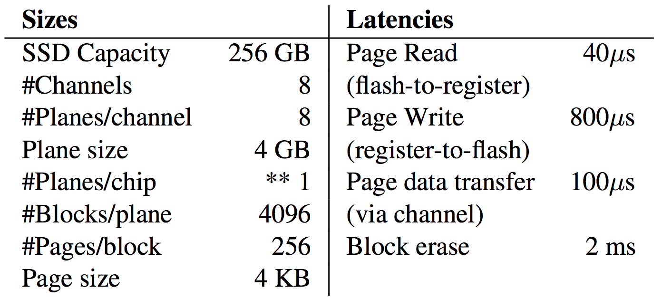
Evaluation
Simulator: SSDsim (verified against hardware)
Workload: 6 real-world traces from Microsoft Windows
Settings and SSD parameters:
  SSD size: 256GB, plane group width = 8 planes (1 parity, 7 data)

Slide 37
Developer Tools Release Server Trace
NoGC
+Rotating GC
ttFlash
99.99th
100%
+GC-Tolerant Read
+Plane-Blocking
Result:
99.99th percentile:
ttFlash 3x slower than NoGC
Base 138x slower than NoGC
CDF (Percentile)
Base
95%
0.3ms
Latency
80ms

Slide 38
Evaluated on 6 windows workload traces with various characteristics
Reduced blocked I/Os (total) from 2 – 7% to 0.003 – 0.05%
99 – 99.99%: 1.0 – 2.6x slower for ttFlash and 5.6 – 138.2x for Base

Slide 39
Other Evaluations
Filebench on VSSIM+ttFlash
  ttFlash achieves better average latency than base case
Vs. Preemptive GC
  ttFlash is more stable than semi-preemptive GC
    (If no idle time, preemptive GC will create GC backlogs, creating latency spikes)
6
Latency (s)
ttflash
stable
0
4386
Elapsed time (s)
4522

Slide 40
Tradeoffs/Limitations
ttFlash depends on RAIN
  1 parity for N parallel pages/channels
  We set N = 8, so we lose one channel out of 8 channels.
  Average latencies are 1.09 – 1.33x slower than NoGC, No-RAIN case
RAID → more writes (P/E cycles)
  ttFlash increases P/E cycles by 15 – 18% for most of workloads
  Incur > 53% P/E cycles for TPCC, MSN (random write)
ECC is not checked during GC
  Suggest background scrubbing (read is fast & not as urgent as GC)
  Important note: in ttFlash, foreground/user reads are still ECC checked

Slide 41
Tails under Write Bursts
ttFlash 55MB/s
Latency CDF w/ Write Bursts
90%
ttFlash 64MB/s
CDF (Percentile)
Base 64MB/s
20%
0
Latency (ms)
80 ms
Under write burst and at high watermark, ttFlash must dynamitcally disable Rotating GC to ensure there is always enough number of free pages.

Slide 42
Conclusion
ttFlash
New techniques:
GC-induced
long tail
Plane-Blocking GC
GC-Tolerant Read
Rotating GC
GC-Tolerant Flush
CDF (Percentile)
Overall results achieved:
Between 99 - 99.99th percentiles:
ttFlash 1-3x slower than NoGC
Base 5-138x slower than NoGC
technology:
Latency
Powerful Controller
RAIN (parity-based redundancy)
Capacitor-backed RAM

Slide 43


Thank you!
Questions?
http://ucare.cs.uchicago.edu
https://ceres.uchicago.edu

