Slide 1

LinnOS
Predictability on Unpredictable Flash Storage with a Light Neural Network
Mingzhe Hao, Levent Toksoz, Nanqinqin Li, Edward Edberg Halim, Henry Hoffmann, and Haryadi S. Gunawi

Slide 2
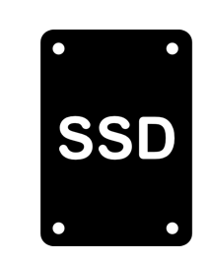


Doubling data every 2 years
30 zettabytes in 2018
175 zettabytes in 2025
15% annual
growth rate.
47 to 80 billion market by 2025!
Large-volume data with microsecond-level access latencies!
30% data access will be real-time by 2025
More real-time data? More flash storage!
[1] Data Age 2025, sponsored by Seagate with data from IDC Global DataSphere, Nov 2018
[2] Solid State Drive (SSD) Market – Growth, Trends, and Forecasts (2020 - 2025), mordorintelligence.com

Slide 3

Do these SSDs solve
real-time data access challenge?
“Most of the interesting devices that we are dealing with are
in the microsecond-level, and we suck at microsecond-level”
2014
[Google Research: Three things that MUST BE DONE to save the data center of the future]
Destructive latency interruptions inside flash storage devices
“A new breed of I/O devices motivates greater interest in
microsecond-scale latencies, and new technologies are needed”
2017
[Attack of the Killer Microseconds, CACM]

Slide 4
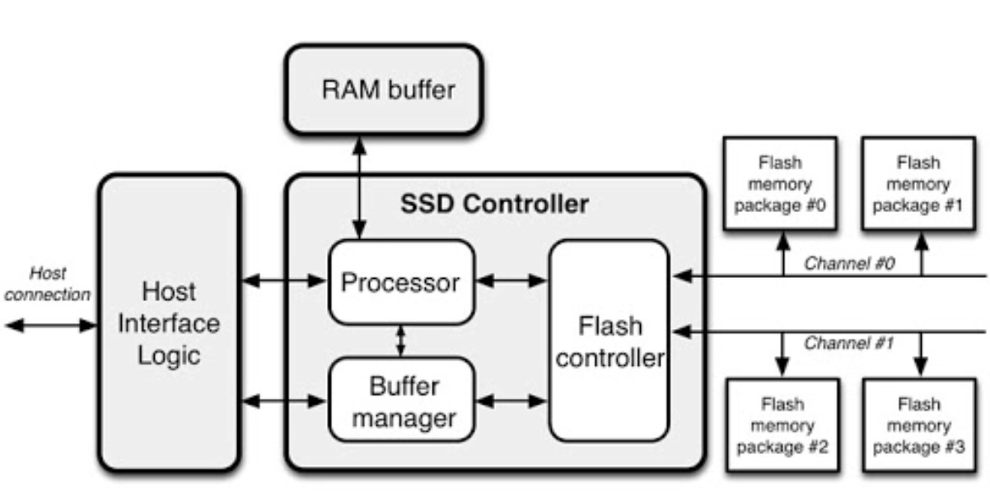
Unpredictable Latency
Unpredictable latency at individual-I/O level!
Buffer flushing..
Garbage collection..
Wear leveling..
...
Internal complexities
1st I/O
100μs
120μs
2nd I/O
80μs
150μs
3rd I/O
110μs
800μs
4th I/O
1.5ms
200μs
Threats to performance stability
...
...
...

Slide 5
Popular Solutions On Unpredictability
White/gray-box
  Re-architect device internals
Black-box
  SSD-aware filesystems and applications
Powerful
No change on hardware
Need to modify hardware
Considerable re-design in software stack

Slide 6



Speculative Execution
...
Black-box approaches
  SSD-aware filesystems and applications
  Speculative execution
Mitigate every slow I/O
in a black-box way
Hedged requests (hedging)
Straggler!
Most popular
App
...
Wait
Backup
Faster!

Slide 7


Agnostic!
Learning!
Speculative execution
LinnOS
- Passively wait due to black-box
- Proactively infer the black-box
Lightweight neural network for
per-I/O speed inference
Straggler!
App
LinnOS
App
I/O attempt
1
...
Wait
...
Fast &
No-Wait!
2
Slow I/O!
Revoke!
Backup
Faster!
3
I/O re-route

Slide 8
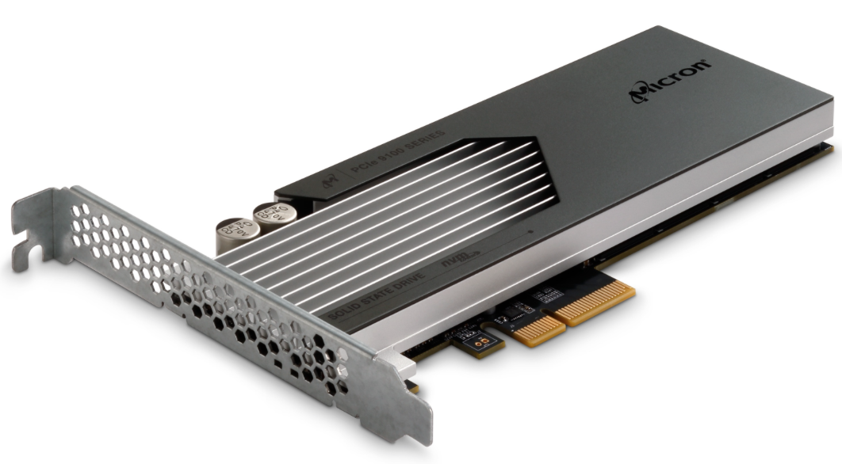
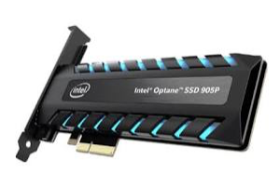
Contribution
…
Azure
Bing
Cosmos
App
vs. state of the art: hedged requests,
black-box heuristics, etc.
OS
LinnOS
Per-I/O
Speed
Prediction
Light neural network
No extra input required
87-97% accuracy
4-6μs overhead
LinnOS:
Latency stability at even p99.99!
Average latency improved by up to 80%!
Hardware
…

Slide 9
Outline
Introduction
Challenges & Solutions
Evaluations
Conclusion

Slide 10
Design Challenges
What to predict?
(accuracy and effectiveness)
Output labeling
e.g., binary classification,
multiclass classification,
regression…
Use what to predict?
(accuracy and inference overhead)
LinnOS
How to minimize the impact?
e.g., individual I/O offsets,
I/O queue lengths,
history latencies…
e.g., false submits,
false revokes
Input features
Handling inaccuracy

Slide 11
Output labeling
Ideal labels:
Exact latency value (e.g. 120μs, 80μs..)
Latency ranges
(e.g., 100-200μs,
200-400μs)
Only 60-70% accuracy
50-100μs
100-200μs
200-400μs
…
Flexible
Mis-Prediction
Difficult to achieve
decent accuracy
Truth

Slide 12
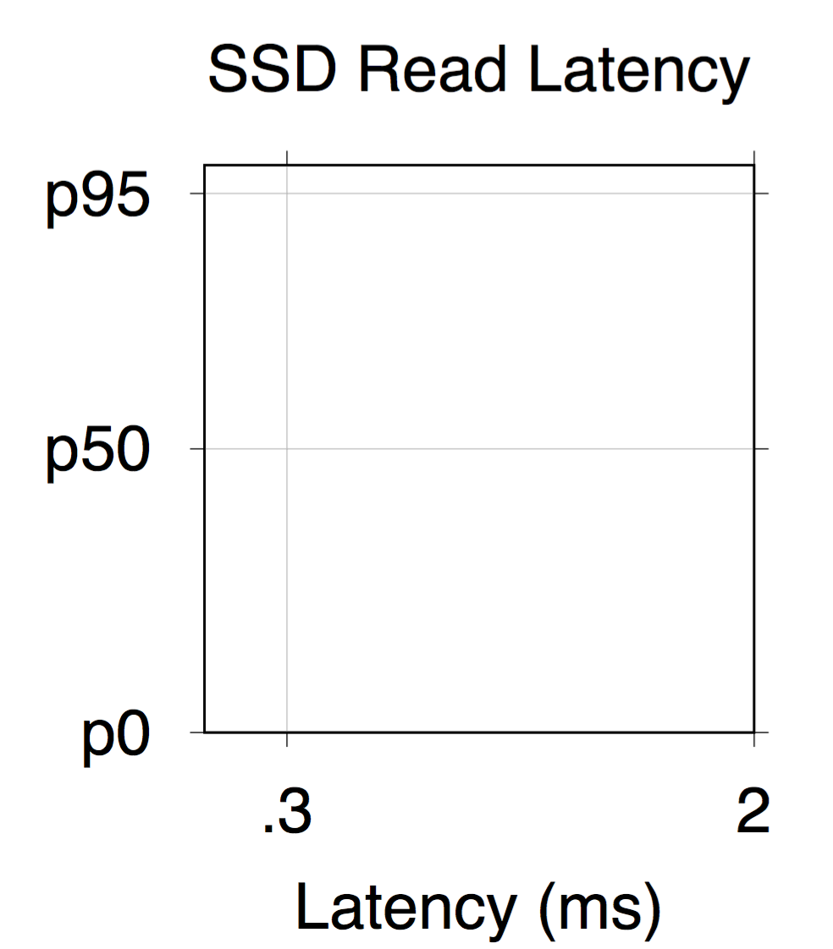
Output labeling
Latency distribution
Pareto
Precise prediction
is difficult!
> p95: Tail!
Revoke
Auto fast/slow split
Inflection algorithm
Great
accuracy!
Simpler and helpful alternatives?
< p95: Stable
LinnOS binary classification
Submit

Slide 13
Input features
Ideal features:
Addresses of related I/Os
Thousands of features
(addresses in 32-bit binaries)
High
overhead
(finest granularity)
Unacceptable
Directly indicate the resource contention
Hundreds of
microseconds
to infer each I/O
High accuracy
(up to 99%)

Slide 14
Input features
Good latency indicator, but how about internal disruption?
Using finest features is expensive!
Queue length and history I/Os
Low history queue length
+ high history latency
= internal disruptions
For each
I/O
102
010
2184
…
Use features that are
more aggregate
Current
queue length
Last I/O queue length
Last I/O latency (μs)
Easier to learn

Slide 15
Input features
Last completed
I/O
2nd last
3rd last
4th last
Queue length and history I/Os
102,
010, 2184,
056, 0800,
126, 1600,
368, 3920
Current
queue length
Queue lengths and latencies
for last four completed I/Os
Split into individual digits
More aggregate
features
1,0,2, 0,1,0, 2,1,8,4, 0,5,6, 0,8,0,0, 1,2,6,1,6,0,0, 3,6,8,3,9,2,0
3 fully-connected
layers (31-256-2)
87-97% accuracy
4-6μs overhead
across various SSDs/traces
31
features

Slide 16
Handling inaccuracy
Category
Description
Cost
False
submits
Mistakenly accept a slow I/O
Up to milliseconds!
:
:
More penalty
Customized loss function:
Reduce false submits by up to 68%!
Inaccurate
cases
Biased
training
Less penalty
False
revokes
Mistakenly revoke a fast I/O
μs-level
failover
:
:

Slide 17
Handling inaccuracy
Apply
(100%-X) hedging (e.g., p93)
False submit rate
X > 5% (e.g., 7%)
Still some false submits!
Training
LinnOS
with hedging using false submit rate!
False submit rate
X < 5% (e.g., 2%)
Apply
p95
hedging

Slide 18
Recap
Per-I/O fast/slow
binary classification
Output labeling
87-97% accuracy,
4-6μs per-I/O overhead,
on various SSDs/traces
Aggregate features:
current queue length,
queue lengths and latencies
of history I/Os
LinnOS
Biased training
& hedging
Input features
Handling inaccuracy

Slide 19
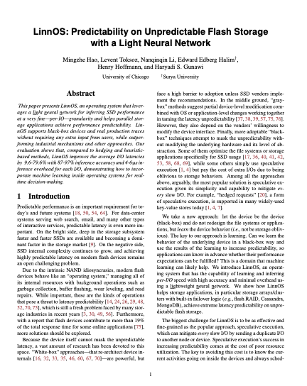

Other designs
More detail
in the paper!
User-space offline training + kernel-space online inference
…
+
OS
Can utilize additional to further reduce inference overhead
Support re-tracing, re-training, and re-uploading weights

Slide 20
Outline
Introduction
Challenges & Solutions
Evaluations
Conclusion

Slide 21
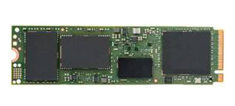
Evaluation setup
Read I/Os are latency-critical! Infer and revoke!
Production traces
Major metric:
Latencies of read I/Os
App
Azure
Bing
Methods compared:
1. Baseline
…
Read/write workloads
LinnOS
Cosmos
Speculation-based
2. Cloning
3. Hedging at p95
4. Hedging at IP (inflection point)
Can failover
Infer-and-revoke
5. Simple heuristic
6. “Advanced” heuristic
7. LinnOS without hedging
8. LinnOS
Local flash array
OR
Three homogeneous consumer-level SSDs
Three heterogenous enterprise-level SSDs

Slide 22
Baseline
App
Better!
34ms at p99.9
Baseline
Sole I/O
Sole resp.
15ms at p95
Slow!
Fast!

Slide 23
Cloning
App
Clone
Baseline
I/O
Dual I/O
Slower resp.
Faster resp.
Little improvement due to 2x workload
Slow!
Fast!

Slide 24
Hedging at p95
App
Timeout:
p95 lat.
Clone
Must wait till p95
Baseline
Time-out I/O
Slower resp.
Backup I/O
Hedge p95
Faster resp.
Cut tail above p95
Slow!
Fast!

Slide 25
Hedging at IP (inflection point)
Timeout:
LinnOS fast/slow latency threshold
Heavier tail
due to more I/Os
App
Baseline
Time-out I/O
Improvement below p95
Slower resp.
Backup I/O
Hedge p95
Faster resp.
Hedge IP
Slow!
Fast!

Slide 26
Simple heuristic (HeurSim)
Revoke:
Current queue length > LinnOS IP percentile
Example: if
LinnOS uses p80 lat,
HeurSim uses p80 queue length
App
HeurSim
I/O attempt
Baseline
Resp.
Revoke
Failover
Limited improvement
Hedge
Slow!
Fast!

Slide 27
“Adv” heuristic (HeurAdv)
History I/Os see high lat. + low queue length, revoke unless short current queue!
Revoke:
HeurSim + checking history I/Os
App
Hedge
HeurSim
I/O attempt
Resp.
HeurAdv
Revoke
Failover
Slow!
Fast!
Better improvement, but requires
manual tuning

Slide 28
LinnOS without hedging
Revoke:
Learning-based.
Auto-tunes 8706 weights!
App
LinnOS w/o hedging
Hedge
Tail due to false submits
I/O attempt
Resp.
HeurAdv
Revoke
Failover
Slow!
Fast!
Further improvement under p95!

Slide 29
LinnOS
Hedging percentile = (100% - false submit rate)
LinnOS + hedging for false submits
App
Hedge
LinnOS w/o hedging
Backup
I/O
I/O attempt
Resp.
HeurAdv
LinnOS
Revoke
Failover
Slow!
Fast!
Stability even at p99.99!
Learning helps!

Slide 30
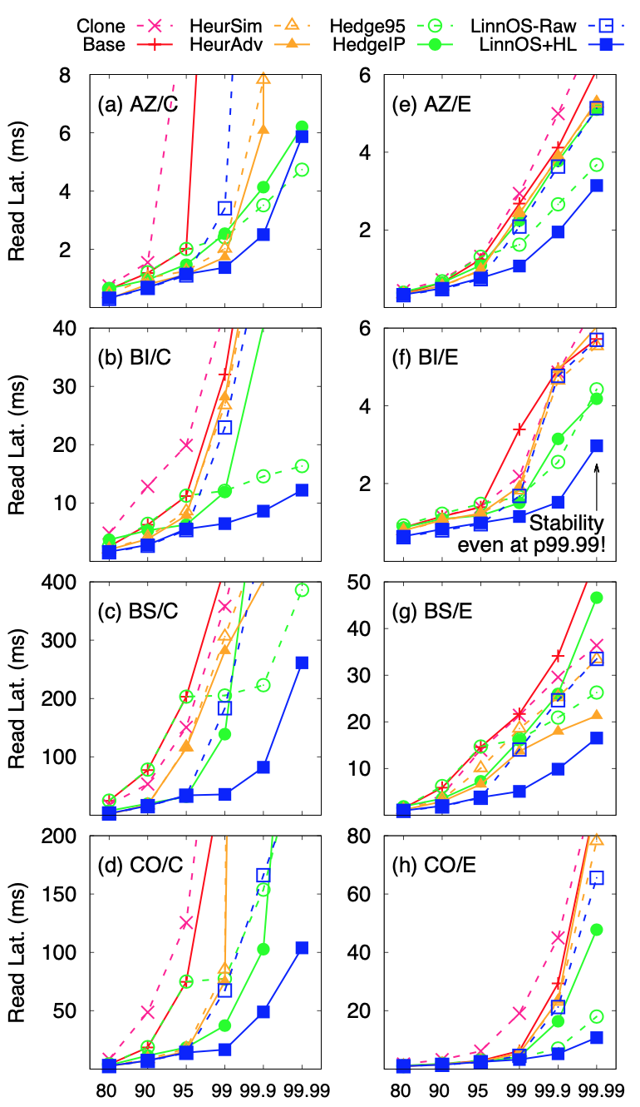
Other evaluations
LinnOS supports various workloads and devices
LinnOS reduces average latency by 9.6-79.6%
LinnOS achieves high accuracy
LinnOS works on public traces
LinnOS helps MongoDB and FS

Slide 31
Conclusion
Predictable performance for flash storage!
…
Azure
Bing
Cosmos
App
OS
LinnOS
Per-I/O
Speed
Prediction
Light neural network
No extra input required
87-97% accuracy
4-6μs overhead
Hardware
…

Slide 32
LinnOS
Predictable performance for flash storage!
…
Azure
Bing
Cosmos
App
OS
LinnOS
Per-I/O
Speed
Prediction
Light neural network
No extra input required
87-97% accuracy
4-6μs overhead
Thank you!
Hardware
…

