Slide 1



ScaleCheck
A Single-Machine Approach for Discovering Scalability Bugs in Large Distributed Systems
Cesar A. Stuardo, Tanakorn Leesatapornwongsa , Riza O. Suminto, Huan Ke, Jeffrey F. Lukman, Wei-Chiu Chuang , Shan Lu and Haryadi S. Gunawi
*
+
+
*

Slide 2


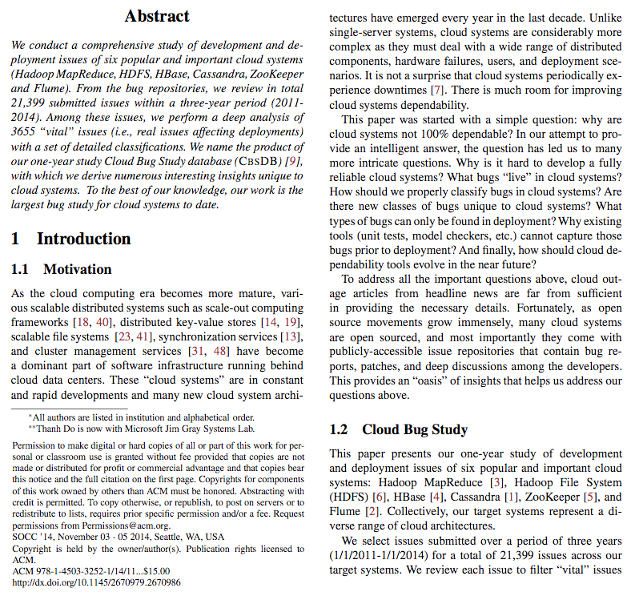


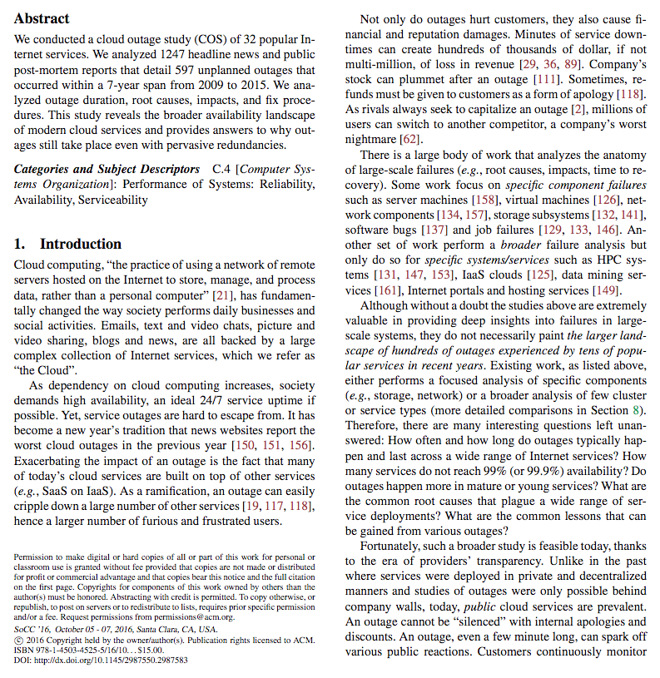





New Class of Bugs?
“Classic” critical bugs
  Concurrency
  Configuration
  Performance
  Security
Scalability bugs?

Slide 3
Scalability Bugs?
Cassandra
  Bug #3831: "start exploding when start reading 100-300 nodes"
  Bug #6127: "obvious symptom is with 1000 nodes”
  Bug #6409: "With >500 nodes, … have trouble"
Hadoop/HDFS
  Bug #1073: "1600 data nodes. randomWriter fails to run"
  Bug #3990: "multi-thousand node cluster often results in [problem]”
HBase:
  Bug #10209: "with 200+ nodes, [cluster] takes 50mins to start"
  Bug #12139: "with >200 nodes, StochasticLoadBalancer doesn't work"
Riak:
  Bug #926: "1000 node cluster is a larger question”

Slide 4



Scalability Bugs
Latent bugs whose symptoms surface in large-scale deployments, but not necessarily in small/medium-scale deployments
Symptom
#Nodes

Slide 5



An Example: Cassandra Bug #3831
Decommissioning
Update Ring
N=6

Slide 6




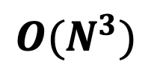
An Example: Cassandra Bug #3831
In every node
for(i=0 to N)
for(j=0 to N)
for(k=0 to N)
$$O(N^{3})$$
CPU intensive
0.1 – 4 seconds
A: “ B is dead”
In all nodes!
(unstable cluster)
A: “ B is alive”
Update Ring
Flapping
Late Gossip
B
N > 200

Slide 7
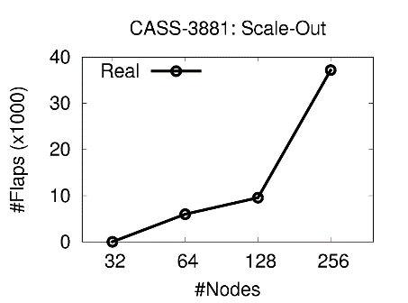

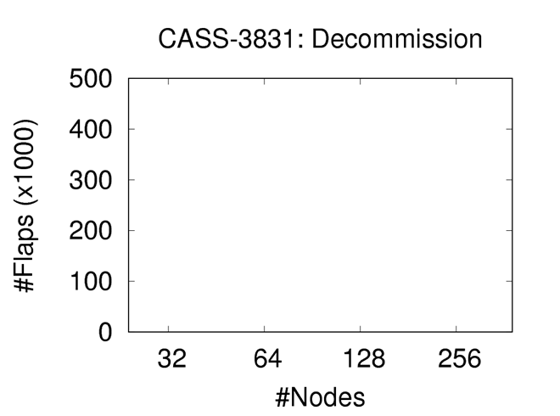



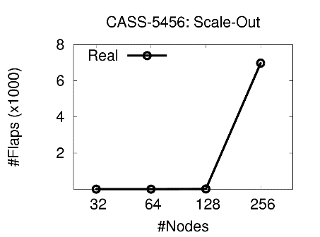
The “Flapping” Bug(s)
The bug
symptom

Slide 8
“For Apache Hadoop, testing at thousand-node scale has been one of the most effective ways of finding bugs,
but it’s both difficult and expensive. It takes considerable expertise to deploy and operate a large-scale cluster, much less debug the issues.
Running such a cluster also costs thousands of dollars an hour, making scale testing impossible for the solo contributor.
As it stands, we are heavily reliant on test clusters operated by large companies to do scale testing.
A way of finding scalability bugs without requiring running a large-scale cluster would be extremely useful”
— Andrew Wang (Cloudera and Apache Hadoop PMC Member and Committer)
Q1
What are the root causes of scalability bugs?
Q2
Can we do large-scale testing easily, e.g. in one machine?

Slide 9
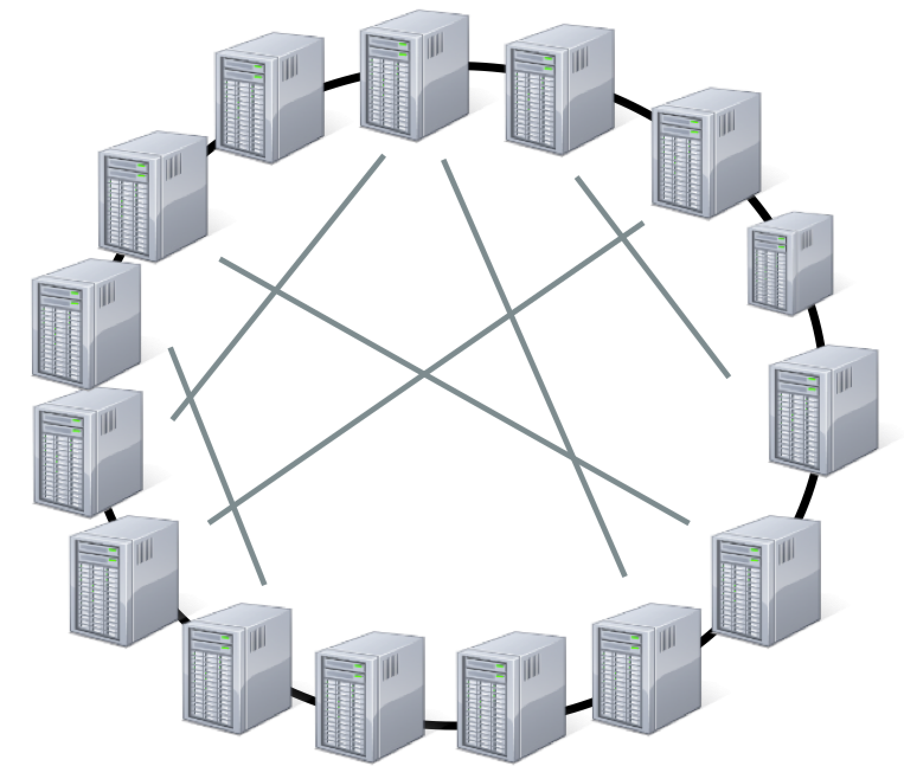


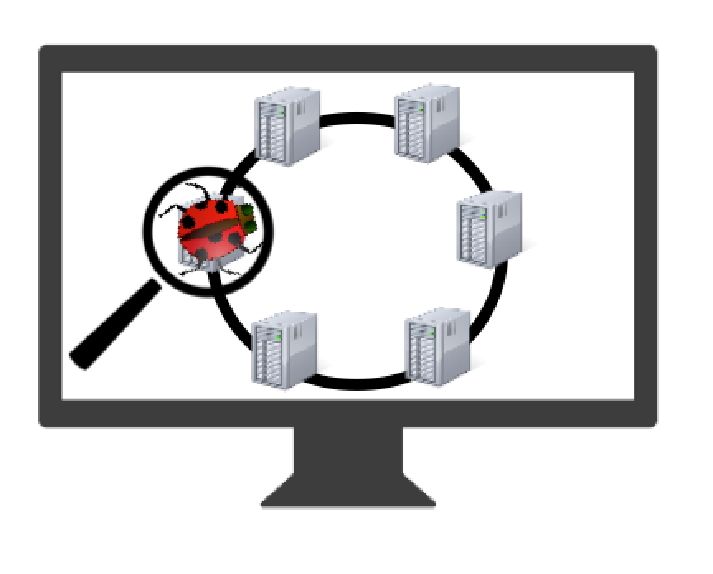


ScaleCheck
Real-scale testing
Discovering scalability bugs
Democratizing large scale testing

Slide 10


ScaleCheck
Q1
What are the root causes of scalability bugs?
SFind
Scale Dependent Loops
Automatically find scale dependent data structures and loops
by checking their in-memory growth tendency over small scale experiments
Loops iterating
scale dependent data structures

Slide 11


ScaleCheck
Q2
Can we do large-scale testing easily, e.g. in one machine?
STest
Many Challenges!!!
Memory Overhead
Context switching
SPC
Single Process Cluster
CPU contention
GEDA
Global Event-Driven Architecture
Network Overhead
PIL
Processing Illusion
Bad modularity
Large scale testing in a single machine with little source code modification

Slide 12
Our Results
Integrated to 4 systems
Scale tested 18 protocols
Accurately reproduced 10 known scalability bugs
Found 4 new bugs
…..in just a single machine

Slide 13
Outline
Introduction
SFind
STest
Evaluations and Conclusions

Slide 14
Our Frequent Root Cause…
is not easy to find in…
Scale Dependent Loops
iterating scale dependent data structures
Any distributed system these days has…
  > 100K LOC
  > 100x source files
  > 1000x maps, lists, queues, etc…
We can find them manually…
  /* … holds one entry per peer … */
  /* … maps partition to node… */
  /* … maps blocks to datanodes… */
How can we find them automatically?

Slide 15

JVMTI and Reflection support
List peers = {A}
peers = {A, B}
peers = {…}
A
A
A
B
…
…
Step 1
Step 2
Step N
List “peers” growth tendency
Size
N
…
2
2
1
1
1
1
Step
1
2
1
2
N

Slide 16
Data structures that tend to grow when one or more dimensions grow are scale dependent
List X
List peers
Set Y
Map Z
Size
Size
Size
Size
Step
Step
Step
Step
Map nodes
Set T
Queue Q
Map R
Size
Size
Size
Size
Step
Step
Step
Step
A’s on heap data structures growth tendency after N steps

Slide 17
Finding many scale-dep data structures
26 data structures (Cassandra, HDFS)
Try out different axes of scale
  Adding files
  Adding partitions
  tables, columns, files, directories…
Try out different workloads
  Snapshot directories
  Removing nodes
  migration, rebalance…
inodes
tokens
18 data structures (Cassandra, HDFS)
snapshots
deadNodes

Slide 18
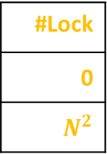
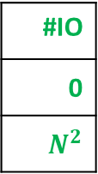
Prioritizing Scale-Testing
Map our data structures to loops using data-flow
Priority | Method
? | sendToEndpoints
? | applyStateLocally
Complexity
2
2
#IO
0
$$N^{2}$$
#Lock
0
$$N^{2}$$
Create inter-procedural call graphs for all methods
applyStateLocally
sendToEndpoints
Prioritize harmful scalability bottlenecks
Priority | Method
1 | applyStateLocally
2 | sendToEndpoints
…

Slide 19
Outline
Introduction
SFind
STest
Evaluations and Conclusions

Slide 20


Democratizing Large Scale Testing with STest
Priority | Method
1 | applyStateLocally
Many Challenges!!!
…
Memory Overhead
…
Context switching
CPU intensity
Network Overhead
TestApplyStateLocally.java
Bad modularity
public void testApplyStateLocally(…){
//…
}

Slide 21

Try #1: Naïve Packing (NP)
Deploy nodes as processes in a single machine
  One process = one node = one system’s instance
Main challenges
  Per node runtime overhead
  Process context switching
    Event Lateness (e.g send message)
Max Colocation factor: 50 nodes
Expected: Msg every second
…
Observed: Msg every 2 seconds
Node 1
Node 2
Node…
Prohibits large scale-testing!

Slide 22

Try #2: Single Process Cluster (SPC)
Deploy nodes as processes threads in a single process
Challenges
  Lack of modularity (e.g. bad design patterns)
    Automatic per-node isolation (e.g. ClassLoader isolation)
  Large amount of threads
    Simplify inter-node communication
Max Colocation factor: 120 nodes
Node 2’s msg queue
send
recv
…
…
…
Node 1
Node 2
Node…

Slide 23
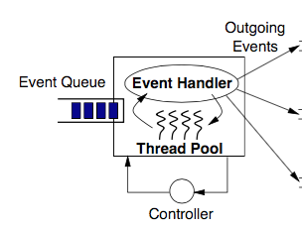
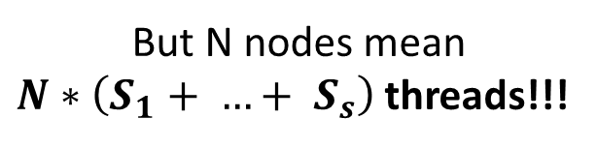

Per-Node Services
Frequent Design pattern
  Service = worker pool + event queue
But N nodes mean
$N∗\left(S_{1}+ …+ S_{s}\right)$ threads!!!
…
service
Node

Slide 24
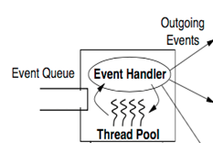
Try #3: Global Event Driven Architecture (GEDA)
One global event handler per service
  total # of threads = # of cores
Identify event constrains
  Multi-threaded versus single-threaded
Max Colocation factor: 512 nodes
Global event handler
Node 1
…
Node 2
…
enforce serial processing

Slide 25
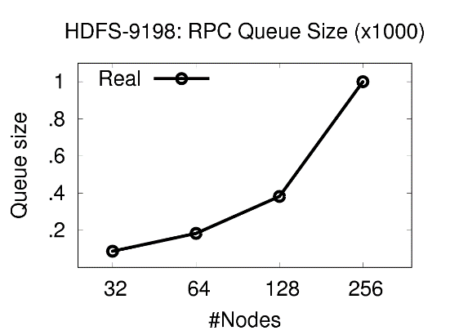

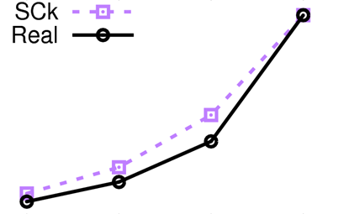
Using our Framework for HDFS-9188
RPC Queue full = no other request can be served
Accurate!
Namenode’s
RPC Queue
Datanodes
IBR
processed in serial
N = 32
N = 64
N = 128
Max size = 1000
FULL!
N = 256

Slide 26

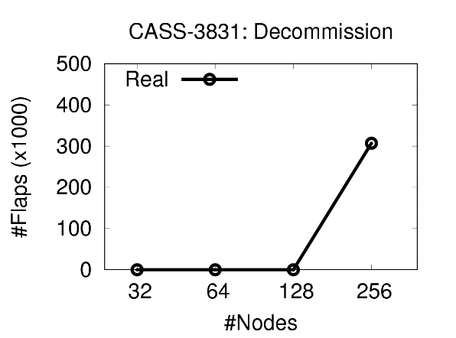
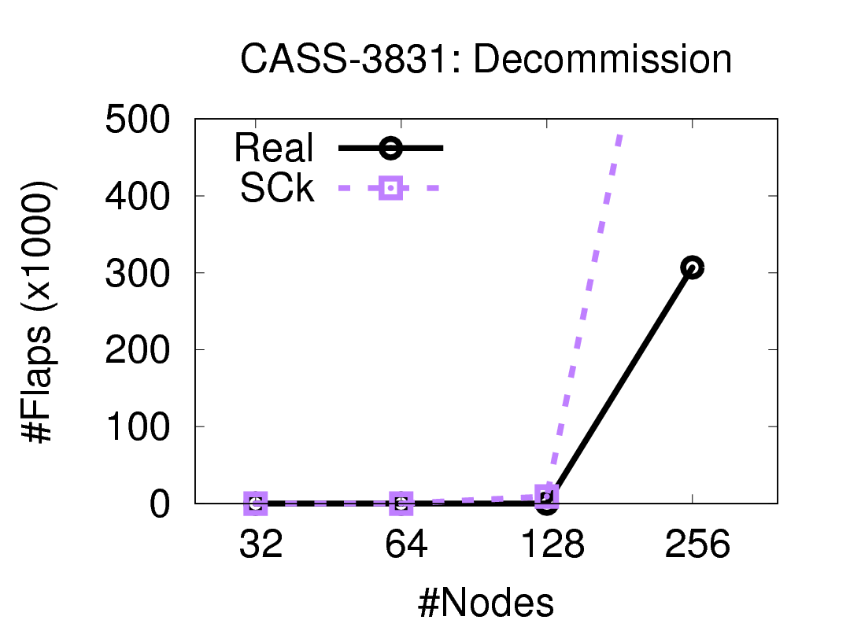
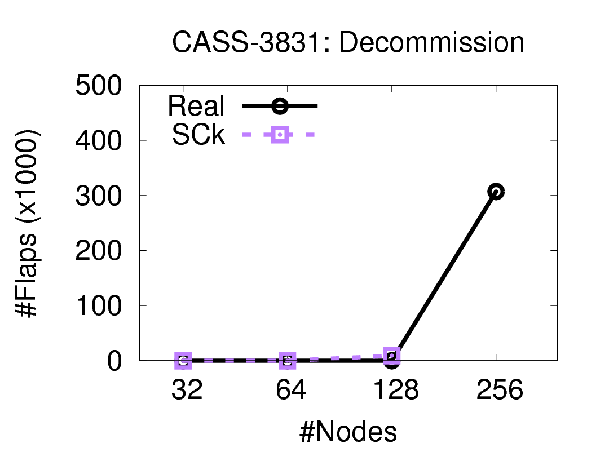

But Meanwhile in CASS-3831…
Inaccurate!

Slide 27


CPU Contention…
Try #4: Processing Illusion (PIL)
Replace CPU intensive computation with sleep
“The key to computation is the execution time and eventual output”
What code blocks can be safely replaced by sleep?
In every node
$$O(N^{3})$$
In every node
$$O(1)$$

Slide 28


(Easy) CPU intensive blocks
Can be PILed…
Non pertinent operations that do not affect processing semantics
function intense()
if(!ScaleCheck){
for(…){
for(…){
for(…){
write(“hello!”);
}
}
}
} else {
t = getTime(…)
sleep(t)
}
function intense()
for(…){
for(…){
for(…){
write(“hello!”);
}
}
}
$$O(N^{3})$$
Offline profiling
$$O(1)$$

Slide 29

(Hard) CPU intensive blocks
Can be PILed…
Pertinent operations that affect processing semantics
function relevantAndRelevant(input)
if(!ScaleCheck){
for(…){
for(…){
for(…){
modifyClusterState(…)
}
}
}
}
else{
t, output = getNextState(input)
sleep(t)
clusterState = output
}
function relevantAndRelevant(input)
for(…){
for(…){
for(…){
modifyClusterState(…)
}
}
}
$$O(N^{3})$$
Offline/Online memoization

Slide 30
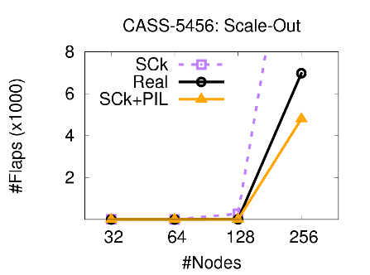
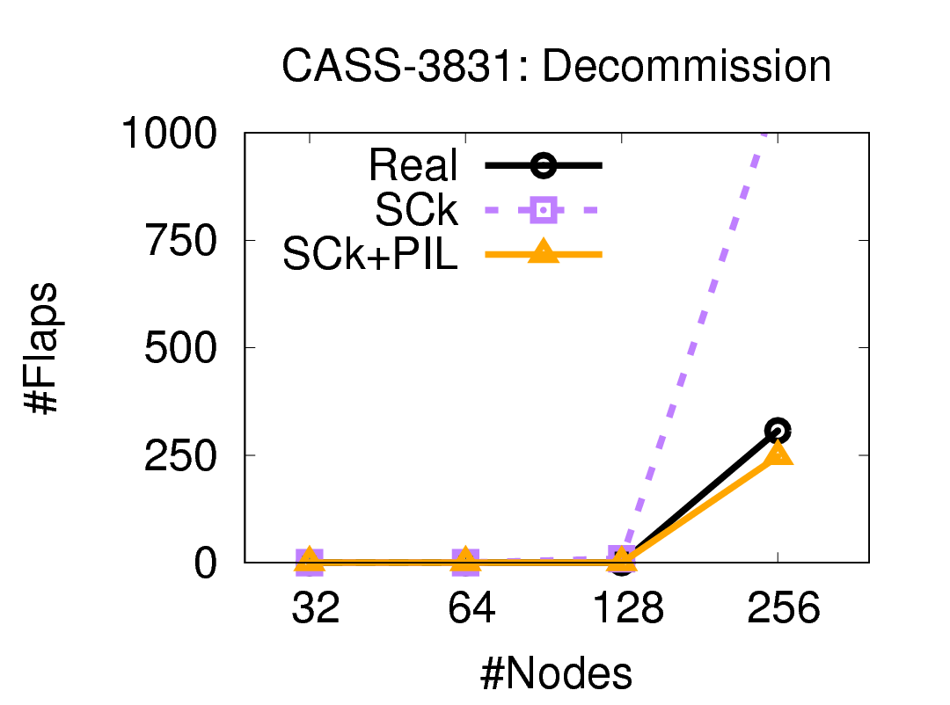
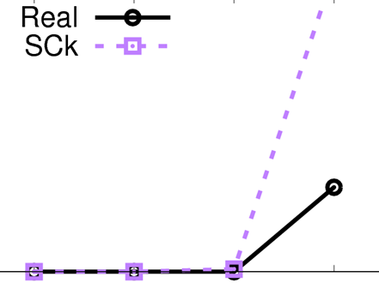

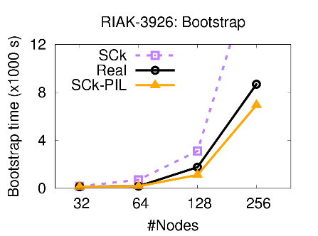
How about now?

Slide 31
Outline
Introduction
SFind
STest
Evaluations and Conclusions

Slide 32
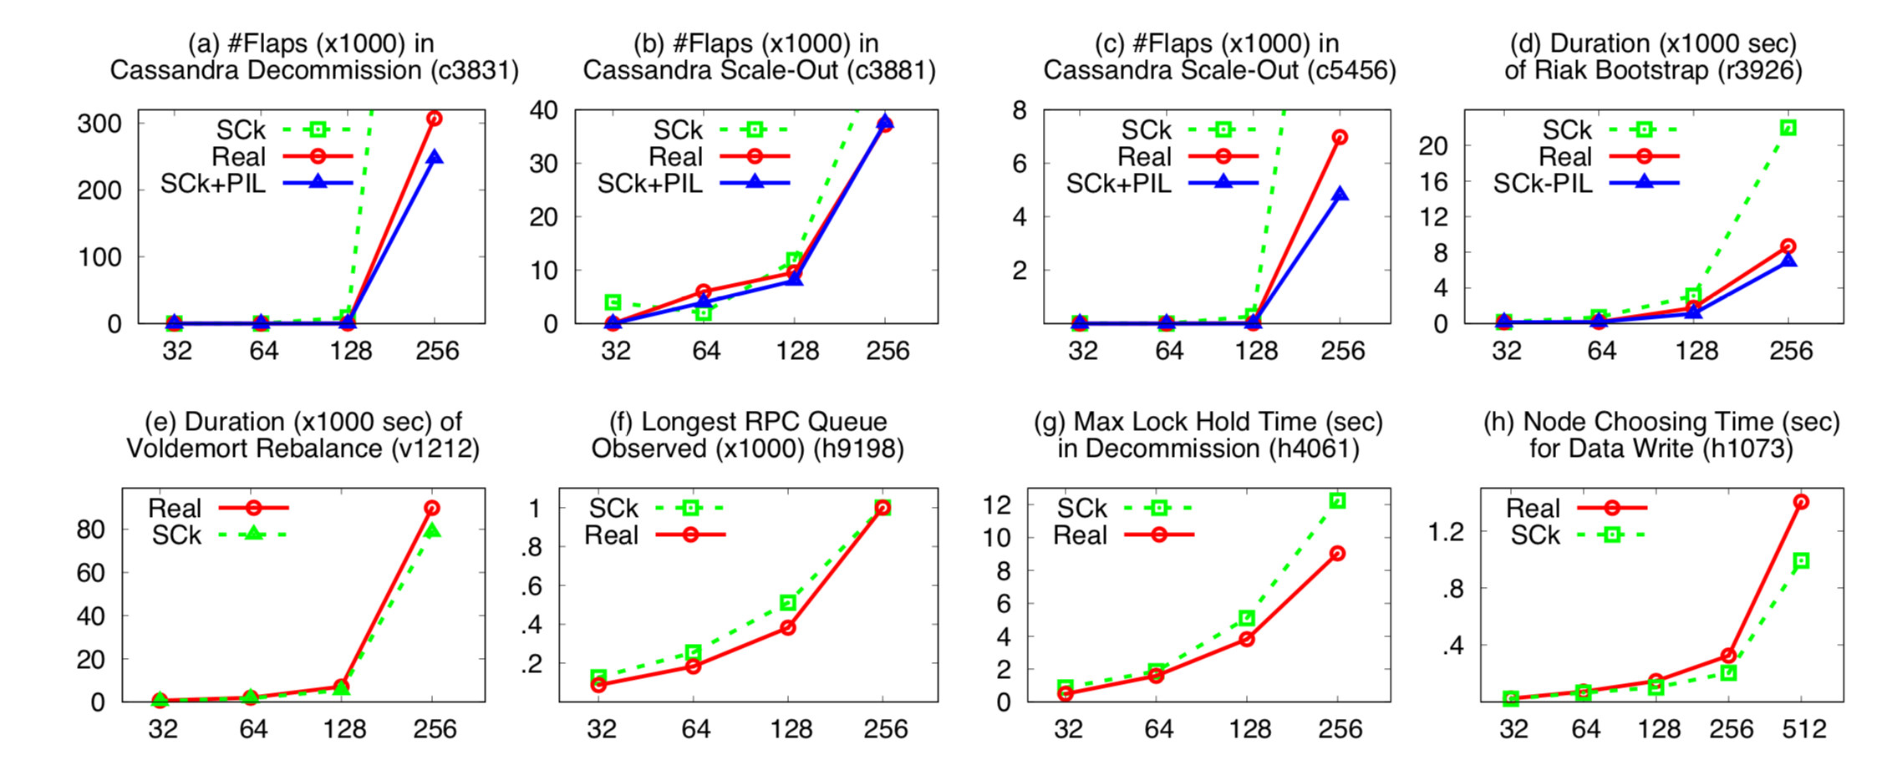
Reproducing 8 known bugs accurately
[see paper for details]

Slide 33
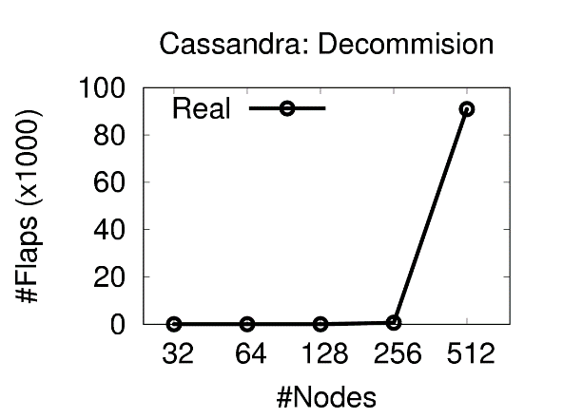



Finding New Bugs
Meanwhile in latest Cassandra…
$$O(N^{3})$$
applyStateLocally
$O\left(N\right)$ IO
$O(N)$ Lock

Slide 34
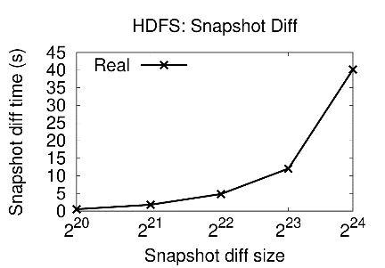
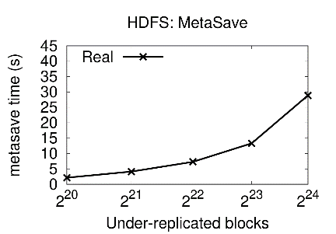
Finding New Bugs

Slide 35
Colocation Factor
How many nodes can we colocate in a single machine maintaining accuracy?
512
+PIL
Need all techniques for a high colocation factor
+GEDA
+NetStub
+SPC
256
Naive
128
64
Cassandra
HDFS
Voldemort
decommission
IBR
rebalance

Slide 36
Limitations and Future Work
Focus on scale dependent CPU/Processing time
  E.g. cluster size, number of files, etc…
  Scale of load, Scale of failure
Colocation factor limited by a single machine
  Akin to unit testing
  Multiple machines
PIL might require real scale memoization
  Offline memoization takes too long (days)
  Explore other CPU contention reduction techniques
New code = New maintenance costs
  Low cost (about 1% of code base)
  Going for zero-effort emulation

Slide 37
Conclusions ScaleCheck:
Real-scale testing
Discovering scalability bugs
Democratizing large scale testing

Slide 38



Thank you!
Questions?
http://ucare.cs.uchicago.edu
http://cs.uchicago.edu
https://ceres.uchicago.edu

