Slide 1

Fail-Slow at Scale
Evidence of Hardware Performance Faults in Large Production Systems
Haryadi S. Gunawi¹, Riza O. Suminto¹, Russell Sears², Casey Golliher², Swaminathan Sundararaman³, Xing Lin⁴, Tim Emami⁴, Weiguang Sheng⁵, Nematollah Bidokhti⁵, Caitie McCaffrey⁶, Gary Grider⁷, Parks M. Fields⁷, Kevin Harms⁸, Robert B. Ross⁸, Andree Jacobson⁹, Robert Ricci¹⁰, Kirk Webb¹⁰, Peter Alvaro¹¹, H. Birali Runesha¹², Mingzhe Hao¹, Huaicheng Li¹
1
2
3
4
5
6
7
8
9
10
11
12

Slide 2
1st anecdote
Slow hardware!
fail-stop
fail-partial
fail-transient
“…a 1Gb NIC card on a machine that suddenly only transmits at 1 kbps,
this slow machine caused a chain reaction upstream
in such a way that the 100 node cluster began to crawl at a snail's pace.”
Cascading
impact!

Slide 3
More anecdotes? All hardware?
Disk throughput dropped to 100 KB/s due to vibration
SSDs stalled for seconds due to firmware bugs
Memory cards degraded to 25% speed due to a loose NVDIMM connection
CPUs ran in 50% speed due to lack of power

Slide 4
Fail-slow Hardware
Hardware that is still running and functional but in a degraded mode, significantly slower than its expected performance
In existing literature:
  “fail-stutter” [Arpaci-Dusseau(s), HotOS ’11]
  “gray failure” [Huang et al. @ HotOS ’17]
  “limp mode” [Do et al. @ SoCC ’13, Gunawi et al. @ SoCC ’14, Kasick et al. @ FAST ’10]
  (But only 8 stories per paper on avg. and mixed with SW issues)

Slide 5






Believe it?
Let’s write a paper together
Yes, it’s real!
Fail-slow hardware is “not” real.
It is rare.

Slide 6
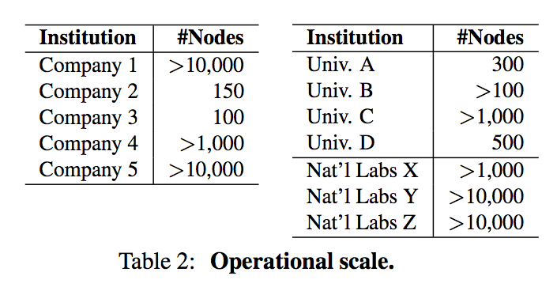
Evidences from …
Fail-slow
at
scale

Slide 7
Data and Methodology
101 reports
  Unformatted text
  Written by engineers and operators (who still remember the incidents)
  2000-2017 (mostly after 2010)
  Limitations and challenges:
    No hardware-level performance logs [in formatted text]
    No large-scale statistical analysis
Methodology
  An institution reports a unique set of root causes
    “A corrupt buffer that slows down the networking card (causing packet loss and retransmission)”
    Counted as 1 report from the institution (although might have happened many times)

Slide 8
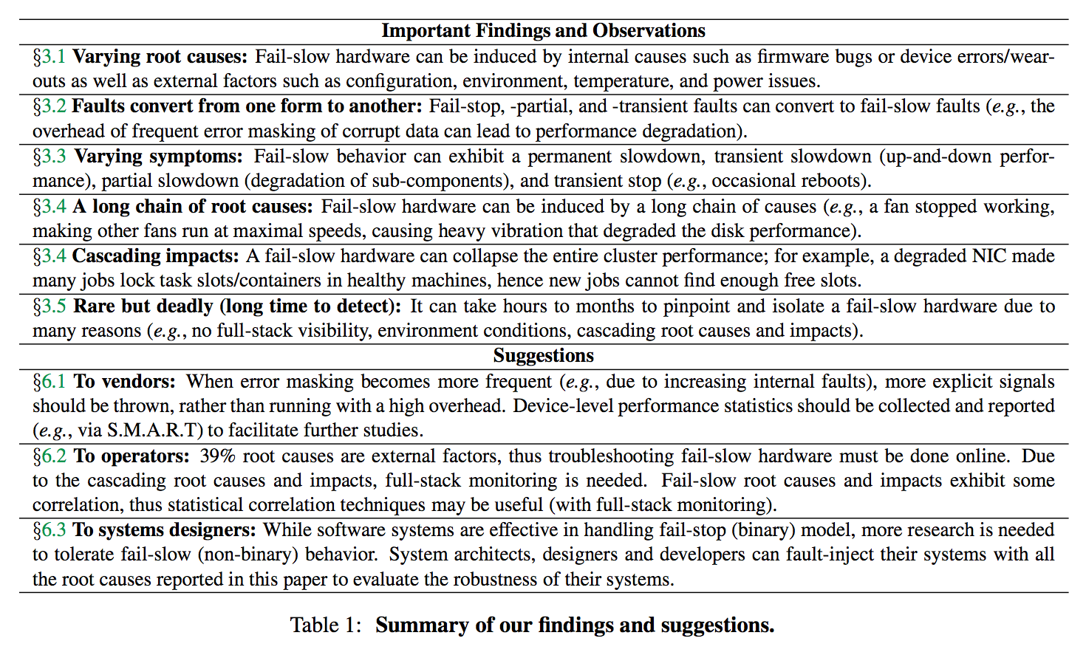

Slide 9
Summary of findings
Varying root causes
  Internal causes: firmware bugs, device errors
  External causes: temperature, power, environment, and configuration
Faults convert
  Fail-stop, -partial, -transient → fail-slow
Varying symptoms
  Permanent, transient, and partial slowdown, and transient stop
Cascading nature
  Cascading root causes
  Cascading impacts
Rare but deadly
  Long time to detect (hours to months)

Slide 10
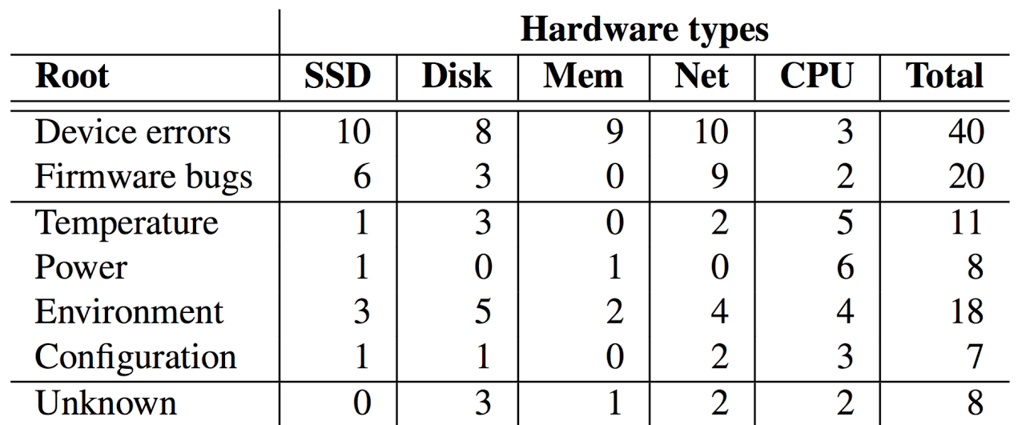
Varying root causes
Internal
root
causes
External
root
causes

Slide 11

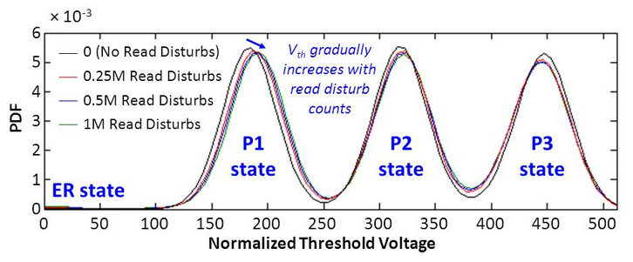

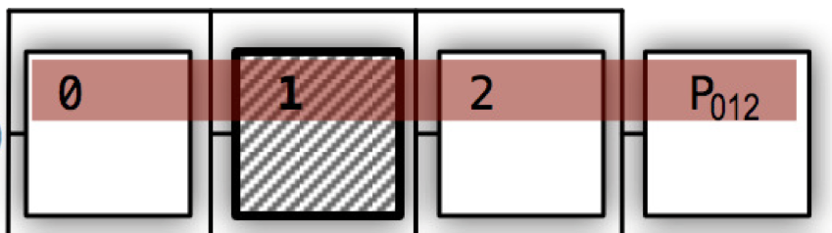

Varying root causes
  Internal
    Device errors/wearouts
      Ex: SSD read disturb/retry + page reconstruction → longer latency and more load
read p0
read p1
read p2
read P012
Voltage shift
read retries!
read p0
read p2
read P012
read p0
read p2
read P012
ECC
error
Picture from http://slideplayer.com/slide/10095910/
read(page X, Vth=v1)
read(page X, Vth=v2)
read(page X, Vth=v3)
read(page X, Vth=v4)
RAIN: Redundant Array of Independent NAND
4x slower!

Slide 12
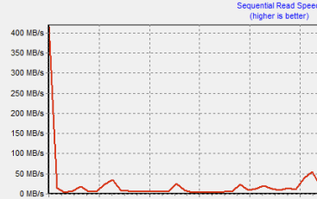
Varying root causes
  Internal
    Device errors
    Firmware bugs
      [No details, proprietary component]
      SSD firmware bugs throttled μs to ms read performance
      Another example: 840 EVO firmware bugs [2014]
Throughput collapse
https://www.anandtech.com/show/8550/samsung-acknowledges-the-ssd-840-evo-read-performance-bug-fix-is-on-the-way

Slide 13
Varying root causes
  Internal Device errors and firmware bugs [More details in paper]
SSD | Disk | Memory | Network | Processors
Firmware bugs (us to ms read performance, internal metadata writes triggering assertion); Read retries with different voltages; RAIN/parity-based read reconstruction; Heavy GC in partially-failing SSD (not all chips are created equal); Broken parallelism by suboptimal wear-leveling; Hot temperature to wear-outs, repeated erases, and reduced space; Write amplification. | Firmware bugs (jitters, occasional timeouts, read retries, read-after-write mode); Device wearouts (disabling bad platters); Weak heads (gunk/dust accumulates between disk heads and platters); and other external factors such as temperature and vibration. | Address errors causing expensive ECC checks and repairs; Reduced space causing more cache hits; Loose NVDIMM connection; SRAM control-path errors causing recurrent reboots (transient stop). | Firmware bugs (buggy routing algorithm, multicast bad performance); NIC driver bugs; buggy switch-NIC auto-negotiation; Starving from electrons (bad design specification); bad VSCEL laser; Bitflips in device buffer; Loss packets cause TCP retries and collapse. | Buggy BIOS firmware down-clocking CPUs; Other external causes such as hot temperature and lack of power.

Slide 14


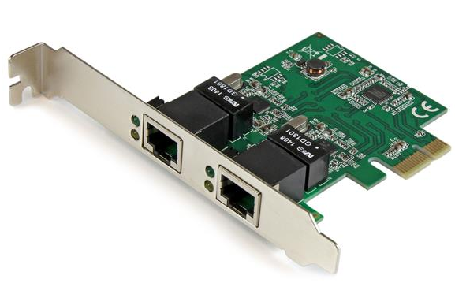



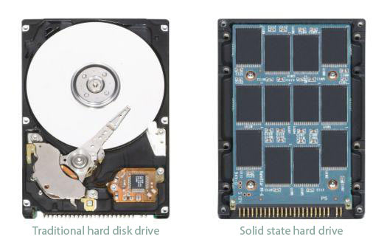

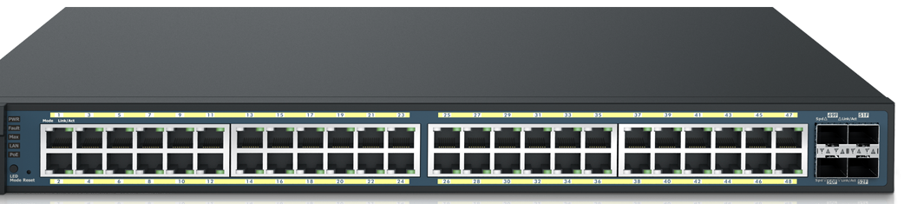

Varying root causes
  Internal [Device errors, firmware bugs]
  External
    Temperature
Slower disk performance
at bottom of the rack
(read-after-write mode)
Hot temperature
→ Corrupt packets
→ Heavy TCP retransmission
Faster SSD
wearouts,
bad Vth →
more read retries
Cold-air-under-the-floor system

Slide 15
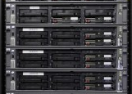
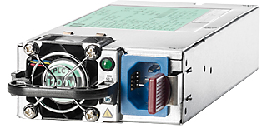
Varying root causes
  Internal [Device errors, firmware bugs]
  External
    Temperature
    Power
100%
100%
100%
100%
50%
50%
50%
50%
throttled
Power-hungry
throttled
throttled
4 machines, 2 power supplies
Power-hungry applications →
throttling neighboring CPUs
1 dead power → 50% CPU speed

Slide 16
Varying root causes
  Internal [Device errors, firmware bugs]
  External
    Temperature
    Power
    Environment
      Altitude, pinched cables, etc.
    Configuration
      A BIOS incorrectly downclocking CPUs of new machines
      Initialization code disabled processor cache

Slide 17
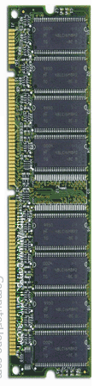
Varying root causes Device errors, firmware, temperature, power, environment, configuration
Faults convert
  Fail-transient → fail-slow
read
Bit flips →
ECC repair
(error masking)
Okay if rare
But, frequent errors
frequent error-masking/repair
repair latency becomes the common case

Slide 18
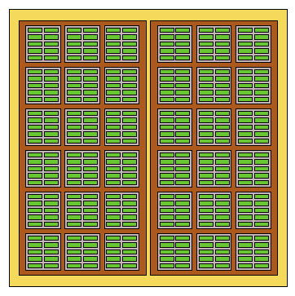
Varying root causes Device errors, firmware, temperature, power, environment, configuration
Faults convert
  Fail-transient → fail-slow
  Fail-partial → fail-slow
SSD Internals
Aggregate
exposed space (e.g. 1 TB)
“Not all chips are created equal”
(some chips die faster)
Overprovisioned space
Reduced
overprovisioned space
Fail-partial
Reduced overprovisioned space
More frequent GCs → Slow SSD
Picture from https://flashdba.com/2014/06/20/understanding-flash-blocks-pages-and-program-erases/

Slide 19
Varying root causes Device errors, firmware, temperature, power, environment, configuration
Faults convert
  Fail-transient → fail-slow
  Fail-partial → fail-slow
Exposed space
X GB
Fail-
partial
<
X GB
Custom memory chips that mask (hide) bad addresses
<<
X GB
Higher
cache misses
(fail-slow)

Slide 20
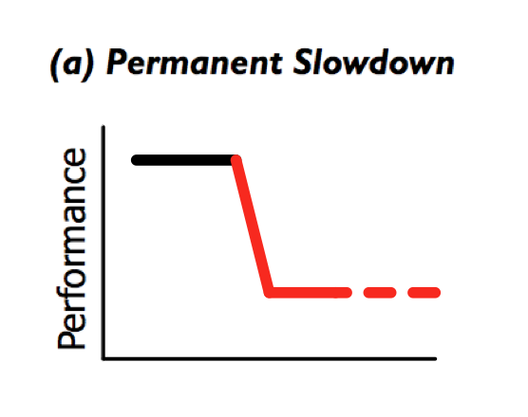
Varying root causes Device errors, firmware, temperature, power, environment, configuration
Faults convert Fail-stop, -transient, -partial → fail-slow
Varying symptoms
  Permanent slowdown
Time

Slide 21
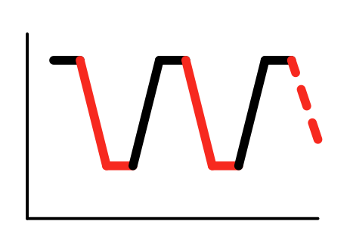

Varying root causes Device errors, firmware, temperature, power, environment, configuration
Faults convert Fail-stop, -transient, -partial → fail-slow
Varying symptoms
  Permanent slowdown
  Transient slowdown
CPU performance
Disk performance
Vibration

Slide 22
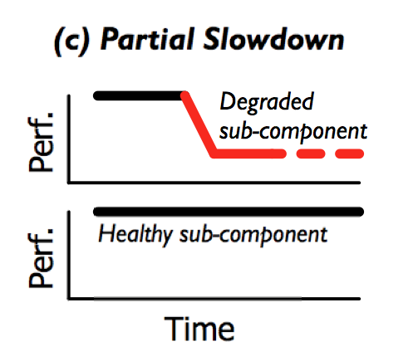
Varying root causes Device errors, firmware, temperature, power, environment, configuration
Faults convert Fail-stop, -transient, -partial → fail-slow
Varying symptoms
  Permanent slowdown
  Transient slowdown
  Partial slowdown
Slow
reads
(ECC repairs)
Small packets (fast)
>1500-byte packets (very slow)
[Buggy firmware/config related to jumbo frames]
Fast
reads

Slide 23
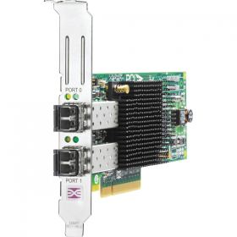

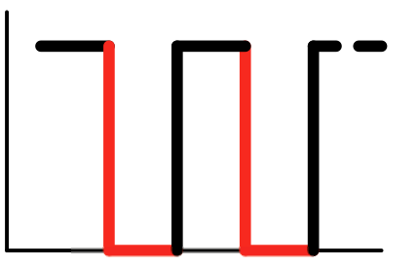
Varying root causes Device errors, firmware, temperature, power, environment, configuration
Faults convert Fail-stop, -transient, -partial → fail-slow
Varying symptoms
  Permanent slowdown
  Transient slowdown
  Partial slowdown
  Transient stop
A bad batch of SSDs “disappeared” and then reappeared
A firmware bug triggered hardware assertion failure
Host Bus Adapter recurrent resets
Uncorrectable bit flips in SRAM control paths
Time

Slide 24



Varying root causes Device errors, firmware, temperature, power, environment, configuration
Faults convert Fail-stop, -transient, -partial → fail-slow
Varying symptoms Permanent, transient, partial slowdown and transient stop
Cascading nature
  Cascading root causes
Bad disks? No!
One died
Fans
normal
speed
Noise and
vibration
Other fans
maximum speed
Disk throughput collapses to KB/s

Slide 25

Varying root causes Device errors, firmware, temperature, power, environment, configuration
Faults convert Fail-stop, -transient, -partial → fail-slow
Varying symptoms Permanent, transient, partial slowdown and transient stop
Cascading nature
  Cascading root causes
  Cascading impacts e.g. in Hadoop MapReduce
A fast map task
(read locally)
All reducers are slow
(“no” stragglers → no Speculative Execution)
R1
R3
M1
Use (lock-up) task slots in
healthy machines for a long time
Slow
NIC
Shuffle
R2
Eventually no free task slots
→ Cluster collapse
Slow!!

Slide 26
Varying root causes Device errors, firmware, temperature, power, environment, configuration
Faults convert Fail-stop, -transient, -partial → fail-slow
Varying symptoms Permanent, transient, partial slowdown and transient stop
Cascading nature
  Cascading root causes
  Cascading impacts
Facebook Hadoop Jobs, 30 nodes
with 1 slow NIC
~170 jobs/hour
1 job/hour !!!
[From PBSE @ SoCC ’17]

Slide 27
Varying root causes Device errors, firmware, temperature, power, environment, configuration
Faults convert Fail-stop, -transient, -partial → fail-slow
Varying symptoms Permanent, transient, partial slowdown and transient stop
Cascading nature
Rare but deadly
  13% detected in hours
  13% in days
  11% in weeks
  17% in months
  (50% unknown)
Why?
External causes and cascading nature (vibration→slow disk); offline testing passes
No full-stack monitoring/correlation hot temperature → slow CPUs → slow Hadoop → debug Hadoop logs?
Rare? Ignore?

Slide 28
Varying root causes Device errors, firmware, temperature, power, environment, configuration
Faults convert Fail-stop, -transient, -partial → fail-slow
Varying symptoms Permanent, transient, partial slowdown and transient stop
Cascading nature
Rare but deadly
+
Suggestions to vendors,
operators, and systems designers

Slide 29

Varying root causes Device errors, firmware, temperature, power, environment, configuration
Faults convert Fail-stop, -transient, -partial → fail-slow
Varying symptoms Permanent, transient, partial slowdown and transient stop
Cascading nature
Rare but deadly
Conclusion:
Modern, advanced systems
+ Fail-slow hardware
Thank you!
Questions?

Slide 30
EXTRA

Slide 31
Suggestions
To vendors:
  Make the implicits explicit
    Frequent error masking → hard errors
  Record/expose device-level performance statistics
To operators:
  Online diagnosis
    (39% root causes are external)
  Full-stack monitoring
  Full-stack statistical correlation
To systems designers:
  Make the implicits explicit
    Jobs retried “infinite” time
  Convert fail-slow to fail-stop? (challenging)
  Fail-slow fault injections

Slide 32
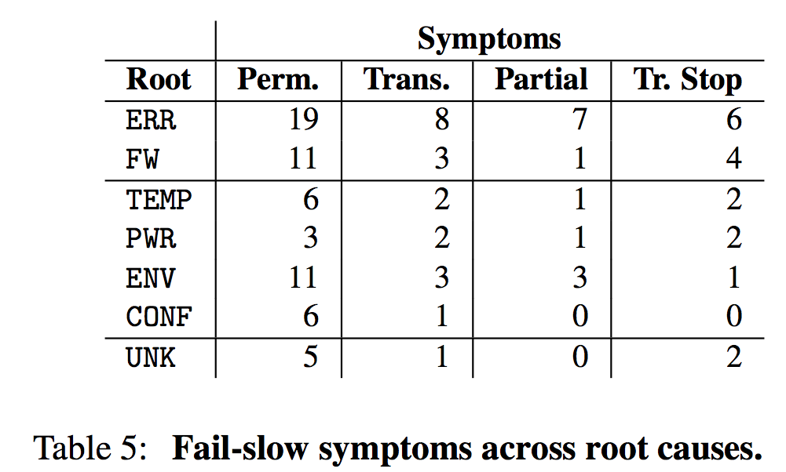
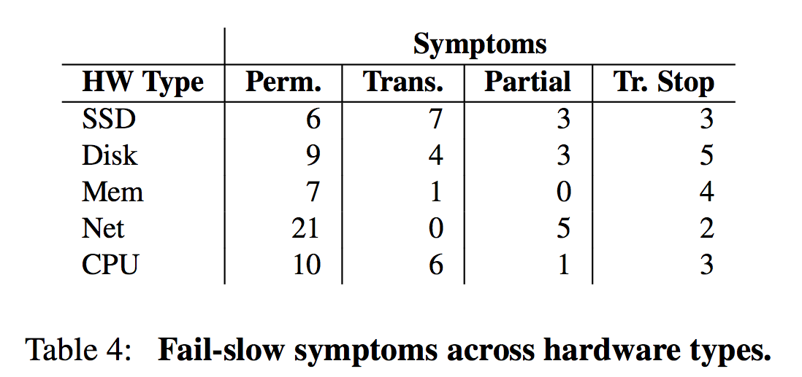

Slide 33

Operators
Cannot use application bandwidth check (all are affected)
Hadoop, not fully tail/limpware tolerant??
Facebook Hadoop Jobs, 30 nodes
~170 jobs/hour
1 job/hour !!!

Slide 34
Varying root causes Device errors, firmware, temperature, power, environment, configuration
Faults convert
  Fail-stop → fail-slow
    Fail-stop power → fail-slow CPUs
    Fail-stop disk → fail-slow RAID
Fail-slow
Fail-stop
100%
100%
100%
100%
50%
50%
50%
50%

