Slide 1






FlyMC:
Highly Scalable Testing of Complex Interleavings in Distributed Systems
Jeffrey F. Lukman, Huan Ke, Cesar Stuardo, Riza Suminto, Daniar Kurniawan, Dikaimin Simon¹, Satria Priambada²,
Chen Tian³, Feng Ye³, Tanakorn Leesatapornwongsa⁴,
Aarti Gupta⁵, Shan Lu, and Haryadi Gunawi
¹
²
³
⁴
⁵

Slide 2
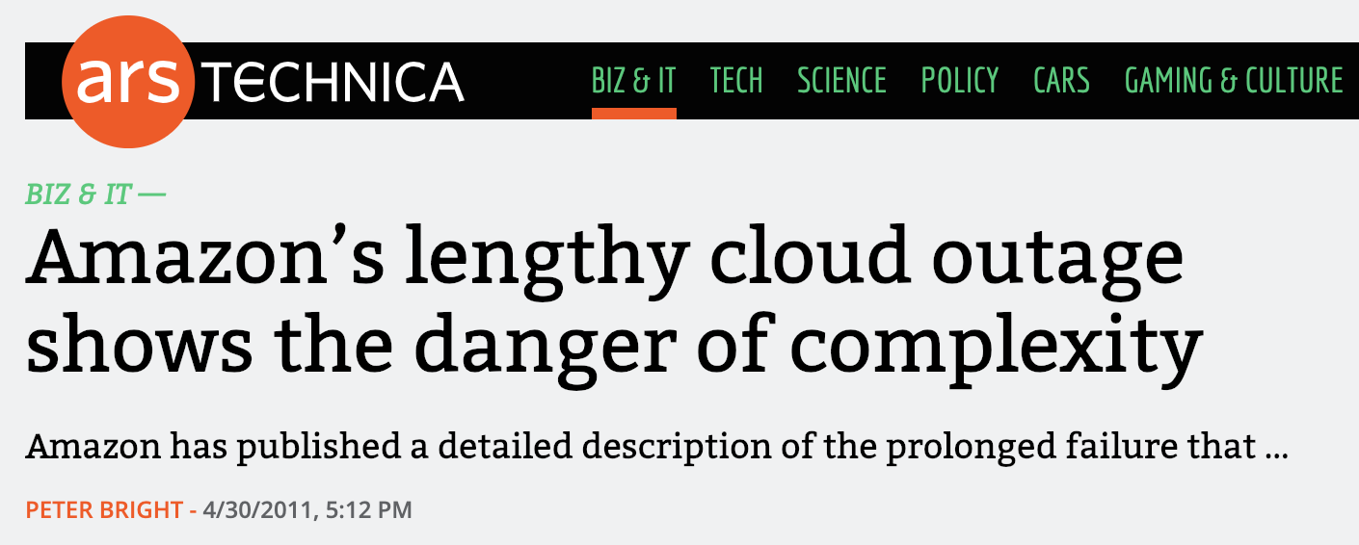
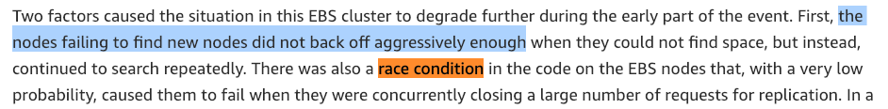
Distributed System Outages
Distributed Concurrency Bug

Slide 3

Distributed Concurrency Bug
Caused by non-deterministic timing of concurrent events involving multiple nodes
Events: Messages, crashes, reboots, timeouts, local computations
Data loss, downtimes,
inconsistent replicas,
hanging jobs, etc.

Slide 4
Let’s look at a simple dist. conc. bug pattern,
Msg-Msg Race

Slide 5


Let’s look at a real complex bug,
Paxos Msg-Msg Race
Prepare #2
Commit #1
Prepare #3
Propose #2
race
race
2 pairs!!!
Workload
3 concurrent updates
  Red, blue, green

Slide 6

Another simple dist. conc. bug pattern,
Msg-Fault Timing
A
B
A
B
m₁
m₁
m₂
m₂

Slide 7

Let’s look at a real complex bug,
Msg-Fault Timing
A
B
C
1. Nodes A, B, C start (w/ latest txid id-1)
2. B becomes leader
3. B crashes
4. C becomes leader
5. C commits new txid-value pair (id, X)
6. A crashes, before committing (id, X)
7. C loses quorum and C crashes
8. A and B are back online
9. A becomes leader
10. A's commits new txid-value pair (id, Y)
11. C is back online
12. C announces to B (id, X)
13. B replies the diff from tx 8
14. Inconsistency: A and B say “Y”, C says “X”
F
L
F
F
L
x
F
L
x
L
x
x
L
F
y
y
x
L
F
y
y
x
Result: Permanently inconsistent replicas
L
F
F

Slide 8

Msg-Fault Timing
1. Nodes A, B, C start (w/ latest txid id-1)
2. B becomes leader
3. B crashes
4. C becomes leader
5. C commits new txid-value pair (id, X)
6. A crashes, before committing (id, X)
7. C loses quorum and C crashes
8. A and B are back online
9. A becomes leader
10. A's commits new txid-value pair (id, Y)
11. C is back online
12. C announces to B (id, X)
13. B replies the diff from tx 8
14. Inconsistency: A and B say “Y”, C says “X”
1. Out-of-order messages
2. Multiple crashes
Specific Order
3. Multiple reboots
How to unearth these complex bugs?
HAPPEN IN
ANY ORDER
Result: Permanently inconsistent replicas

Slide 9

Dev’s discussion on Dist. Conc. bugs
“Do we have to rethink this entire [HBase] root and meta ’huh hah’? There isn’t a week going by without some new bugs about races between splitting and assignment [distributed protocols].” — HBase #4397
“That is one monster of a race!” — MapReduce #3274
“This has become quite messy, we didn’t foresee some of this [message races] during design, sigh.” — MapReduce #4819
It’s hard to unearth
conc. bugs!

Slide 10
Unearth Dist. Conc. bugs?
Key: Re-order events!
Software/Impl-Level Model Checking
(Checker)
Popular Checkers:
MaceMC [NSDI’07]
MoDist [NSDI’09]
CrystalBall [NSDI’09]
dBug [SSV’10]
Demeter [SOSP’13]
SAMC [OSDI’14], etc.

Slide 11
Here is how it works,
Checker
Intercept!
Node 1
Node 2
Inflight messages:
[a, b, c]
[a, b, c, d]
a
enable (d)
To-explore paths:
b
_{- abdc}
_{- bacd}
_{- acbd}
_{- badc}
_{- …}
_{- …}
c
d
Control Event Timing
Checker

Slide 12

Checker
In reality, millions/billions
of paths
1. Nodes A, B, C start (w/ latest txid id-1)
2. B becomes leader
3. B crashes
4. C becomes leader
5. C commits new txid-value pair (id, X)
6. A crashes, before committing (id, X)
7. C loses quorum and C crashes
8. A and B are back online
9. A becomes leader
10. A's commits new txid-value pair (id, Y)
11. C is back online
12. C announces to B (id, X)
13. B replies the diff from tx 8
14. Inconsistency: A and B say “Y”, C says “X”
3
4
1
5
2
6
7
8
9
12
11
10
14
13
2
7
1
4
5
6
3
8
11
10
9
12
14
13
6
9
3
4
5
1
7
8
2
10
11
13
12
14
1
2
3
4
5
6
7
8
9
10
11
12
13
14
2
1
3
4
5
7
6
8
9
10
11
14
12
13
Path/state-space explosion problem
Specific order of events
Path
#1
#2
#3
#4
#5
#…
Goal: Unearth buggy paths!

Slide 13
Challenge
Reduction Algorithms!
Reduction algorithms!
#Paths To Evaluate By Each Checker
> millions of paths
> millions of paths
> millions of paths
> millions of paths
~100 of paths
> millions of paths
12 paths
~500 paths
~20,000 paths
~2000 paths
Complex workloads

Slide 14
Challenge
Path explosion problem prevails
in complex workloads
#Paths To Evaluate By Each Checker
Checker needs more advanced algorithms
The Paxos bug earlier…

Slide 15


FlyMC
Fast, Scalable, and Systematic Software Model Checker
Uniquely targeting dist. sys.
Reduction Algorithms
  State Symmetry
    Reduce symmetrical state transitions paths
  Event Independence
    Detect pair of events with disjoint/commutative updates
    Supported by static analysis
Prioritization Algorithm
  Parallel Flips
    Prioritize paths with multiple flips

Slide 16










FlyMC
Fast, Scalable, and Systematic Software Model Checker
Integrated to
8 systems
Results
  At least
  up to 78X,
  on avg 16X
  faster
  Unearth
  10 new bugs

Slide 17
Outline
Introduction
Design
  State Symmetry
  Event Independence
  Parallel Flips
Evaluation
Conclusion

Slide 18
Principles
Goal: Quickly unearth conc. bugs
Reduction Algorithm
  Reduce redundant paths
    State Symmetry
    Event Independence

Slide 19
Communication Symmetry
Reduce!
k x y l
k l x y
x y k l
Let’s reorder!
Communication Symmetry is NOT effective when messages content are unique

Slide 20
A
B
A
B
k
l
x
y
y
x
l
k
k x y l
l y x k
Other way to reduce?
No Comm.
Symmetry
Hence, reorder both paths

Slide 21
State Symmetrical!
if node.v < msg.v {
node.v = msg.v
}
(mirrored)
A
B
A
B
A | B
0 | 0
0 | 1
2 | 1
2 | 2
2 | 2
A | B
0 | 0
1 | 0
1 | 2
2 | 2
2 | 2
v=1
v=2
k
l
x
x
y
y
l
k
k x y l
l x y k
Reduce!

Slide 22
State Symmetry is great, but …
Still, many events to one node
A
B
C
n
o
p
m
Reorder 4! paths
How to reduce?

Slide 23
Let’s recap,
Dependency vs Independency
events
a,b
a,b
s₂
s₁
s₁
s₂
global
state
b,a
s₃
b,a
Reduce!
a & b = Dependent
a & b = Independent
Independent = Reduce!

Slide 24
How to apply Event Independence to Dist. Sys.?
B
B
To Explore
To Explore
p₁
r₁
r₁ r₂ r₃
p₁ cr₁ r₁
r₂
cr₁
p₁ r₁ cr₁
r₁ r₃ r₂
r₁
cr₁ p₁ r₁
r₃
r₂ r₁ r₃
cr₁ r₁ p₁
r₂ r₃ r₁
r₁ p₁ cr₁
r₃ r₁ r₂
r₁ cr₁ p₁
if r.resp {
node.v++;
}
r₃ r₂ r₁
All msgs
update
different
node states
Reduce!
Reduce!
Commutative updates
Disjoint updates

Slide 25
Principles
Goal: Quickly unearth complex conc. bugs
Reduction Algorithm
  Reduce redundant paths
    State Symmetry
    Event Independence
Prioritization Algorithm
  Prioritize paths to quickly discover new states
    Parallel Flips

Slide 26
Single Flips:
Suppose a₂ a₁ leads to ,
wait 4! paths to hit the bug

Slide 27
Parallel Flips
Yes: Parallel flips! And Prioritize!
Conc. pairs of events?
For Coverage, keep Single Flips paths in Lower Priority Queue
Different nodes?
To quickly discover
new states!

Slide 28
More details in paper
Q₁: How static analysis extract event independence?
A₁: Compare pair of events’ readSet, updateSet, IOSet, and sendSet
Q₂: Challenges in developing FlyMC algorithms?
A₂: Avoid missing necessary paths and hanging path execution
Q₃: How to speed up path execution?
A₃: Implement Local Ordering Enforcement & State-Event Caching

Slide 29
Outline
Introduction
Design
  State Symmetry
  Event Independence
  Parallel Flips
Evaluation
Conclusion

Slide 30
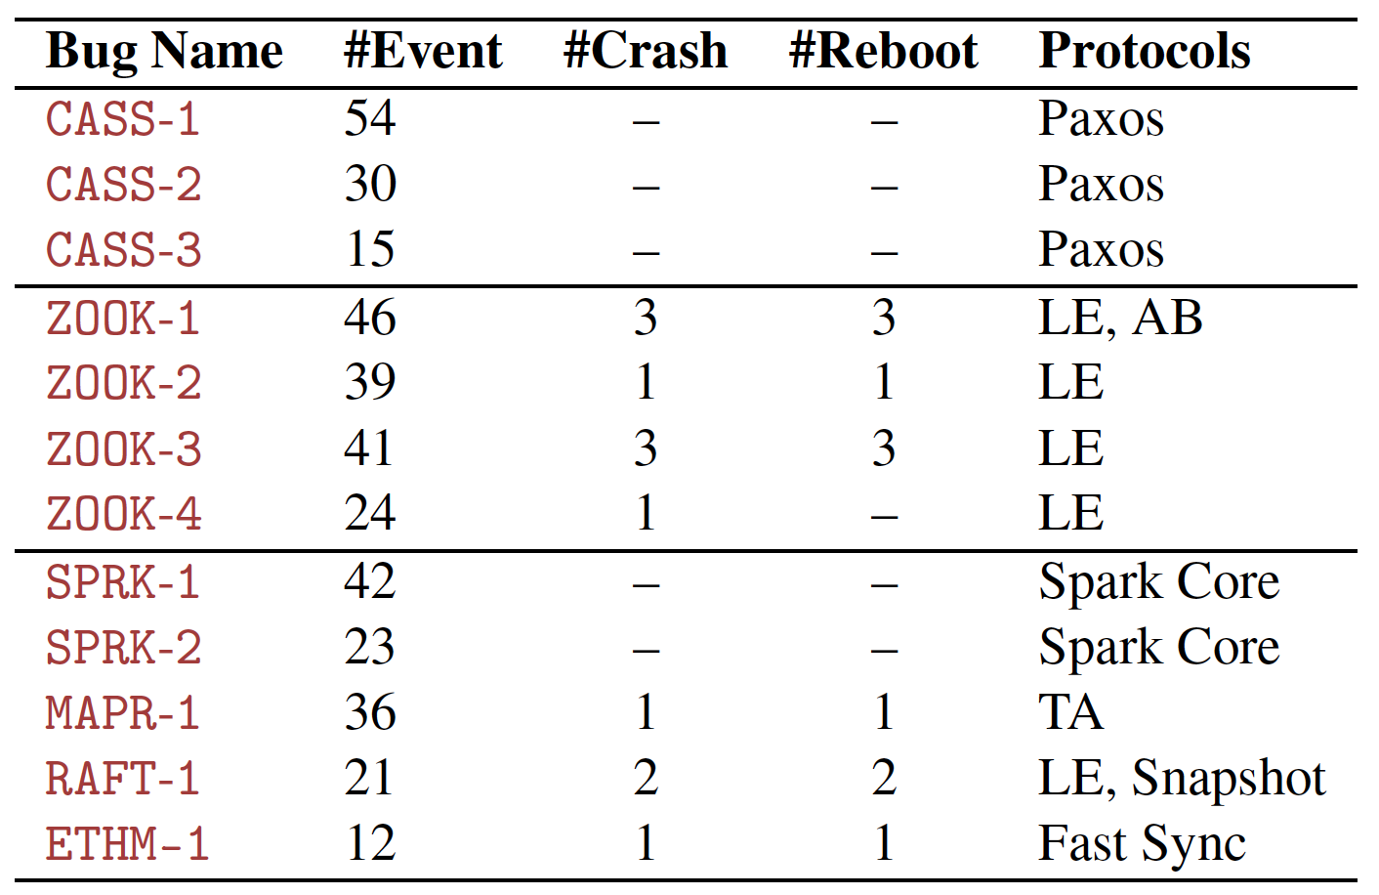
Unearthing Known Bugs
Complex workloads w/ tens of events, multiple crashes/reboots

Slide 31
Unearthing Known Bugs
Lower is
Better!
MoDist
DPOR*
SAMC^
FlyMC
Bounded
Random
DPOR*
Random
DPOR*
Bounded
DPOR*
Random
Systematic
Hybrid
[*] MoDist paper. NSDI 2007.
[^] SAMC paper. OSDI 2014.

Slide 32
MoDist
DPOR
SAMC
FlyMC
Bounded
Random
DPOR
Random
DPOR
Bounded
DPOR
Random
FlyMC
up to 78X, on avg16X faster
(at least!)
Done exploring; can’t reproduce

Slide 33


FlyMC Unearth New Bugs?
Yes!
Check Recent Stable Systems
2
Confirmed!
Cassandra
3
ZooKeeper
5
Proprietary (2 y.o.)

Slide 34

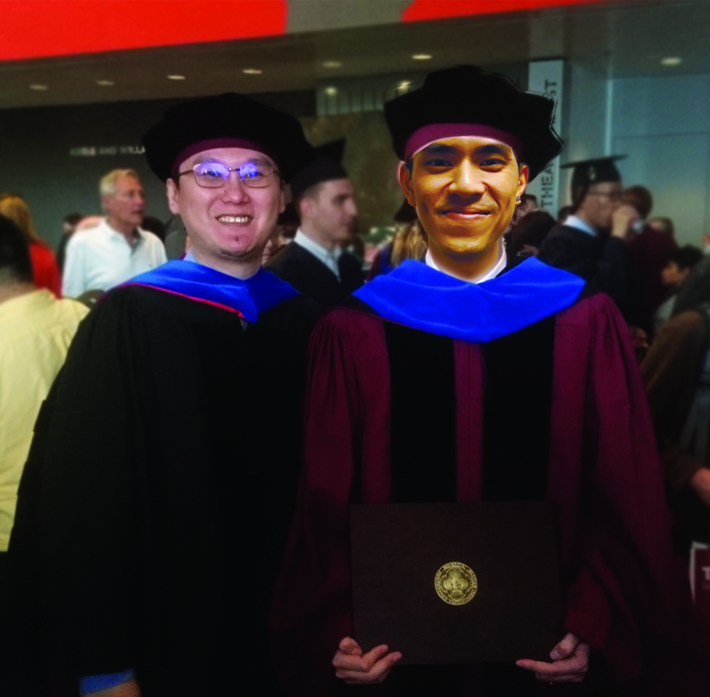

Conclusion
Graduate Next Year!
Still checking
Paxos-3 Correctness …
White hair
abcdef
bcefda
fdcabe
Without FlyMC
With FlyMC
FlyMC, a fast, scalable, and systematic
software model checker
to quickly unearth complex
dist. conc. bugs
http://ucare.cs.uchicago.edu
Thank you!
Questions?
  State Symmetry, Event Independency, Parallel Flips

