Slide 1

Layered Contention Mitigation for Cloud Storage
Meng Wang, Cesar A. Stuardo, Daniar H. Kurniawan,
Ray A. O. Sinurat, and Haryadi S. Gunawi

Slide 2
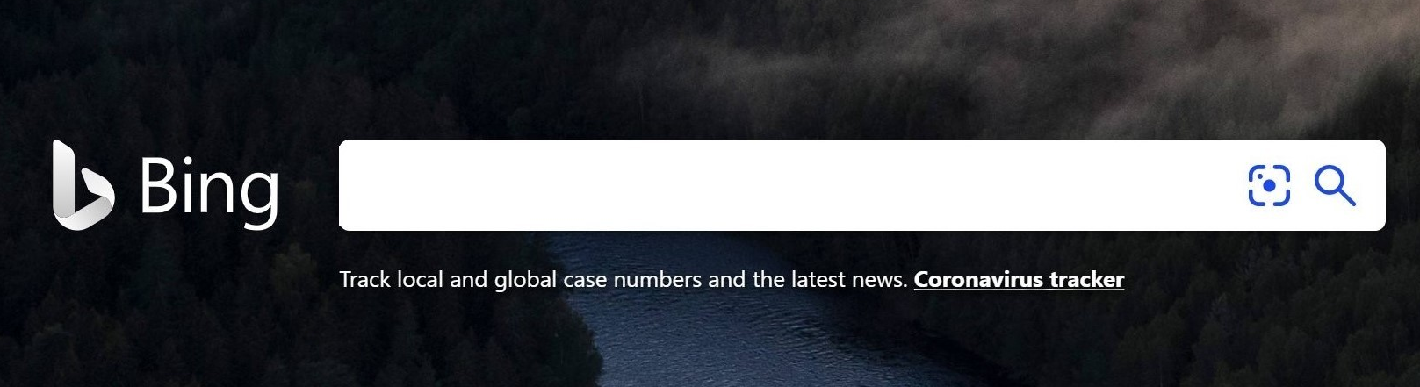
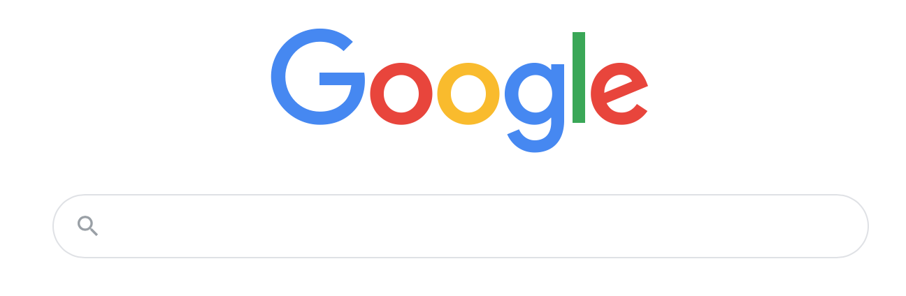
The Cost of Latency
2 Second slowdown reduced revenue/user by 4.3%
An extra 0.5 seconds in search page generation time dropped traffic by 20%.

Slide 3
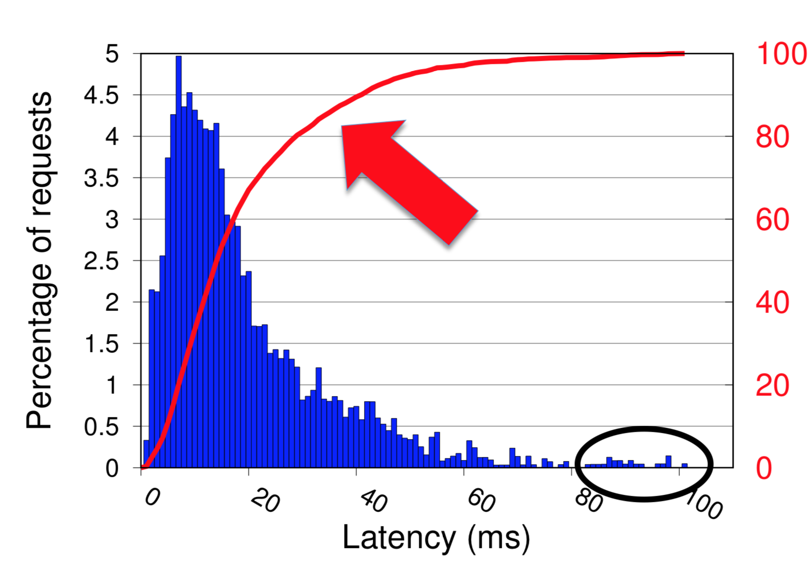
Tail Latency
A small fraction of requests can exceed the median latency by orders of magnitude.
Tail Latency!

Slide 4
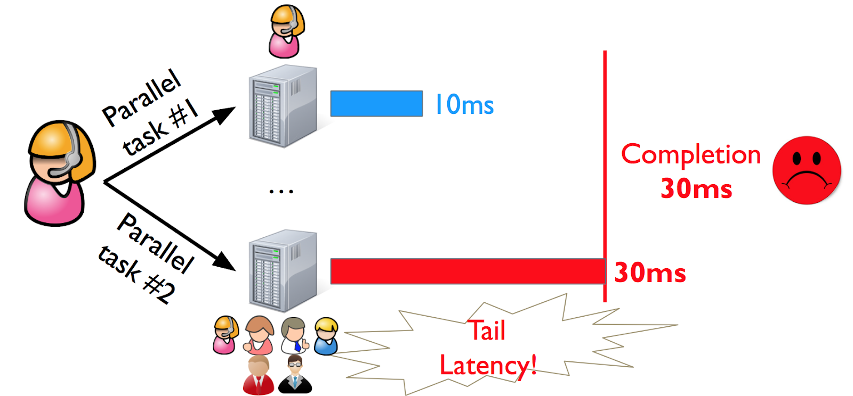
Tail Latency Matters
High degrees of parallelism
  A Facebook web request may access thousands of Memcached servers
  A Bing search may access 10,000 index servers

Slide 5

Root Cause of Tail
Resource sharing!
  Different applications run on the same machine
  Contentions for CPU, memory, lock, etc.
Library
Lock contention
AcquireLock()
Runtime
R = new Request(bytes)
Garbage Collection
R
OS
Process Contention
CPU Queue

Slide 6
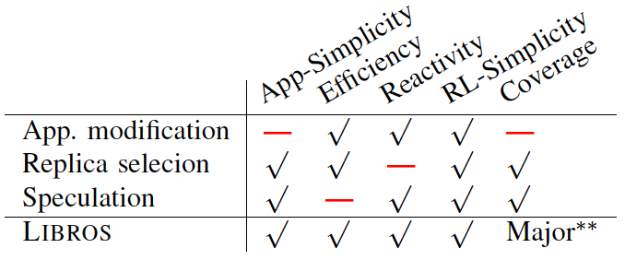
Existing Solutions
Application-level modification
Need to redesign app
No coverage outside app

Slide 7

Existing Solutions
Application-level modification
Replica selection
Not reactive
History says this replica is better

Slide 8
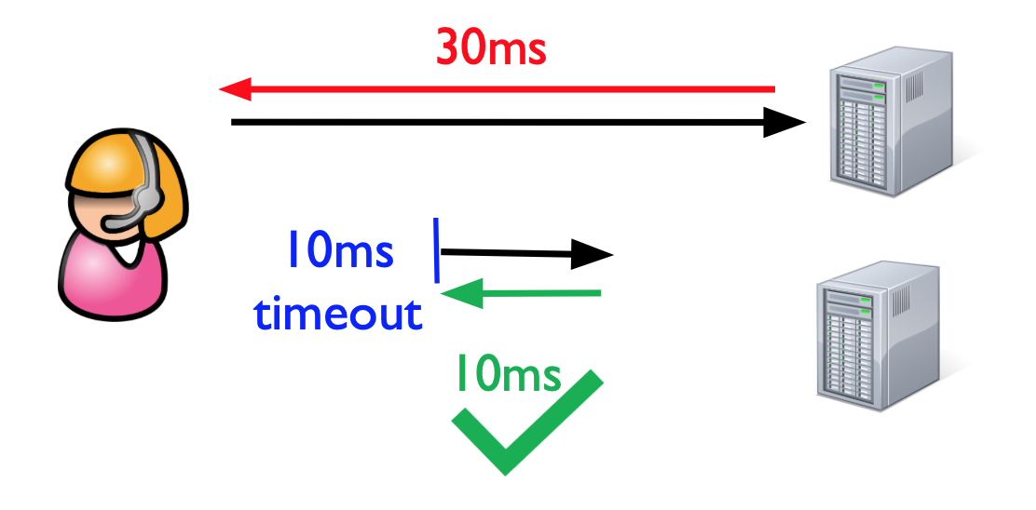
Existing Solutions
Application-level modification
Replica selection
Speculative execution
  Send the second request after a timeout
  It must wait
Not efficient enough

Slide 9
Existing Solutions
Application-level modification
Replica selection
Speculative execution
LIBROS

Slide 10
LIBROS
LIBROS: an ecosystem of contention mitigation supports from library, runtime and operating system layers
  Accurately predicts wait time for Resource
  Promptly cancels if SLO cannot be met
Library
AcquireLock()
R
Runtime
R = new Request(bytes)
OS
if remDL > predDelay()
continue
else
cancel
R.deadline(DL)
R.sendtime
CPU Queue
retry()
No waiting

Slide 11
“ET” = End-to-end Tail mitigation support
LIBROS
if remDL > predDelay()
continue
else
cancel
ETLIB (lock library)
retry()
Library
AcquireLock()
Layered
Runtime
if remDL > predDelay()
continue
else
cancel
R = new Request(bytes)
ETR (in Java runtime)
R
retry()
OS
if remDL > predDelay()
continue
else
cancel
R.deadline(DL)
R.sendtime
ETOS (in OS)
CPU Queue
retry()

Slide 12
Outline
Introduction
Design Challenges & Solutions
  Delay Prediction
  Request Cancellation
Evaluation
Conclusion

Slide 13
Design Challenges
Should I cancel the request?
Accurate delay prediction
Every layer needs to address these questions specifically.
That’s the CONTRIBUTION of our paper.
ETLIB
LIBROS
ETR
ETOS
How to cancel the request?
Prompt request cancellation

Slide 14
ETLIB
ETOS: Delay Prediction
ETR
Predict CPU delay
Naïve scenario
  One CPU, one group
ETOS
Tail
Time slice = 4ms
How many threads in front?
How long?
Ordered by vruntime
Head
smallest vruntime

Slide 15
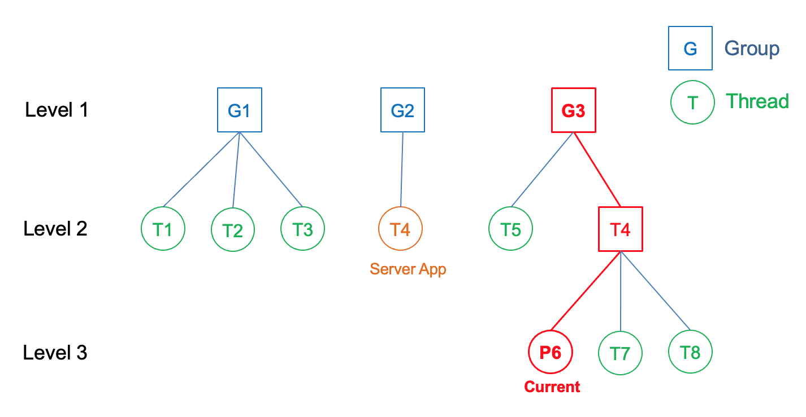
ETLIB
ETOS: Delay Prediction
ETR
Predict CPU delay
Naïve Scenario
Completely Fair Scheduler (CFS)
  Multiple groups
ETOS
Simulate the scheduling logic of CFS in a copy of the hierarchical structure
Group of threads

Slide 16
ETLIB
ETOS: Delay Prediction
ETR
Predict CPU delay
Naïve Scenario
Completely Fair Scheduler (CFS)
Thread dependency
  vips
ETOS
Solution: estimate wake up time
Sleeping thread B
Sleep
Wake up
Runqueue
Running
thread A
Target application

Slide 17
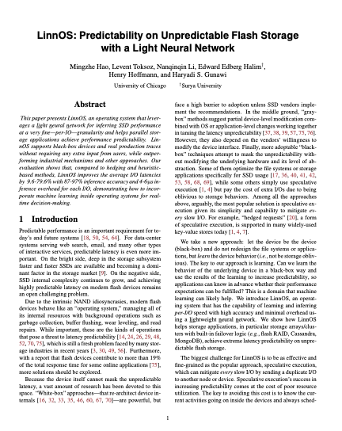
ETLIB
ETOS: Delay Prediction
ETR
Predict CPU delay
Naïve Scenario
Completely Fair Scheduler (CFS)
Thread dependency
More…
ETOS
More detail
in the paper!
<10 us overhead

Slide 18
ETOS: Request cancellation
Cancel in application
Cancel in OS
CPU contention already happend
App
R
retry()
OS
App
CPU Queue
R
retry()
OS
Carefully implemented in TCP layer
No delay
CPU Queue

Slide 19
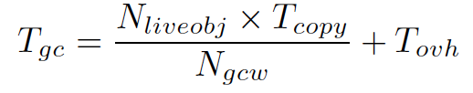


ETR
GC delay prediction
Request cancellation
Object copy time dominates!
No java thread can run
Garbage Collection
Threads
Symbol | Description
Tgc | the predicted delay
Nliveobj | the number of live objects
Tcopy | the average copy time per object
Ngcw | a constant configuration value
Tovh | Additional constant overhead
Create a special runtime thread that keeps running during GC

Slide 20
ETLIB
Predict delay in synchronization
  When lock will be released?
  Consider dominant factor and code complexity of the function
  Track historical information
Request cancellation
  Simply cancel in application
Simple and effective
retry()
ETLIB
R
ETR
ETOS

Slide 21
Outline
Introduction
Design Challenges & Solutions
Evaluation
Conclusion

Slide 22

ETLIB
Experiment setup – 3 nodes
ETR
With CPU-intensive threads
OS
ETOS
CPU Queue
OS
Cassandra server
CPU Queue
Major metric:
Latencies of requests

Slide 23
No contention
lower left is better
OS
CPU Queue
CCDF
(e.g. 1% > 1ms)
OS
CPU Queue

Slide 24
Baseline
OS
CPU Queue
6ms at p95
OS
12ms at p99
CPU Queue

Slide 25
LIBROS
Adopts LIBROS
ETOS
Request
CPU Queue
Cancel
OS
Retry
CPU Queue

Slide 26
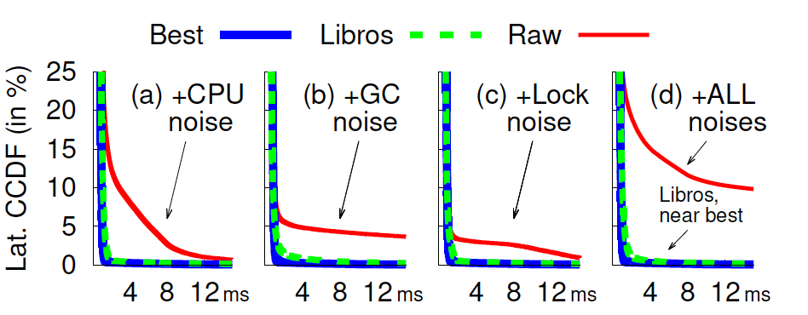
ETLIB
Evaluation – 3 nodes
ETR
LIBROS mitigates contentions in various resource layers
ETOS
Near best!

Slide 27
ETLIB
Experiment setup – 6 nodes
ETR
OS
ETOS
OS
Runs random CPU benchmarks in short burst and short pauses
Server changes between busy state and free state
OS

Slide 28
No contentions
log2 scale
6ms at p99.9
Contentions in other resource layers

Slide 29
CPU contentions
8ms at p95

Slide 30
Speculative retry
Send back-up request after timeout
Must wait until 3ms
Cut tails above 3ms
Tighter threshold, better performance

Slide 31
LIBROS
No need to wait timeout
Tail due to other contentions

Slide 32
LIBROS with speculation
Most effective

Slide 33
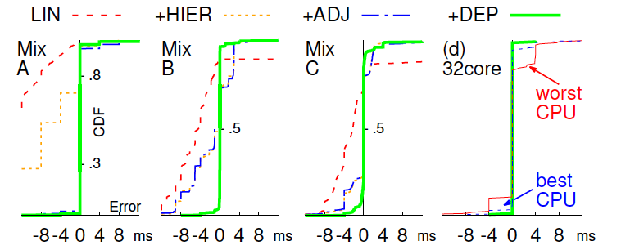
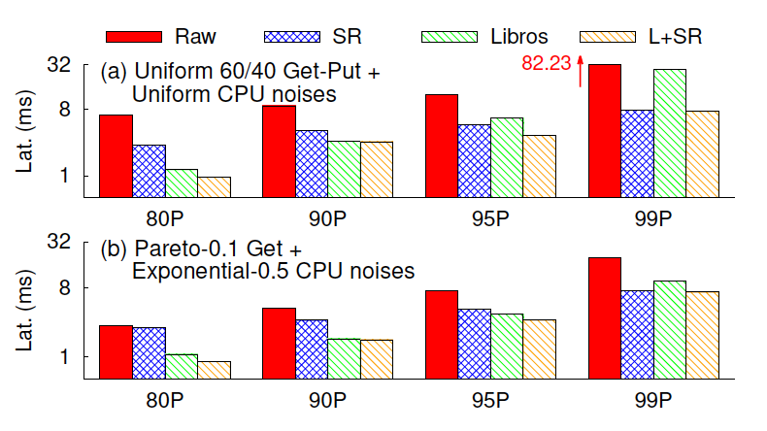
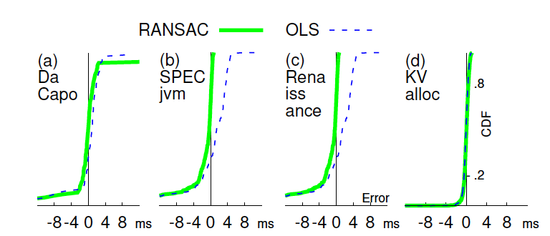
Other evaluations
LIBROS achieves high prediction accuracy
LIBROS also effective for large setups

Slide 34
Conclusion
LIBROS: an ecosystem of contention mitigation supports from library, runtime and operating system layers
  Composable, layered
  Every layer must address two questions:
    How to accurately predict delay
    How to promptly cancel request
R
Library
ETLIB
if ...
AcquireLock()
Runtime
if ...
ETR
R = new Request(bytes)
R.deadline(DL)
R.sendtime
OS
ETOS
if ...
else…
retry()
CPU Queue

Slide 35
Q&A?

