Slide 1
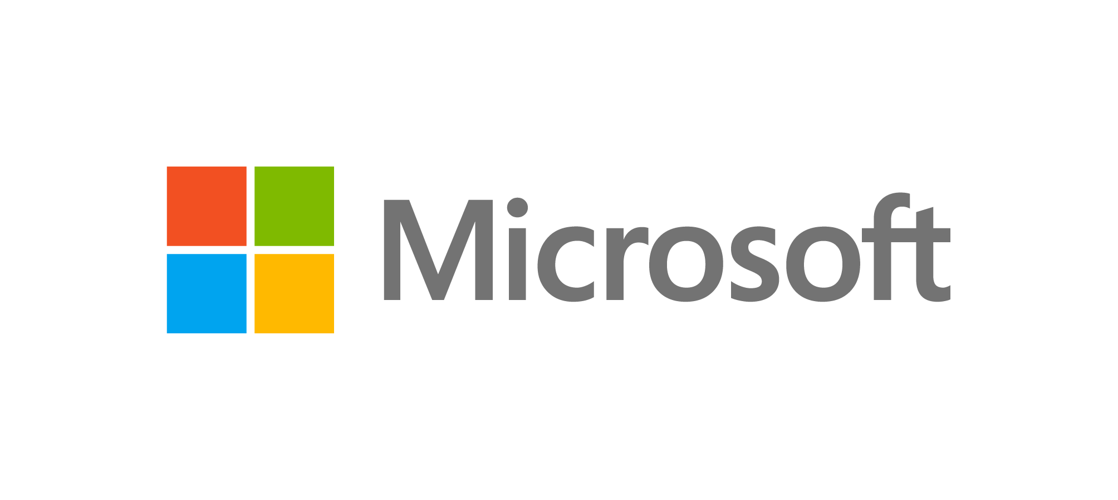


LeapIO:
Efficient and Portable Virtual
NVMe Storage on ARM SoCs
Huaicheng Li, Mingzhe Hao, Stanko Novakovic,
Vaibhav Gogte, Sriram Govindan, Dan Ports, Irene Zhang,
Ricardo Bianchini, Haryadi S. Gunawi, Anirudh Badam

Slide 2






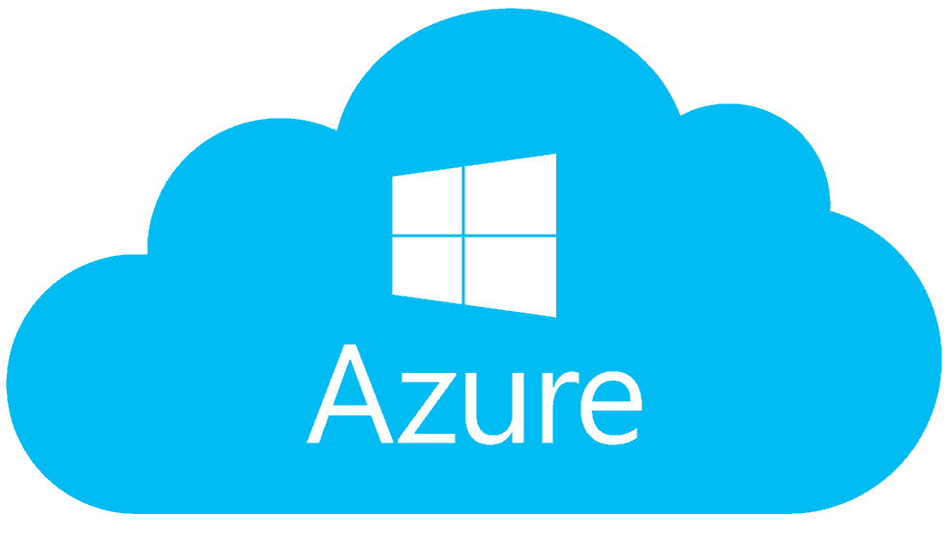

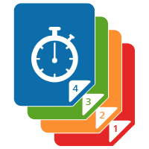


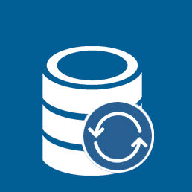
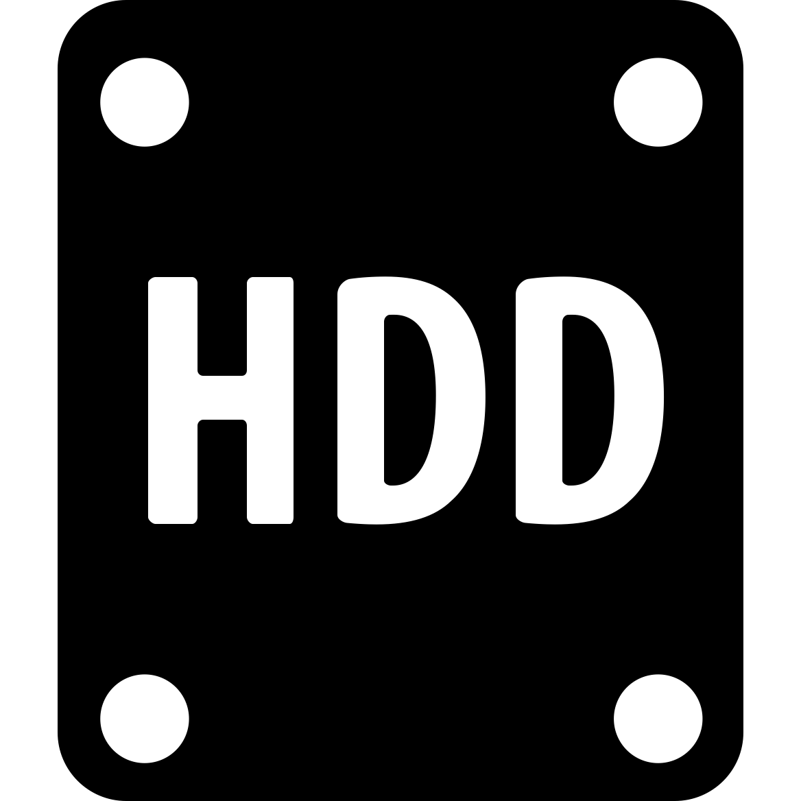
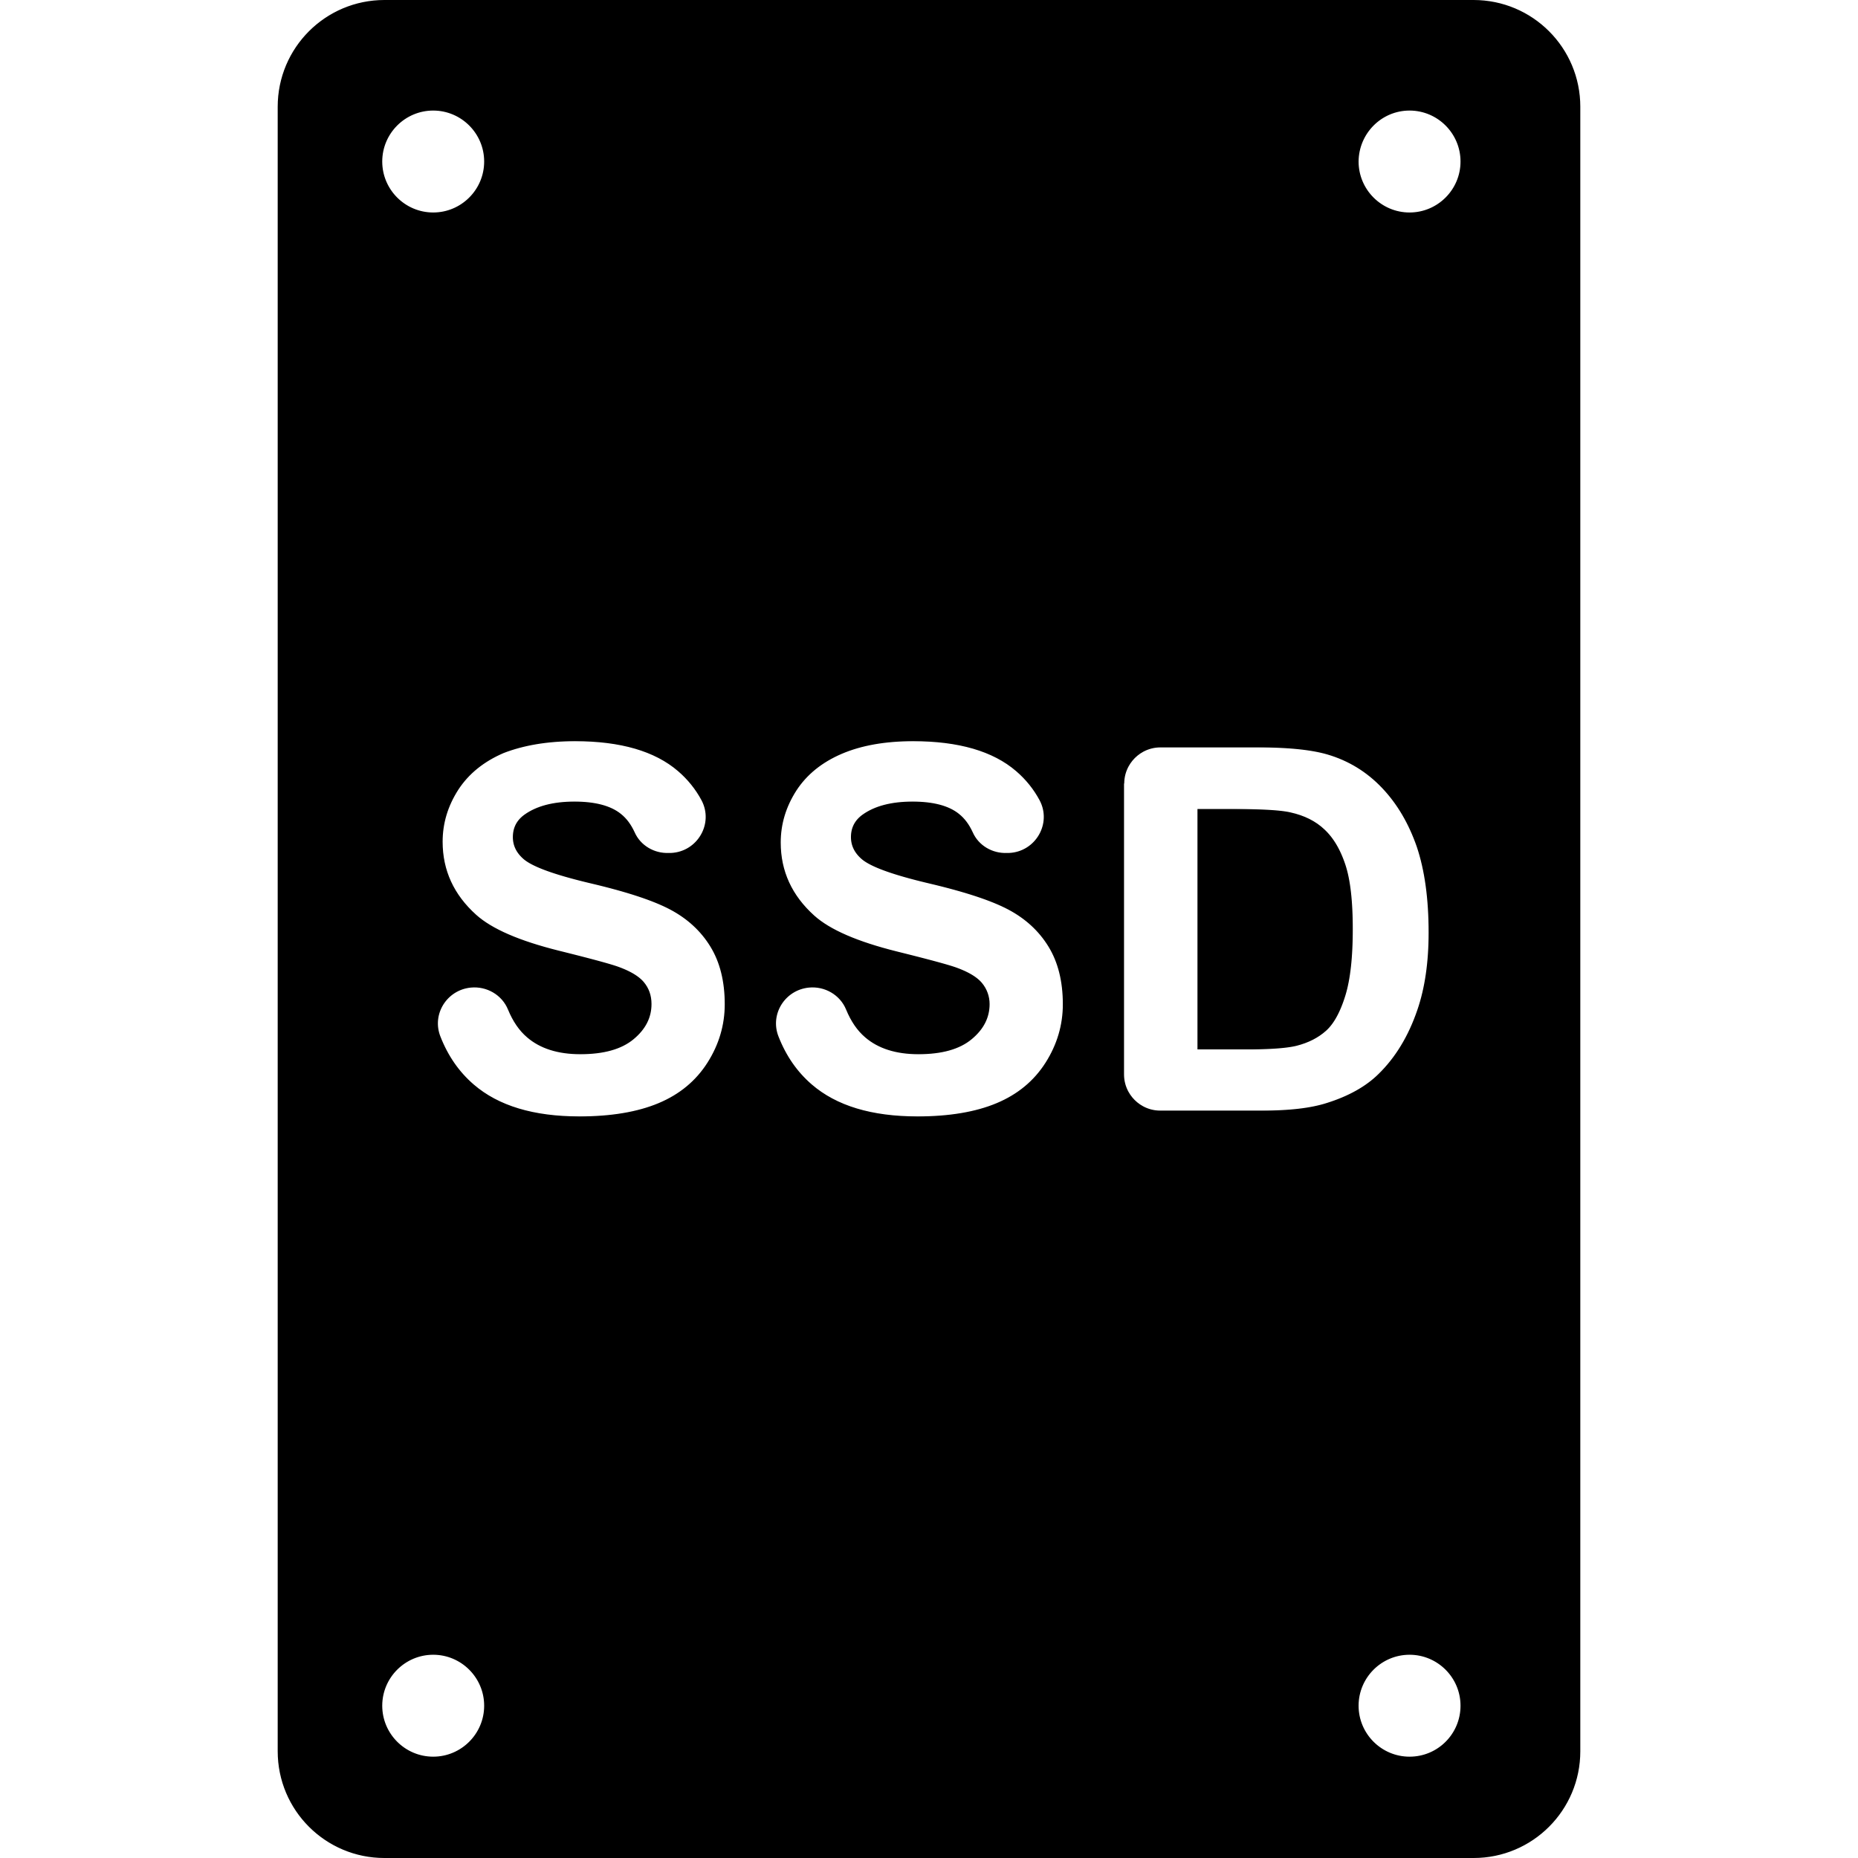
Today’s Cloud Storage Model
VM
VM
VM
/dev/sda
/dev/vda
/dev/nvme0n1
Reliability
Security
Versioning
Performance
Scalability
Disaggregation

Slide 3



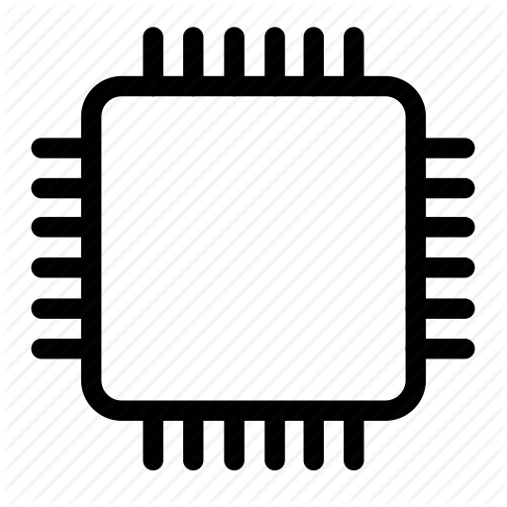

The Heavy Cloud Storage Tax
Storage
services
VM
VM
VM
Cloud
server
...
...
x86
x86
x86
x86
x86
x86
x86
x86
x86
Deep Storage Stack
Device
management
Context Switches
10-20% CPU cycles burnt only for storage stack
Polling/Interrupts
SSD
SSD
SSD

Slide 4
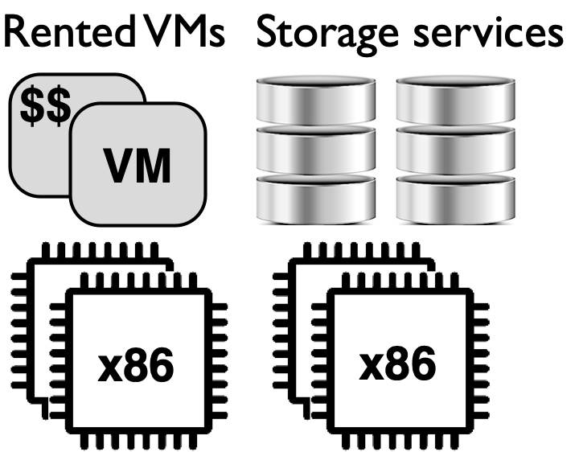
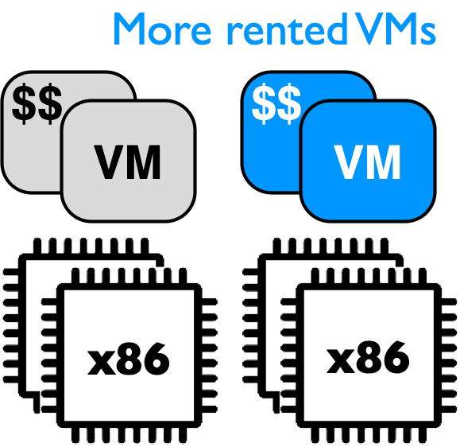
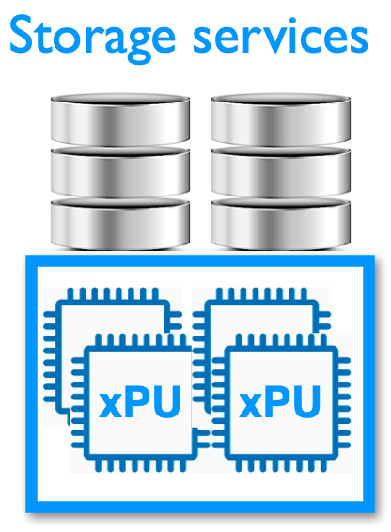

ARM Offloading for Cost-Efficiency
ARM SoC TCO: $100/year
x86 for VMs: $2000/year
~20x revenue gains
+

Slide 5
LeapIO Overview
Next generation of Cloud Storage Stack offload-ready to ARM System-on-Chip (SoC)
VM
VM
VM
VM
VM
VM
Storage Services
Storage Services
x86
x86
x86
ARM
Device Management
Device Management
SSD
SSD
SSD
SSD
SSD
SSD
x86

Slide 6
Motivation & Goals
LeapIO Architecture
LeapIO Designs
- Portability
- Efficiency
Evaluation
Conclusion

Slide 7

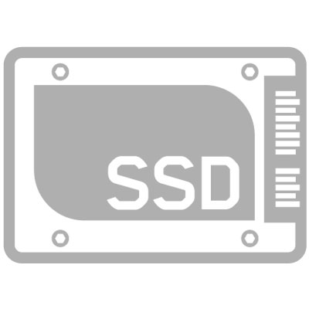
LeapIO Architecture
NVMe QP Mapping
Storage
Services
SSD
ARM
F( )
Replication
SSD
User
Priority Scheduling
VM
Design benefits:
OS
+ Service extensibility
x86
+ Polling for efficiency
PCIe
+ Service virtualization/composability
NVMe Queue Pair (QP):
=
SQ
CQ

Slide 8
Storage
Functions
ARM
ARM
F( )
F( )
User
VM
OS
RDMA / TCP / REST
x86
PCIe
PCIe
Client
Server
=
SQ
CQ

Slide 9
LeapIO Challenges
How to achieve portability?
How to achieve bare-metal performance?
How to achieve service composability?

Slide 10

The Need for Portability
1st Generation
2nd Generation
3rd Generation
TCP
RDMA
RDMA
x86
x86
x86
ARM
SSD
SSD
SSD
Try to avoid fragmenting the server fleet into silos defined by their hardware capabilities and specific software optimizations

Slide 11
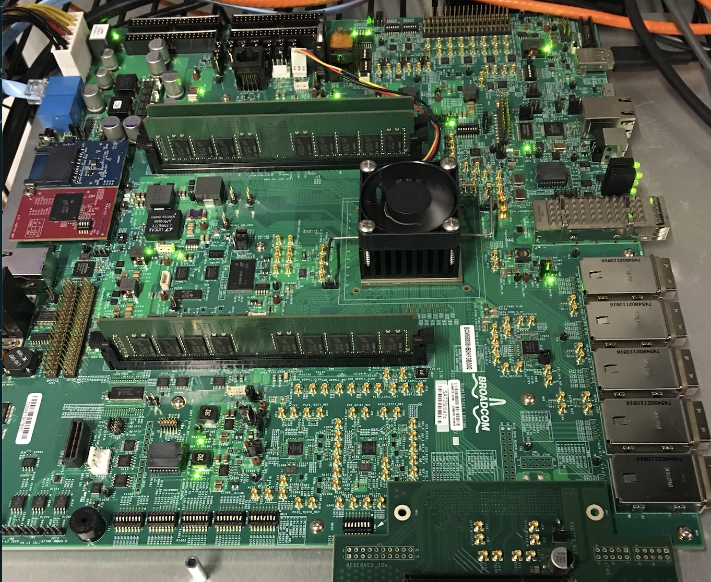
LeapIO Portability
User VM
SoC
“SoC”-in-VM
ARM
x86
RDMA
REST
TCP
PCIe
HDD
SSD
OpenChannel-SSD
Treat Hardware Acceleration as Opportunity instead of Necessity
PCIe

Slide 12
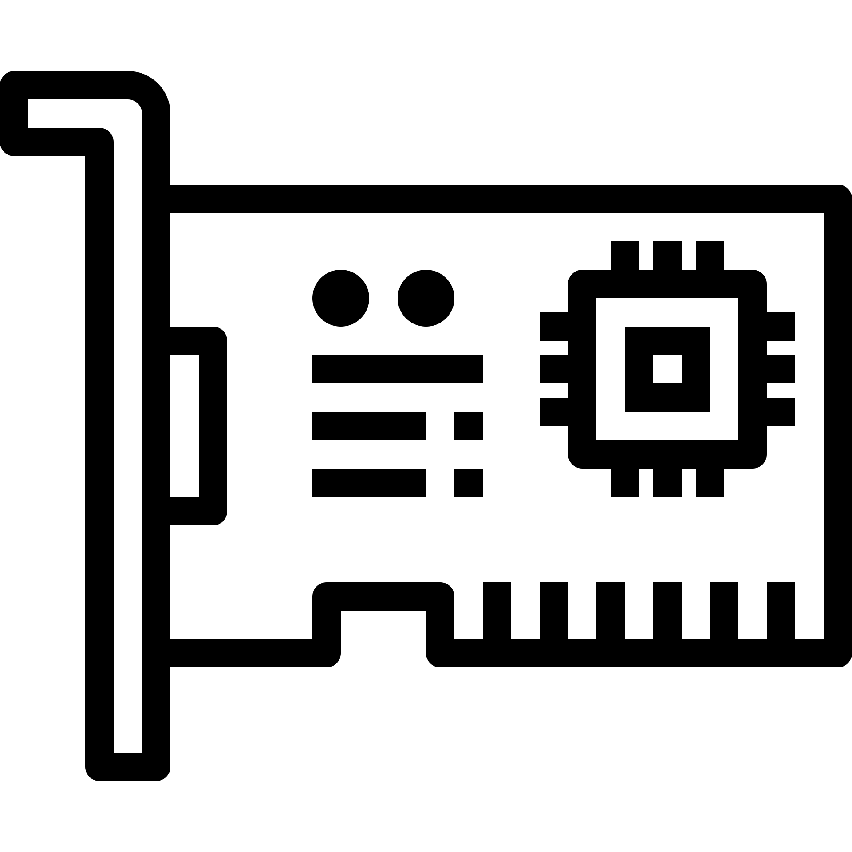
LeapIO Efficient Data Path
Storage
Functions
ARM
F( )
No direct ARM-x86 communication
User
Data copies across address spaces
VM
OS
x86
ARM
SSD
Unified Address Space
x86
PCIe
Zero Copy
Client

Slide 13
Existing ARM SoC Design Inefficiencies
Implications for SoC Vendors
- Add Native DMA interface for ARM-x86 communication
- Enable (IO)MMU Access from ARM for Address Translation
- Expose SoC DRAM to x86 to enable P2P-DMA
DRAM
x86
(1). DMA access for QP mapping and data transfer
PCIe
(2). (IO)MMU access
ARM
(3). P2P-DMA

Slide 14
Software Stack Overhead (“SoC”-VM)
No Tails
FIO
User
VM
Host
Linux
Low Overhead: 2-5%
“SoC”
VM

Slide 15
LeapIO Performance on ARM SoC
30% Overhead due to ARM SoC Inefficiencies; Will improve with future ARM SoC Designs

Slide 16
More in the Paper!
LeapIO IO path and address translation
VM-“SoC” enhancement
Threat Model
NVMe over RDMA/TCP/REST
More evaluation results
  Comparison with state of the art virtualization solutions
  Service composability

Slide 17
LeapIO Summary
End-to-end Offload-Ready Cloud Storage Stack
  Portability
  Extensibility
  Efficiency
Thank you!
Questions?
20x revenue gains
2-5% software overhead (30% on SoC)
Implications for SoC vendors to bridge the
performance gap between ARM and x86

