Slide 1

TaxDC
Taxonomy of
Non-Deterministic Concurrency Bugs in Datacenter Distributed Systems
Tanakorn Leesatapornwongsa,
Jeffrey F. Lukman, Shan Lu, Haryadi S. Gunawi
Notes:
Hi! My name is Tanakorn. Today I will talk about TaxDC.

Slide 2


TaxDC
Notes:
No worry. I’m not gonna complain about tax or government. I love government, they fund our re- search group.

Slide 3
TaxDC
Taxonomy of
Non-Deterministic Concurrency Bugs in Datacenter Distributed Systems
Tanakorn Leesatapornwongsa,
Jeffrey F. Lukman, Shan Lu, Haryadi S. Gunawi
Notes:
TaxDC is a study of concurrency bugs in distributed systems. This is a joint work with Jeffrey Lukman, professor Shan Lu, and my advisor, professor Haryadi Gunawi.

Slide 4
Distributed Systems
More people develop distributed systems
Distributed systems are hard
Hard largely because of concurrency
Concurrency leads to unexpected timings
  X should arrive before Y, but X can arrive after Y
Unexpected timings lead to
distributed concurrency (DC) bugs
Notes:
Today more and more people develop distributed sys- tems.
But distributed systems are hard to get correct.
It’s hard largely because of concurrency of events.

Slide 5
“… be able to reason about
the correctness of
increasingly more complex distributed systems
that are used in production”
– Azure engineers & managers
Uncovering Bugs in Distributed Storage Systems during Testing
(Not in Production!) [FAST ‘16]
Understanding distributed system bugs is important!
Notes:
DC bugs are the worst nightmare for large-scale engi- neers.

Slide 6
Distributed Concurrency (DC) bugs
Bugs caused by non-deterministic timing
Non-deterministic timing of concurrent events involving more than one node
  Messages, crashes, reboots, timeouts, computations
Notes:
Before going further, I want to give a term definition of DC bugs first.

Slide 7




(LC bug: multi-threaded single machine software)
Top 10 most cited ASPLOS paper
Notes:
Here, we also have local concurrency bugs or LC bugs, which are bugs in multi-threaded single machine software.

Slide 8


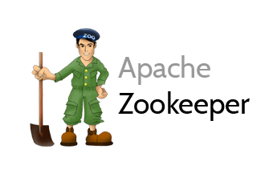

TaxDC
104 bugs
4 varied distributed systems
Bugs in 2011-2014
Study description, source code, patches
Notes:
TaxDC is a study on 104 bugs in 4 popular varied open-source distributed systems, including Cassandra,
Hadoop MapReduce, HBase, and ZooKeeper. The data is the bugs reported between 2011-2014.

Slide 9
Contribution:
TaxDC
Trigger
Error & Failure
Fix
Timing
Input
Scope
Order Violation
Atomicity Violation
Fault Timing
Reboot Timing
Fault
Reboot
Workload
Nodes
Messages
Protocols
Error
Failure
Loc Mem
Loc Sem
Loc Hang
Loc Silence
Glob Wrong
Glob Silence
Glob Miss
Downtime
Data Loss
Op Fail
Performance
Timing
Handling
Global Sync
Local Sync
Retry
Ignore
Accept
Others
Timing
Input
Scope
Error
Failure
Timing
Handling
Notes:
Here is our contribution, a full complete taxonomy of DC bugs.
I want to say that creating this taxonomy is painful.

Slide 10
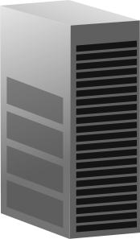

Bug Example
ZooKeeper-1264
1. Follower F crashes, reboots, and joins cluster
2. Leader L sync snapshot with F
3. Client requests new update, F applies this only in memory
4. Sync finishes
5. Client requests other update, F writes this to disk correctly
6. F crashes, reboots, and joins cluster again
7. This time L sends only diff after update in step 5.
8. F loses update in step 3.
F
L
F
L
F
F
L
F
F
L
F
a
a
F
L
F
a
b
F
L
F
F
L
F
L
F
F
L
F
a=?
Notes:
Let me show you an example of real world DC bug in ZooKeeper.

Slide 11
Detailed Characteristics
ZooKeeper-1264
1. Follower F crashes, reboots, and joins cluster
2. Leader L sync snapshot with F
3. Client requests new update, F applies this only in memory
4. Sync finishes
5. Client requests other update, F writes this to disk correctly
6. F crashes, reboots, and joins cluster again
7. This time L sends only diff after update in step 5.
8. F loses update in step 3.
Timing:
- Atomicity
violation
- Fault Timing
Input:
- 4 Protocols
- 2 faults
- 2 reboots
Error:
- Global
Failure:
Data inconsistency
Fix:
Delay msg.
Notes:
But after we run the systems, study protocols, read the source code and patches
we can define new detailed characteristics of the bugs which lead to this full tax- onomy.

Slide 12
Contribution:
TaxDC
Trigger
Error & Failure
Fix
Timing
Input
Scope
Order Violation
Atomicity Violation
Fault Timing
Reboot Timing
Fault
Reboot
Workload
Nodes
Messages
Protocols
Error
Failure
Loc Mem
Loc Sem
Loc Hang
Loc Silence
Glob Wrong
Glob Silence
Glob Miss
Downtime
Data Loss
Op Fail
Performance
Timing
Handling
Global Sync
Local Sync
Retry
Ignore
Accept
Others
Timing
Input
Scope
Error
Failure
Timing
Handling
Notes:
This looks depressing, but don’t worry, I’ll discuss some of them.

Slide 13
TaxDC
Trigger
Error & Failure
Fix
Timing
Input
Scope
Order Violation
Atomicity Violation
Fault Timing
Reboot Timing
Fault
Reboot
Workload
Nodes
Messages
Protocols
Error
Failure
Loc Mem
Loc Sem
Loc Hang
Loc Silence
Glob Wrong
Glob Silence
Glob Miss
Downtime
Data Loss
Op Fail
Performance
Timing
Handling
Global Sync
Local Sync
Retry
Ignore
Accept
Others
Timing
Input
Scope
Error
Failure
Timing
Handling
Conditions that make
bugs happen
Notes:
Let’s start with trigger. Trigger is conditions that make bugs happen.

Slide 14
TaxDC
Trigger
Error & Failure
Fix
Timing
Input
Scope
Order Violation
Atomicity Violation
Fault Timing
Reboot Timing
Fault
Reboot
Workload
Nodes
Messages
Protocols
Error
Failure
Loc Mem
Loc Sem
Loc Hang
Loc Silence
Glob Wrong
Glob Silence
Glob Miss
Downtime
Data Loss
Op Fail
Performance
Timing
Handling
Global Sync
Local Sync
Retry
Ignore
Accept
Others
Timing
Input
Scope
Error
Failure
Timing
Handling
What: Untimely moment
that makes bug happens
Why: Help design
bug detection tools
Notes:
First, I’ll focus on timing condition.
Timing condition is an untimely moment that makes bug happens. Understanding timing helps design de- tection tools.

Slide 15
Trigger
Timing
Message
“Does the timing
involve many messages?”
Ex: MapReduce-3274
Notes:
From our study, DC bugs are triggered by message timing or fault timing.
Look at message timing first.
In a distributed operation, it involves many events. First we think to hit a bug, it’s about the ordering of many events. Like 10 events must be in an exact order.

Slide 16
Trigger
Timing
Message
Order violation (44%)
“Does the timing
involve many messages?”
2 events, X and Y
Y must happen after X
But Y happens before X
Ex: MapReduce-3274
Notes:
But that’s not true, let look at this pattern that we call order violation.

Slide 17


Trigger
Kill
Submit
Timing
Message
Order violation (44%)
Msg-msg race
“Does the timing
involve many messages?”
Kill
Submit
2 events, X and Y
Y must happen after X
But Y happens before X
Ex: MapReduce-3274
Notes:
This pattern only involves 2 events, X and Y. X must happen before Y, but X can happen after Y.
This takes 44% of the bugs.

Slide 18
Trigger
A
B
A
B
Kill
Timing
New
key
Message
Order violation (44%)
Msg-msg race
New
End report
A
B
A
B
Old
key
Kill
End report
New
key
(late)
Expired!
Kill
what
job?
Receive-receive
race
Receive-send
race
Send-send
race
MapReduce-3274
HBase-5780
MapReduce-5358
Notes:
This looks simple but actually in our study, message- message race can come in different complex forms.
Here what I’ve just shown you receive-receive race.

Slide 19
Trigger
Timing
cmp
Message
Order violation (44%)
Msg-msg race
Msg-compute race
Order violation:
2 events, X and Y
Y must happen after X
But Y happens before X
cmp
Ex: MapReduce-4157
Notes:
Well, interestingly, order violation is not just message- message race, we could also have message-compute race.

Slide 20
Trigger
A
B
A
B
Timing
Message
Order violation (44%)
Atomicity
violation (20%)
A
B
A message comes in
the middle of atomic operation
Ex: Cassandra-1011, Hbase-4729, MapReduce-5009, Zookeeper-1496
Notes:
The next message timing is atomicity violation, which takes 20%.

Slide 21
Trigger
A
B
A
B
C
Timing
Message
Fault (21%)
Fault at specific timing
A
B
C
No fault timing in LC bugs
Only in DC bugs
Ex: Cassandra-6415, Hbase-5806, MapReduce-3858, Zookeeper-1653
Notes:
Okay, those’re message timing bugs, but we found that sometime bugs are happening from fault timing, which take 21%.
Because fault is expected in distributed systems. And it happens at very very specific timing, we’ll get a problem.
There is no fault timing in LC bugs, this is only in DC bugs.

Slide 22


A
B
Trigger
Timing
Message
Fault
Reboot (11%)
A
B
Reboot at specific timing
Ex: Cassandra-2083, Hadoop-3186, MapReduce-5489, Zookeeper-975
Notes:
Okay, after node crashes, it can reboot back. And we also have reboot timing bugs which are similar to fault timing. So I’ll skip it.

Slide 23
Trigger
Timing
ZooKeeper-1264
1. Follower F crashes, reboots, and joins cluster
2. Leader L sync snapshot with F
3. Client requests new update, F applies this only in memory
(in the middle of sync snapshot)
4. Sync finishes
5. Client requests other update, F writes this to disk correctly
6. F crashes, reboots, and joins cluster again
7. This time L sends only diff after update in step 5.
8. F loses update in step 3.
Message
Fault
Reboot
Mix (4%)
Atomicity violation
Fault timing
Failure
Notes:
Okay, to recap, we have order and atomicity viola- tion bugs, fault and reboot timing bugs. But that’s not 100%.

Slide 24
Trigger
Implication: simple patterns can inform
pattern-based bug detection tools, etc.
Timing
cmp
cmp
Message timing
Fault timing
Reboot timing
Notes:
So, in summary, DC bugs have different forms of tim- ing violations.
Here, DC bugs are complex, but we can abstract all of them with only these timing patterns.

Slide 25
TaxDC
Trigger
Error & Failure
Fix
Timing
Input
Scope
Order Violation
Atomicity Violation
Fault Timing
Reboot Timing
Fault
Reboot
Workload
Nodes
Messages
Protocols
Error
Failure
Loc Mem
Loc Sem
Loc Hang
Loc Silence
Glob Wrong
Glob Silence
Glob Miss
Downtime
Data Loss
Op Fail
Performance
Timing
Handling
Global Sync
Local Sync
Retry
Ignore
Accept
Others
Timing
Input
Scope
Error
Failure
Timing
Handling
What: Input to
exercise buggy code
Why: Improve
testing coverage
Notes:
Now let me tell you about input condition
Input condition is input to exercise buggy code

Slide 26
Trigger
Timing
ZooKeeper-1264
1. Follower F crashes, reboots, and joins cluster
2. Leader L sync snapshot with F
3. Client requests new update, F applies this update only in memory
4. Sync finishes
5. Client requests other update, F writes this to disk correctly
6. F crashes, reboots, and joins cluster again
7. This time L sends only diff after update in step 5.
8. F loses update in step 3.
Input
Fault & reboot
2 crashes
2 reboots
Notes:
Come back to this bug again. This bug shows that DC bugs are NOT just about message re-ordering, but also about fault and reboot.
And not just 1 fault, 1 reboot, we need multiple. Like this bug, we need 2 crashes and 2 reboots to hit it.

Slide 27
Trigger
Timing
“How many bugs require fault injection?”
Input
37% = No fault
63% = Yes
Fault
“What kind of fault? & How many times?”
88% = No timeout
12%
53% = No crash
35% = 1 crash
12%
Real-world DC bugs are NOT just about
message re-ordering, but faults as well
Notes:
From this bug, we ask “HOW MANY bugs require fault injection in order to reveal them?”
Here it shows that 63% require some fault injections to manifest.

Slide 28
Trigger
Timing
“How many reboots?”
Input
73% = No reboot
20% = 1
7%
Fault
Reboot
Notes:
And again we collect how many reboots too.

Slide 29
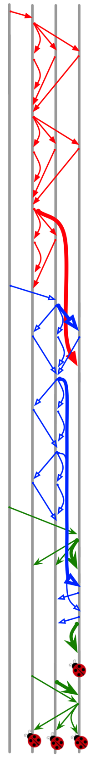
Trigger
Cassandra Paxos bug
(Cassandra-6023)
3 concurrent
user requests!
“How many protocols to run as input?”
Timing
Input
Fault
Reboot
Workload
n
m
20% = 1
80% = 2+ protocols
p
o
Implication: multiple protocols
for DC testing
r
q
Notes:
Alright, I’ve told you that to get to the bugs, we need message ordering, and sometime faults and reboots.

Slide 30
TaxDC
Trigger
Error & Failure
Fix
Timing
Input
Scope
Order Violation
Atomicity Violation
Fault Timing
Reboot Timing
Fault
Reboot
Workload
Nodes
Messages
Protocols
Error
Failure
Loc Mem
Loc Sem
Loc Hang
Loc Silence
Glob Wrong
Glob Silence
Glob Miss
Downtime
Data Loss
Op Fail
Performance
Timing
Handling
Global Sync
Local Sync
Retry
Ignore
Accept
Others
Timing
Input
Scope
Error
Failure
Timing
Handling
What: First effect of
untimely ordering
Why: Help failure diagnosis
and bug detection
Notes:
Well, that is about the triggers. Now let me briefly talk about errors.

Slide 31

Trigger
Error
Local
Error can be observed
in one triggering node
(46%)
Null pointer,
false assertion,
etc.
Implication: identify opportunities for
failure diagnosis and bug detection
Notes:
Here we have local errors which are errors that we can see it by looking at a node that trigger happens.
46% have local error.
This means we can backward diagnose to root cause and build detection tools.

Slide 32

Trigger
Error
Local
Global
Error cannot be
observed in one node
(54%)
??
Many are silent errors and hard to diagnose
(hidden errors, no error messages, long debugging)
Notes:
The rest is global error which we cannot see in one node and have to look at other nodes.
Many bugs have hidden errors which mean

Slide 33
TaxDC
Trigger
Error & Failure
Fix
Timing
Input
Scope
Order Violation
Atomicity Violation
Fault Timing
Reboot Timing
Fault
Reboot
Workload
Nodes
Messages
Protocols
Error
Failure
Loc Mem
Loc Sem
Loc Hang
Loc Silence
Glob Wrong
Glob Silence
Glob Miss
Downtime
Data Loss
Op Fail
Performance
Timing
Handling
Global Sync
Local Sync
Retry
Ignore
Accept
Others
Timing
Input
Scope
Error
Failure
Timing
Handling
What: How developers fix bugs
Why: Help design runtime prevention
and automatic patch generation
Notes:
Now let me talk about the fixes.
Here, we study the patches and categorize them. This will help us identify opportunities for runtime preven- tion and patch generation.

Slide 34
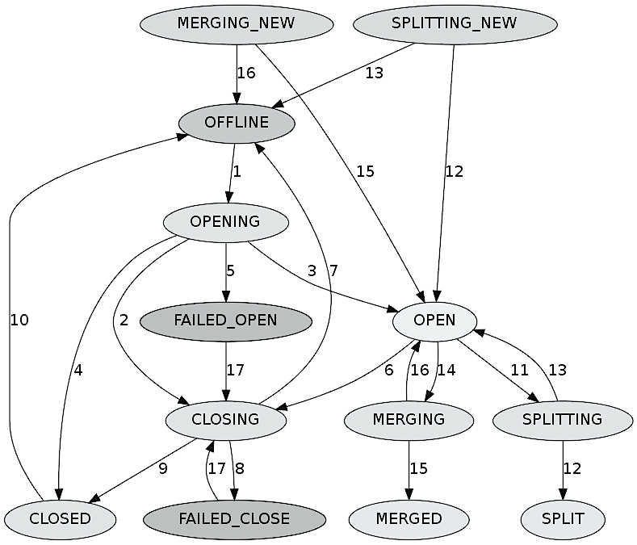
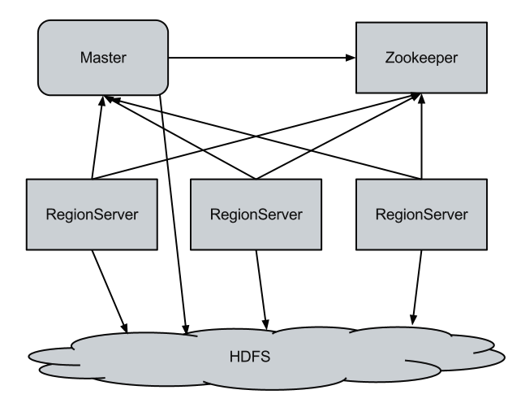
Trigger
Error
Add new states
& transitions
Fix
Complex
Are patches complicated?
Are patches adding synch.?
Add
Global
Synchro-
nization
Similar to fixing LC bugs:
add synchronization
e.g. lock()
Notes:
first, when I first started this study, I thought that fixes for DC bugs must be very complex.
Yes, some fix add new states and transitions, some add global synchronization which is similar to LC bugs

Slide 35
Trigger
Error
Fix
Complex
Simple
Delay
Notes:
But we see many of the bugs have simple fixes.

Slide 36

Trigger
Error
Fix
Complex
Simple
Delay
Ignore/discard
Notes:
This case message come too early. fixes just IGNORE it, and sometime it’s safe to do that.

Slide 37
Trigger
Error
Fix
Complex
Simple
Delay
Ignore/Discard
Retry
Notes:
This case message come too early. It get rejected. Sender retry sending message again

Slide 38
Trigger
Error
Fix
f(msg);
Complex
g(msg);
Simple
Delay
Ignore/Discard
Retry
Accept
Notes:
This case message come too early, we change processing function from F to existing function G.

Slide 39
Trigger
Error
Fix
Complex
Simple
Delay
Ignore
40% are easy to fix
(no new computation logic)
f(msg);
g(msg);
Implication:
many fixes can inform
automatic runtime
prevention
Retry
Accept
Notes:
a good news here is 40% of bugs can be fixed with very easy fixes like this, which no new computa- tion logic is introduced.

Slide 40
Trigger
Error
Fix
Fix
Complex
Simple
Sync.
Delay
Ignore/Discard
Retry
Accept
DC
bugs
vs.
LC
bugs
Notes:
Let me recap again. This is different from fixing LC bugs which we usually add lock to synchronize. But for DC bugs, sometime we could do this simple fixes like delay, ignore, retry, and accept.

Slide 41
Challenges & Opportunities in …
Distributed system model checker
Formal verification
DC bug detection
Runtime failure prevention
Notes:
Okay, TaxDC is bug study. And for all bug studies, people will ask, “SO WHAT?”

Slide 42


Distributed System Model Checker
Event
Message
Crash
Multiple crashes
Reboot
Multiple reboots
Timeout
Computation
Disk fault
Modist NSDI’11 | Demeter SOSP’11 | MaceMC NSDI’07 | SAMC OSDI’14
Reality
Let’s find out how to re-order all events
without exploding the state space!
Notes:
So let’s start with distributed systems model checker. This is a growing popular technique to reveal DC bugs as they permute all possible orderings of events.

Slide 43
Formal Verification
State-of-the-art
  Verdi [PLDI ‘15]
    Raft update
    ~ 6,000 lines of proof
  IronFleet [SOSP ‘15]
    Paxos update
    Lease-based read/write
    ~ 5,000 – 10,000 lines of proof
Challenges
Foreground & Background
#Protocol interactions
Let’s find out how to better verify
more protocol interactions!
19%=FG
52% = BG
29% = Mix
20%=1
80% = 2+ Protocols
Only verify foreground protocols
Foreground
& background
Notes:
Today, we have much advancement in formal verifica- tion of distributed systems. But so far we only verify FOREGROUND protocols such as read and write.

Slide 44
DC Bug Detection
State-of-the-art: LC bug detection
  Pattern-based detection
  Error-based detection
  Statistical bug detection
Opportunities: DC bug detection?
  Pattern-based detection
  Error-based detection
Let’s leverage these timing patterns and explicit error to do DC bug detection!
Message timing
Fault timing
Reboot timing
53% = Explicit
47% = Silent
Notes:
For bug detection, we have plentiful tools on LC bugs that look for buggy code patterns.
What about DC bugs?

Slide 45
Runtime Failure Prevention
State-of-the-art: LC bug prevention
  Deadlock Immunity [OSDI ‘08]
  Aviso [ASPLOS ‘13]
  ConAir [ASPLOS ‘13]
  Etc.
Opportunities: DC bug prevention
Fixes
Let’s build runtime prevention
technique that leverage this simplicity!
60% = Complex
40% = Simple
Notes:
Let’s look at runtime failure prevention. In the case of LC bugs, we have successful tools that inject delays at runtime to prevent LC bugs.

Slide 46
Conclusion
“Why seriously address DC bugs now?”
Everything is distributed and large-scale!
DC bugs are not uncommon!
“Why is tackling DC bugs possible now?”
Open access to source code
Pervasive documentations
Detailed bug descriptions
Notes:
So in conclusion, why do we need to seriously address DC bug now?
Because everything is distributed today and it is run- ning in large scale. Many engineers told us that in large scale, DC bugs are not common. The probabil- ity that we will hit them are not trivial.

Slide 47

Thank you!
Questions?
http://ucare.cs.uchicago.edu
Notes:
Hopefully many of you will find TaxDC useful. And again more details are in the paper.
Now, I’m happy to answer your questions.

